Slide 1

Modal Verbs

Slide 2
Modal verbs are auxiliary verbs which cannot usually work alone.
They are used with a main verb.
These are modal verbs:
might
will
should
may
would
can
could
must
shall
ought to

Slide 3

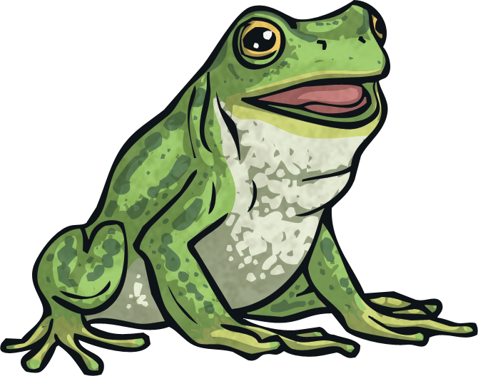
Modal Verbs for Possibility: The Rules
Here are the most common modal verbs:
might
could
would
must
may
will
ought
can
should
shall
You could also use the negative forms of these words as modal verbs, e.g.
The frog might not become a prince.
https://youtu.be/6wnjDkGYb1w

Slide 4

Modal Verbs for Possibility: The Rules
Modal verbs usually come before a verb in its infinitive form.
If I work hard, when I grow up I could be a doctor.
‘could’ is the modal verb.
‘be’ is the infinitive form of the verb ‘to be’. Infinitive means in its most basic form.
In a few years, I shall earn a university degree.
‘shall’ is the modal verb.
‘earn’ is the infinitive form of the verb ‘to earn’.

Slide 5
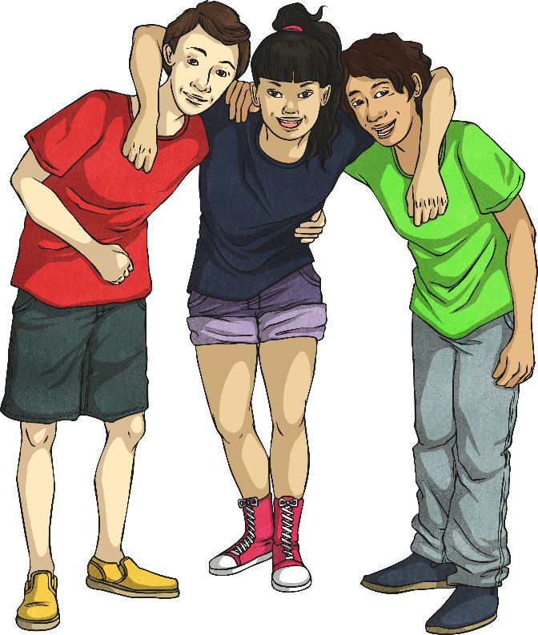
Modal Verbs for Possibility: The Rules
Modal verbs can have many uses. They are sometimes known as ‘modal auxiliary verbs’ or just as ‘modals’. In most cases, they work with another verb to describe the possibility of something happening or to describe to what degree of certainty something is known.
Look at these sentences that contain modal verbs:
The rounders team could win the tournament.
Humpty Dumpty will fall off the wall.

Slide 6
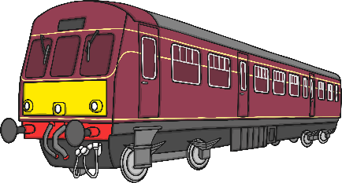


Modal verbs can be used to show how possible something is,
or how likely it is to happen/have happened.
For example:
He’s very late. He could have missed the train.
It’s snowing so it must be very cold outside.
They will lock the windows when they go out.

Slide 7
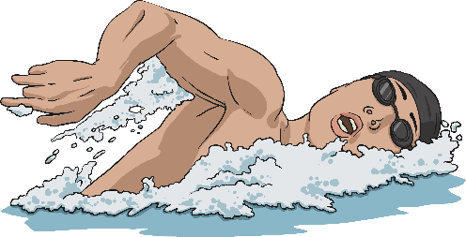
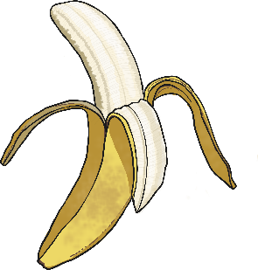



Can you spot the Modal verbs used
to show possibility in these sentences?
might
Mum might take us swimming after school.
could
You could eat a banana instead of those sweets.
will
Hurry up!
“Hurry up! We will be late!” said Dad
can
We can go the other way – it’s quicker.
You ought to go to bed earlier.
ought

Slide 8
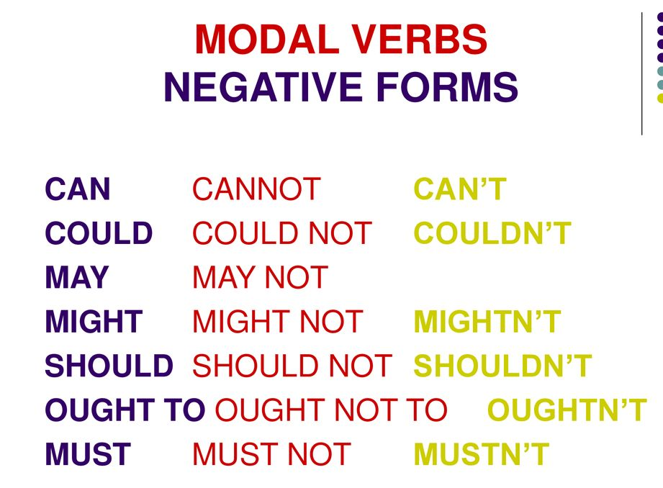
to

Slide 9
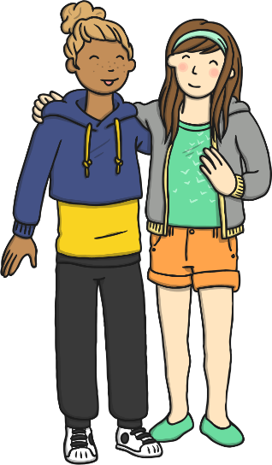

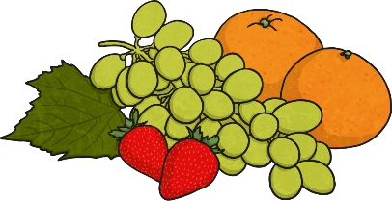
Modal verbs make questions by inversion.
She can go out.
Can she go out?
We could drive there.
Could we drive there?
Children should eat fruit.
Should children eat fruit?

Slide 10
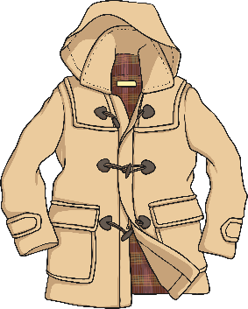
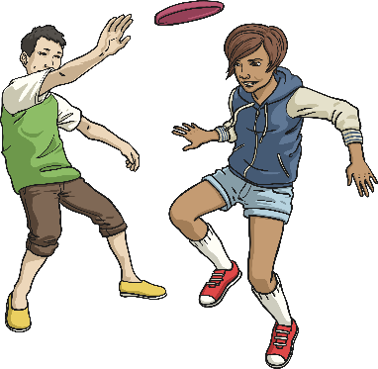
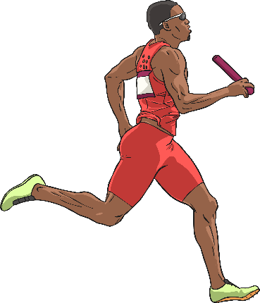
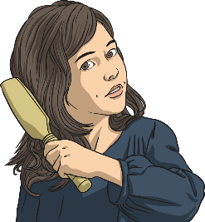
Which Modal verbs are missing
from these sentences?
Must
You be hot in that thick coat.
If it’s dry, we play outside?
shall
He’s so fast, he win the race.
should
I’m fed up with my long hair. I have it cut.
might
Did you choose these modal verbs?
Which others could you have used?

Slide 11
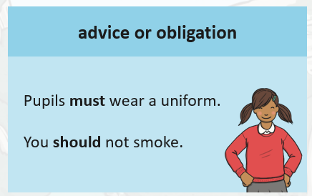
Modal verbs can also be used to show:

Slide 12
We use should and ought to for giving advice.
You should eat more fruit and vegetables.
He shouldn’t smoke.
They ought to work harder.
Must shows strong advice.

Slide 13
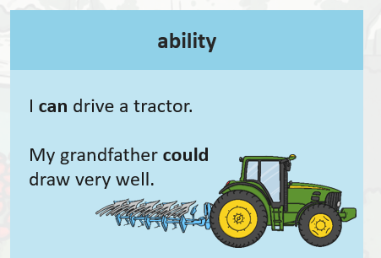
Modal verbs can also be used to show:

Slide 14
We use can and can't to talk about someone's skill or general abilities:
She can speak several languages.
He can swim like a fish.
They can't dance very well

Slide 15
We use could and couldn't to talk about the past:
She could speak several languages.
They couldn't dance very well.

Slide 16
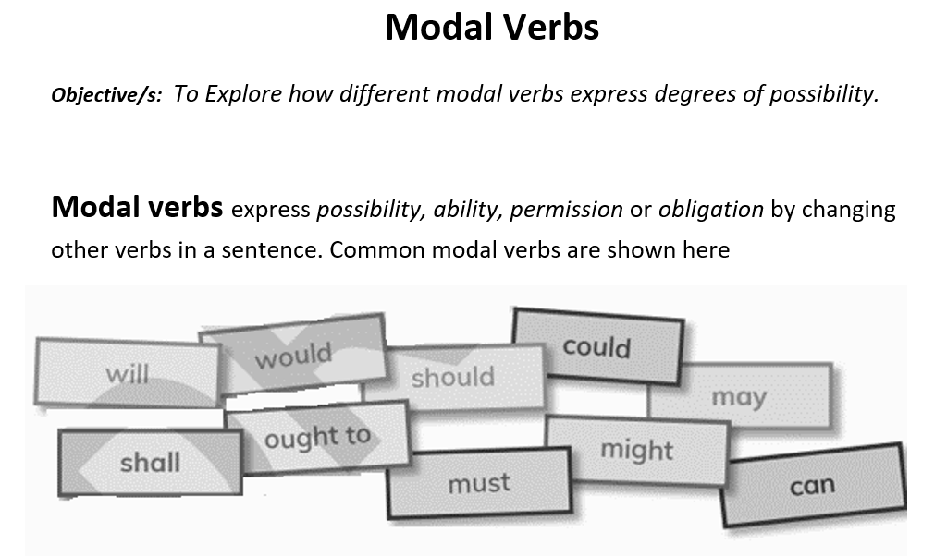
Grammar booklet page 15

Slide 17
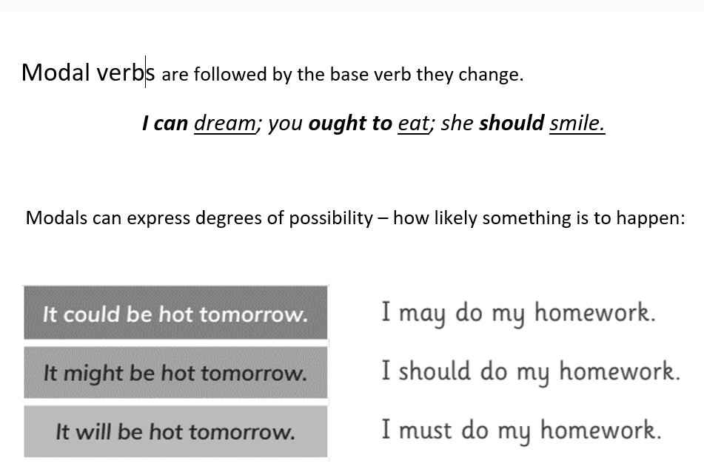

Slide 18
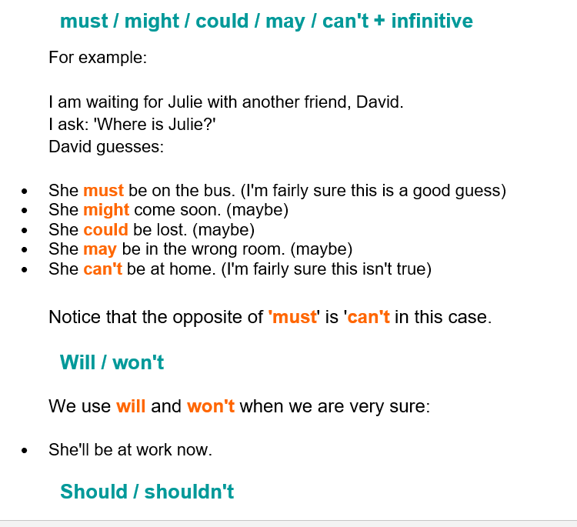

Slide 19
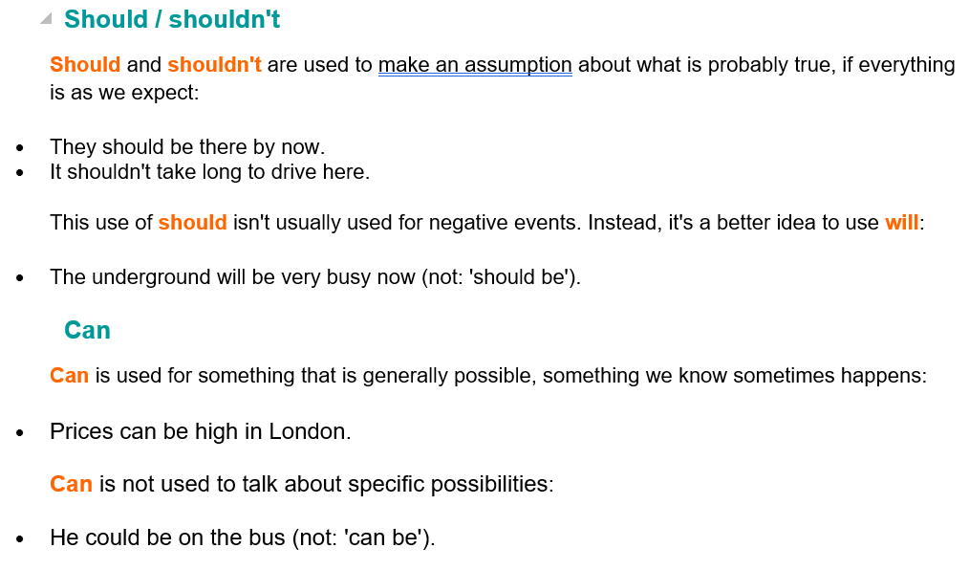

Slide 20
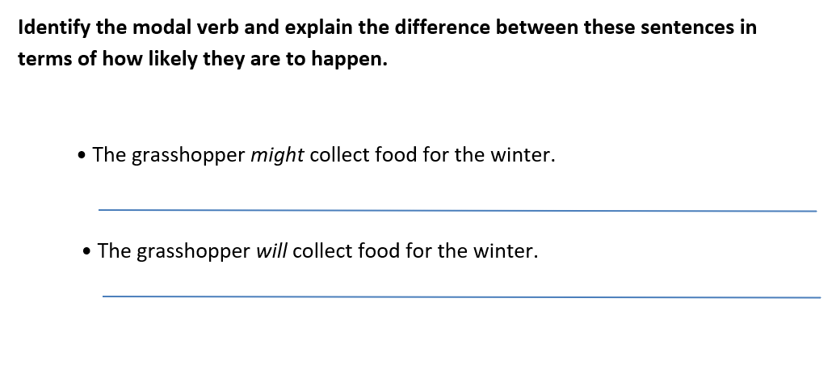
might: possibility / maybe
will: certainty / we are very sure

Slide 21
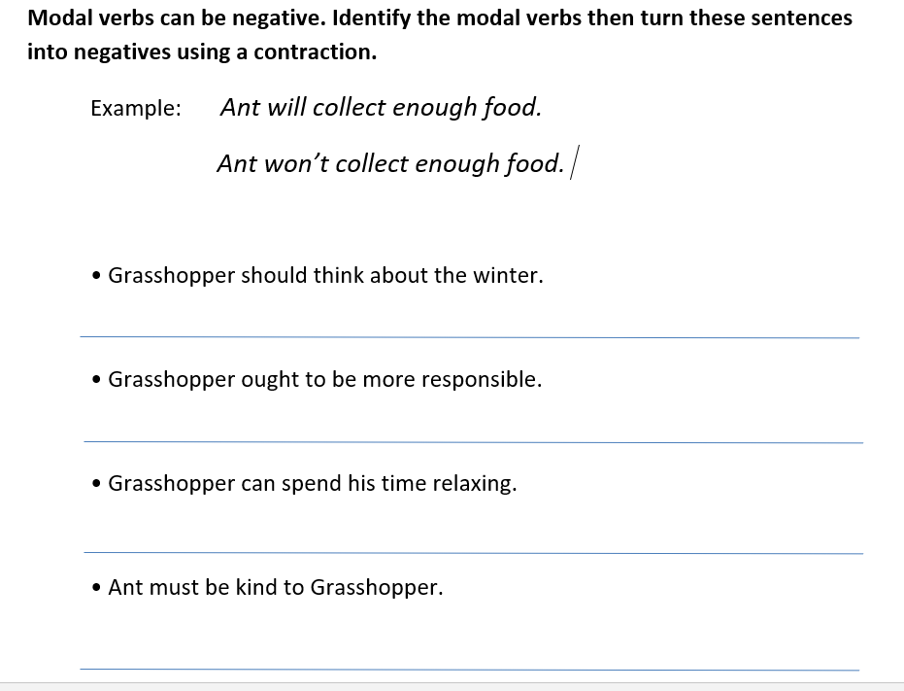
Grasshopper shouldn’t think about the winter.
Grasshopper ought not to( oughtn’t to) be more responsible.
Grasshopper can’t spend his time relaxing.
Ant mustn’t be kind to Grasshopper.

Slide 22
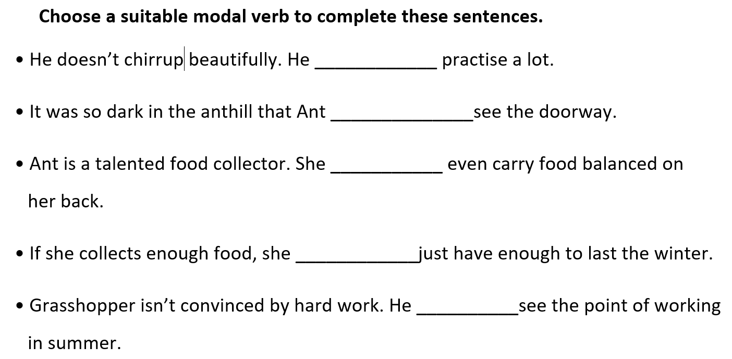
must
couldn’t
can
may/ might/ will
can’t

