Slide 1
Was / Were

Slide 2
WAS/WERE
Positive form
I
He
She
It
We
You
They
was at school yesterday.
were at the beach last week.

Slide 3
WAS/WERE
Negative form
I
He
She
It
We
You
They
was not(wasn't) at school yesterday.
were not(weren’t) at the beach last week.

Slide 4
He was a student ten years ago.
He is a teacher now.

Slide 5
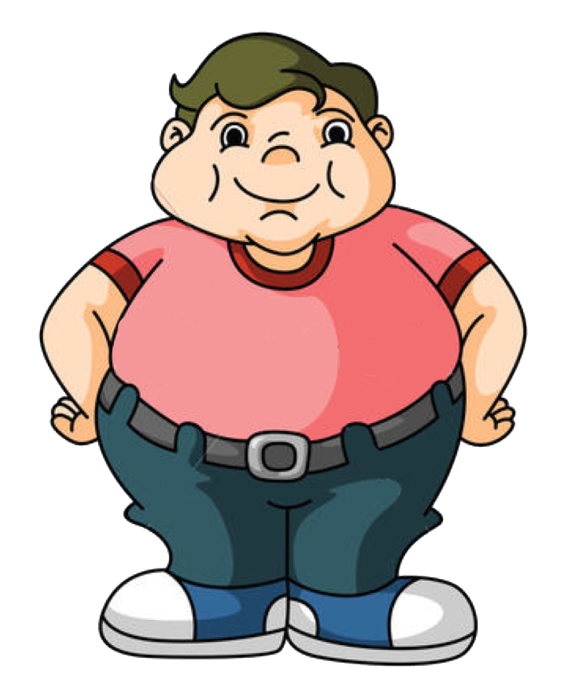
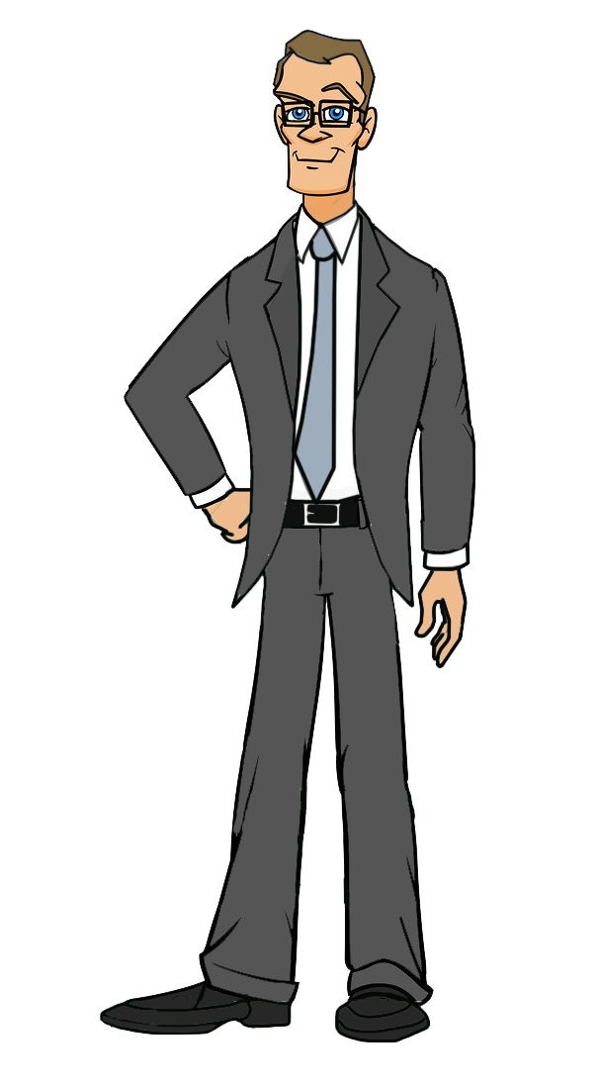
I was fat when I was young.
I am slim now.

Slide 6
My friend is 6 years old now.
He was 5 years old last year.

Slide 7
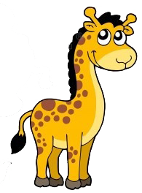
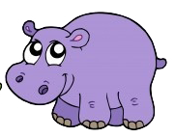
I was in the zoo yesterday.
I am in the museum now.

Slide 8
The weather was rainy yesterday.
It is sunny today.

Slide 9
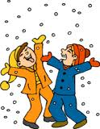
Yesterday it __________ snowy.
was
wasn’t
were
It __________ hot, but
was
wasn’t
were
the boys __________ sad.
were
weren’t
wasn’t
They __________ happy.
were
was
weren’t
The children __________ in the garden.
was
weren’t
were

Slide 10
Sally and Tom __________ in the ZOO last weekend.
was
wasn’t
were
There __________ elephants in the ZOO.
was
were
weren’t
They __________ huge.
was
were
weren’t
But the children _________ scared.
was
were
weren’t

Slide 11
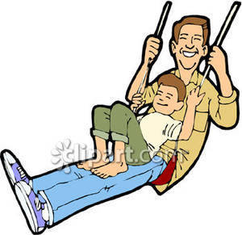
Tom __________ in the playground last week.
was
wasn’t
were
He __________ with his dad.
was
wasn’t
were
Tom’s mum __________ in the playground.
was
wasn’t
were
He __________ on the swing.
wasn’t
was
weren’t

Slide 12
I __________ at home yesterday.
were
wasn’t
weren’t
I __________ at school.
was
wasn’t
were
I __________ happy, because
was
wasn’t
were
My friends __________ at school.
was
were
weren’t

