Slide 1
Abstract Nouns

Slide 2
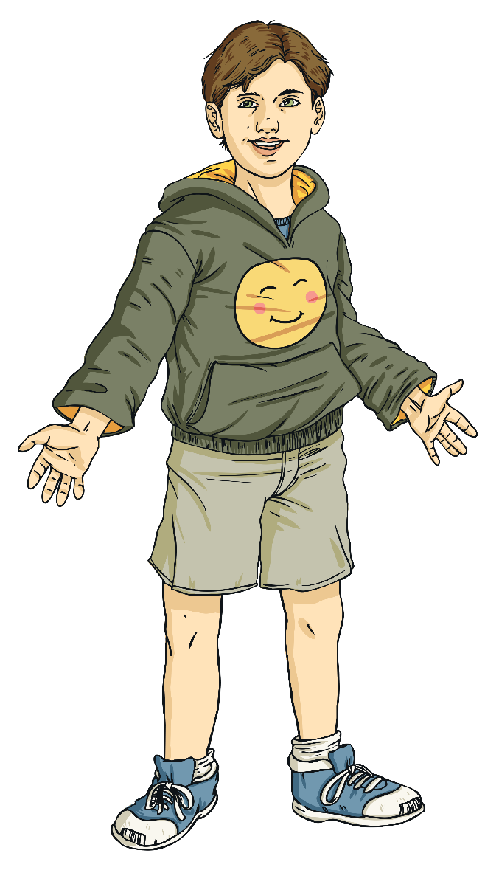
Recap: What is a noun?
Which one of these descriptions describes a noun?
Describes characteristics
Describes actions
Names people, places and things

Slide 3

Abstract Nouns
If something is abstract it exists only as a thought or idea.
It does not have a physical existence.
Therefore, abstract nouns describe a thought or
a state rather than something physical.
Hint: your five senses cannot identify these nouns.
You cannot touch, see, smell, taste or hear them!

Slide 4

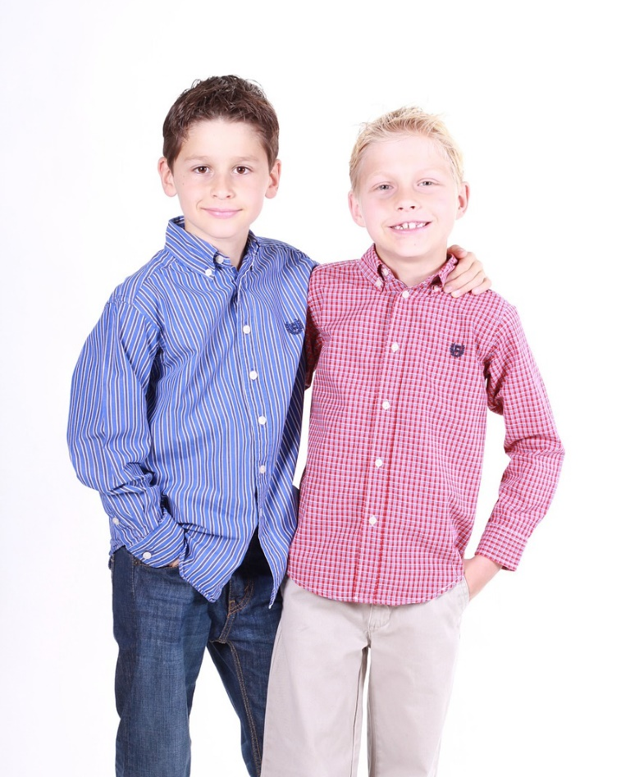
Abstract Nouns
bravery
friendship
Can you think of more?

Slide 5
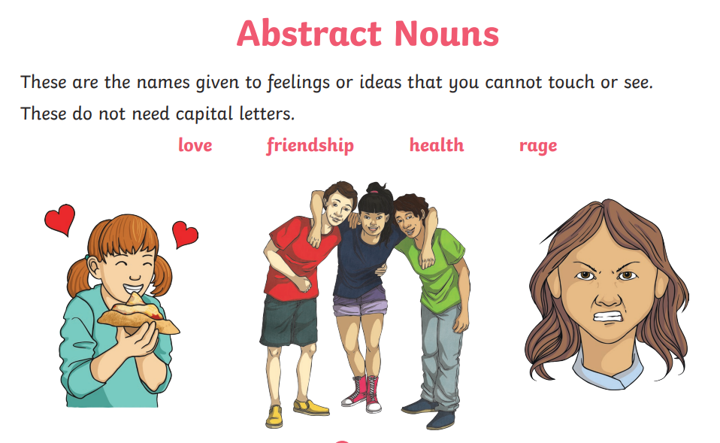

Slide 6
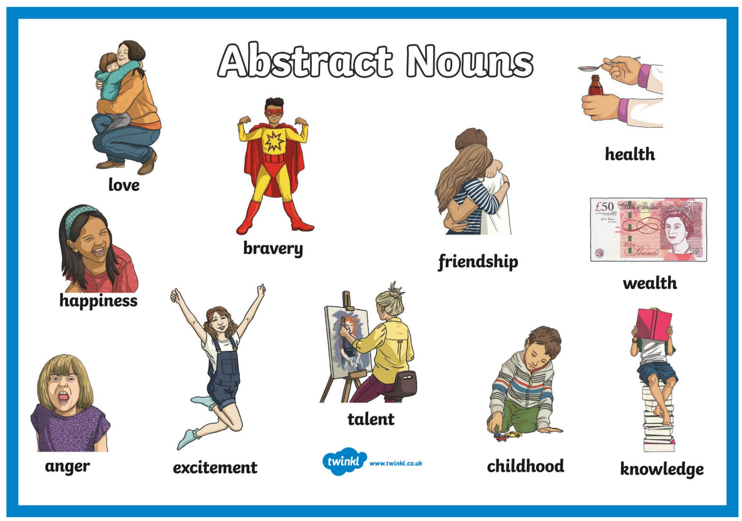

Slide 7

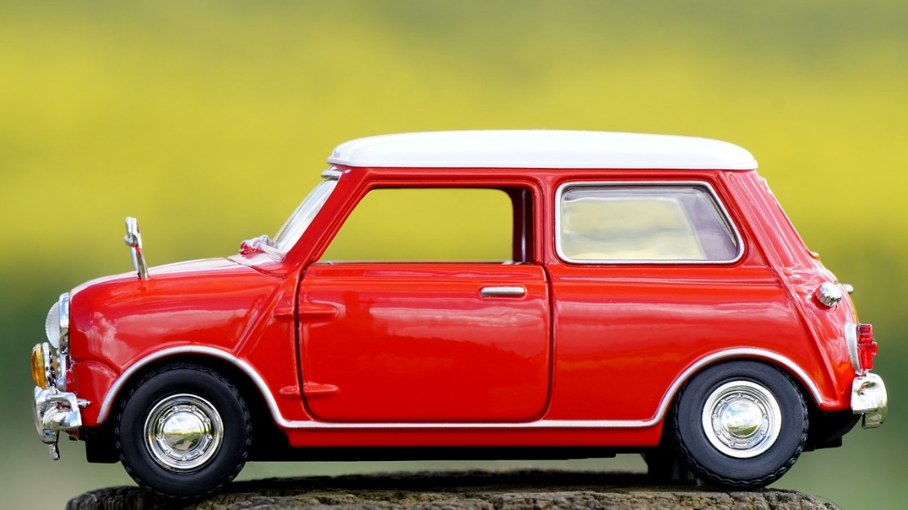
Concrete Nouns
You can experience concrete nouns with your five senses: you see them, hear them, smell them, taste them, and feel them.'
Can you think of more?

Slide 8
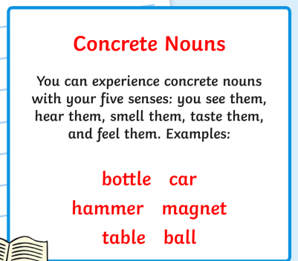
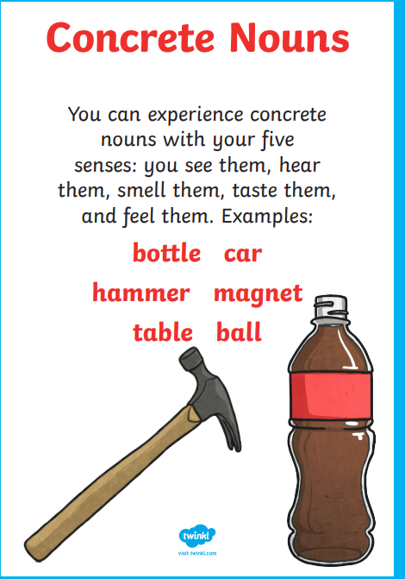

Slide 9
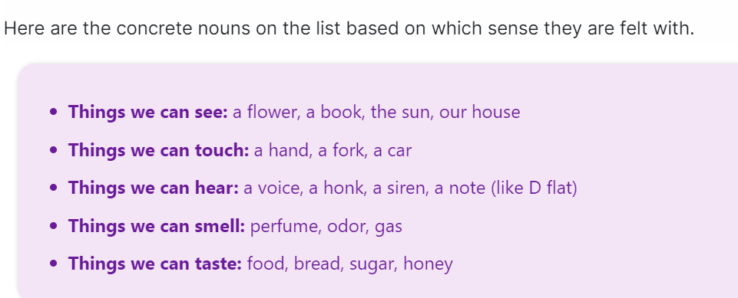

Slide 10
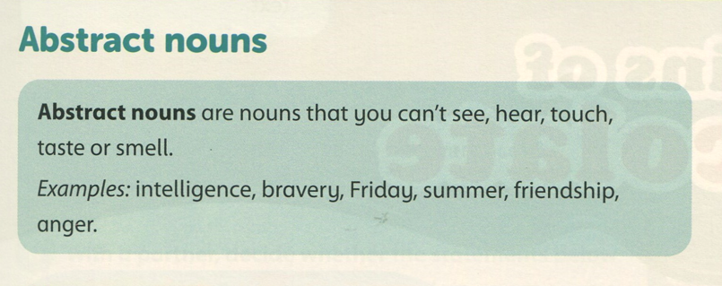

Slide 11
attributes | feeling | time
intelligence | anger | Friday
bravery |  | summer
friendship

Slide 12
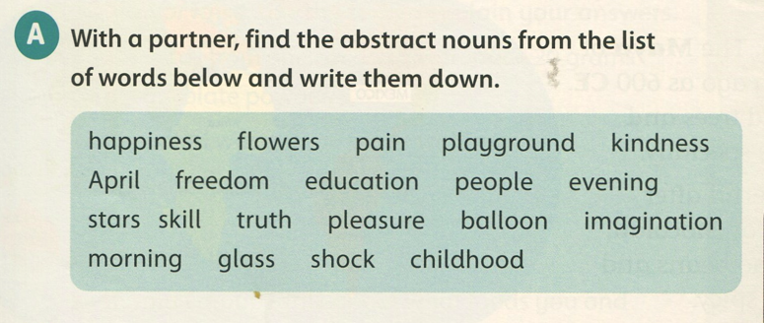
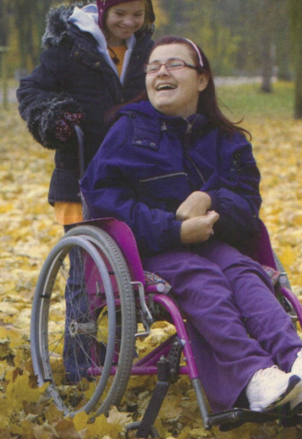

Slide 13
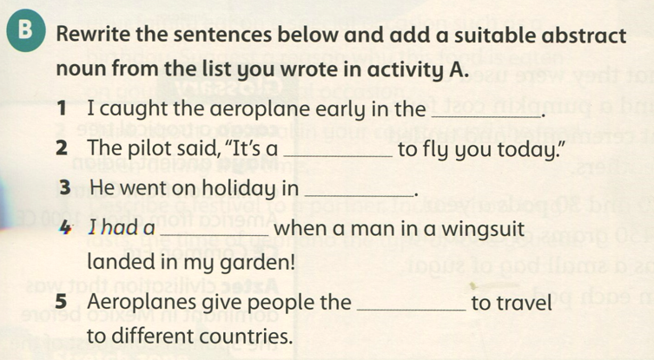
morning/ evening
pleasure
April
shock
freedom

Slide 14
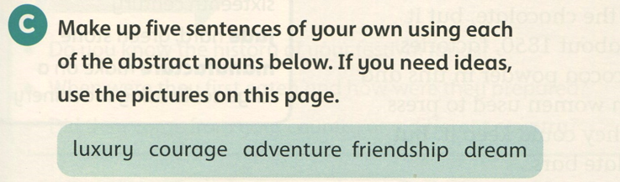

Slide 15
Grammar booklet

Slide 16
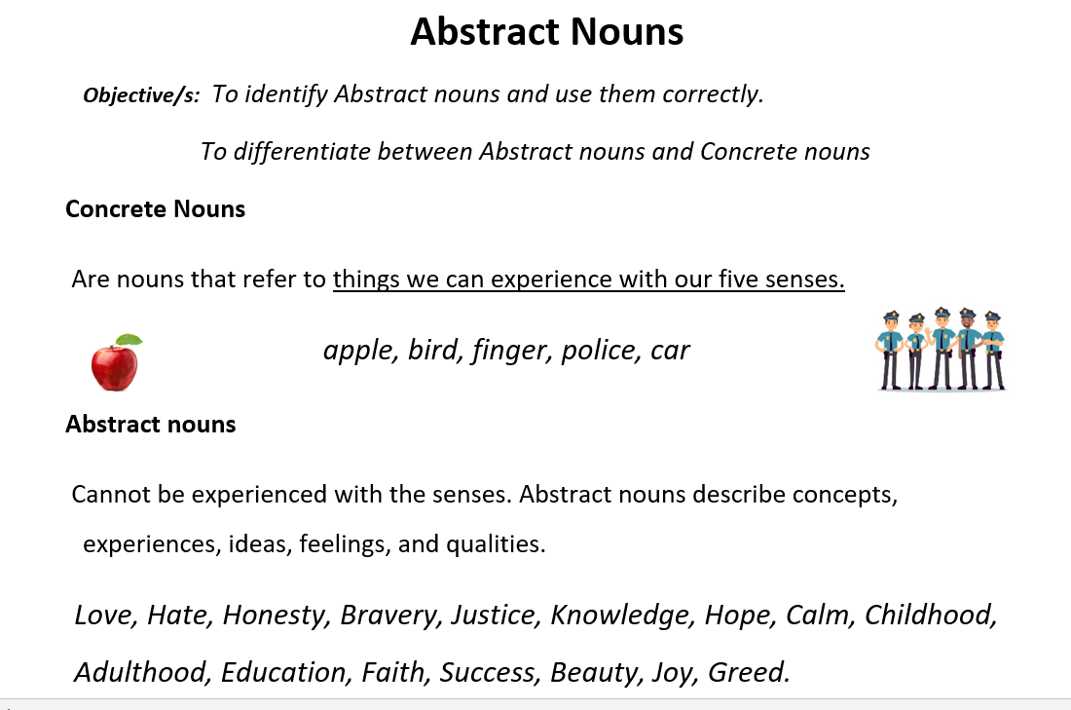

Slide 17
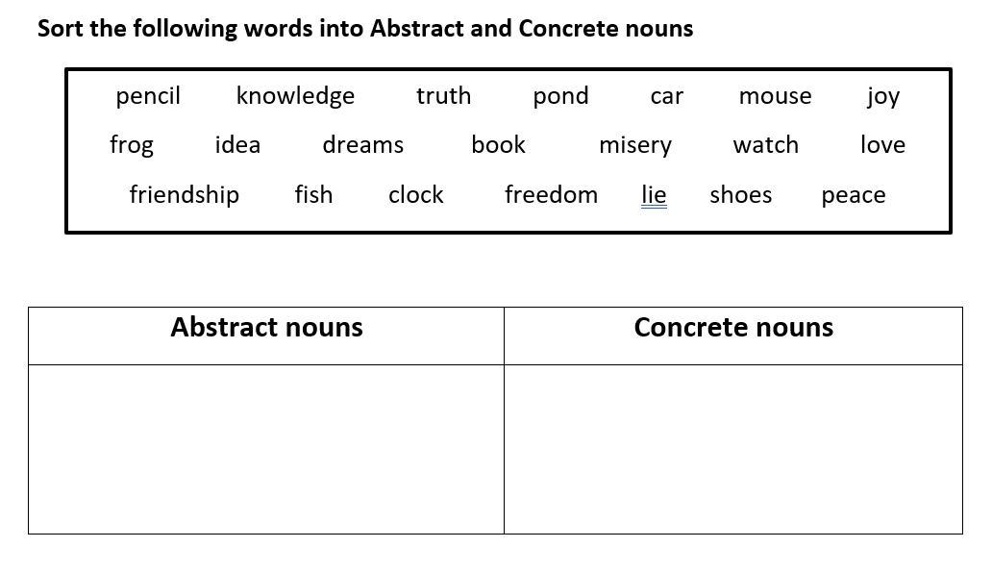
knowledge
truth
joy
pencil
pond
car
idea
dreams
misery
mouse
frog
book
love
friendship
freedom
watch
fish
clock
lie
peace
shoes

Slide 18
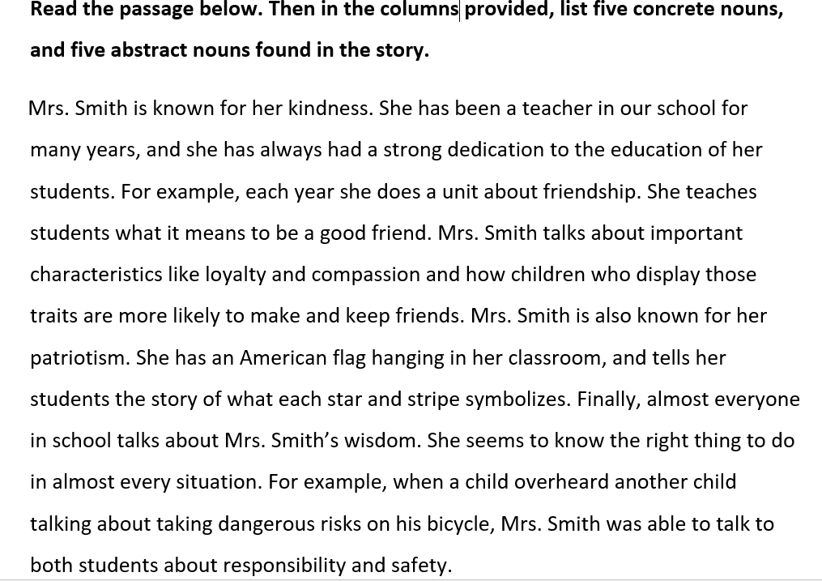

Slide 19
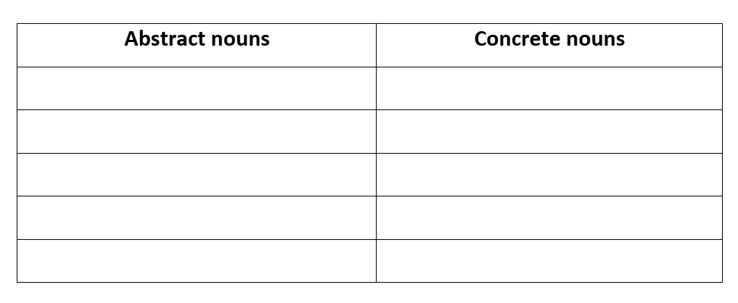
kindness
school
education
students
friendship
friends
loyalty
children
patriotism
flag
dedication, year, characteristics, compassion, wisdom, situation, risk, responsibility, safety.
classroom, star, stripe, bicycle, child

Slide 20
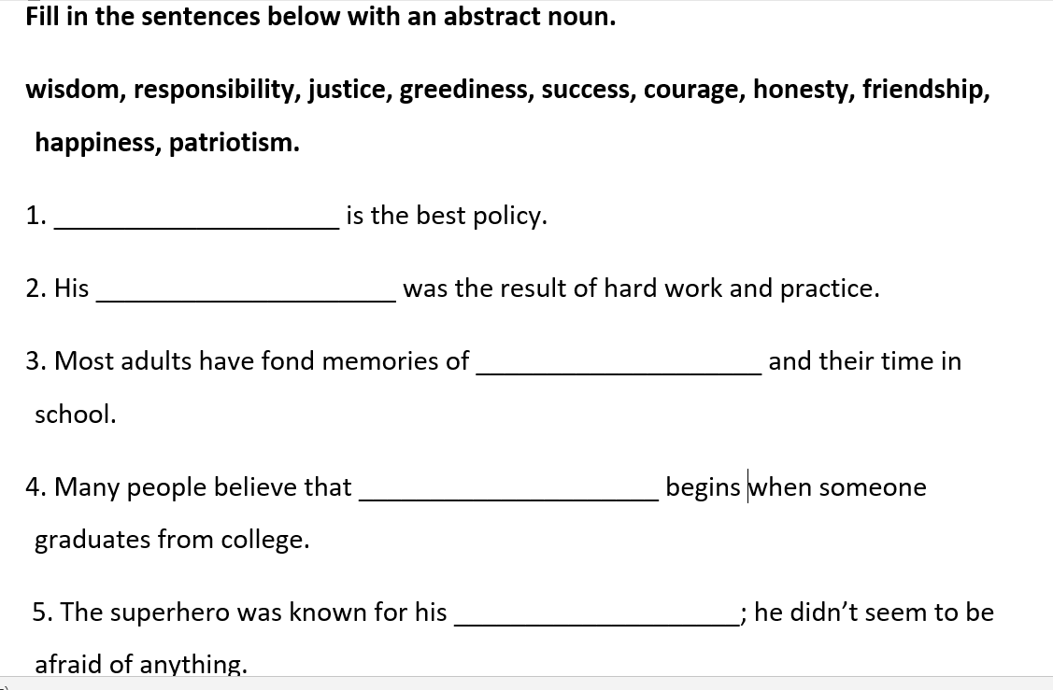
Honesty
success
friendship
responsibility
courage

Slide 21
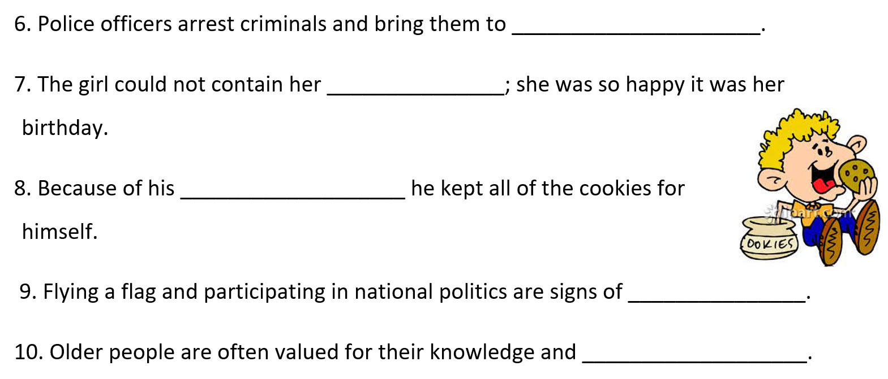
justice
happiness
greediness
patriotism
wisdom

