Slide 1
Lesson: Using keys
Grade: 6 CS

Slide 2
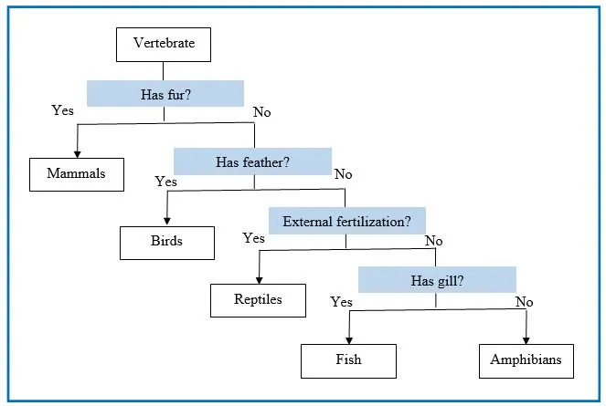
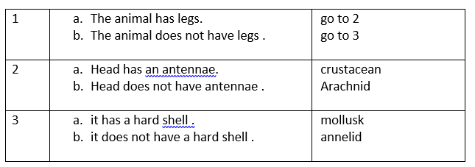
Types of dichotomous keys
Spider/ branched key
Numbered key
A key uses a series of questions to distinguish each species from the rest .

Slide 3
Victor uses three questions to distinguish these four cats .His first question separates them into two groups. His next questions separates the members of each group .
Put the cats’ names into the correct boxes in the table below
Leopard and cheetah
Lion and caracal
Leopard
Cheetah
Lion
caracal

Slide 6
Diving beetle
Leech
Pond skater
Fresh water shrimp
Water spider

Slide 7
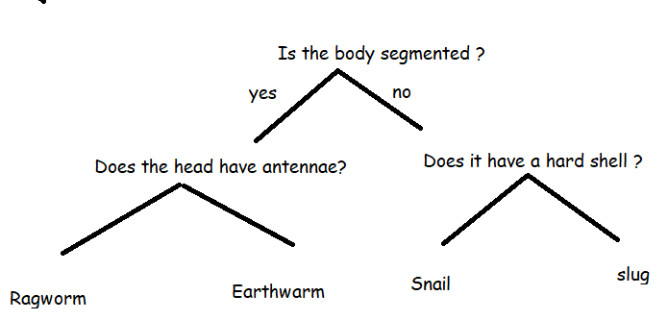
Use the key to identify the name of each organism.
no
yes
no
yes
Earthworm

Slide 8
Ragworm
Snail
Slug
Earthworm

Slide 9
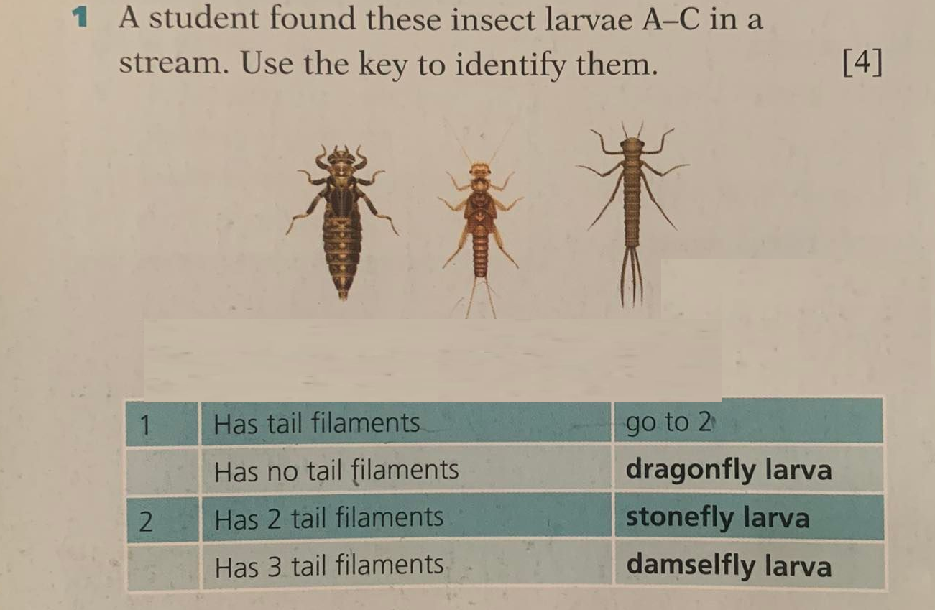

Slide 10
Dragonfly larva
Stonefly larva
damselfly larva

Slide 11
D

Slide 12
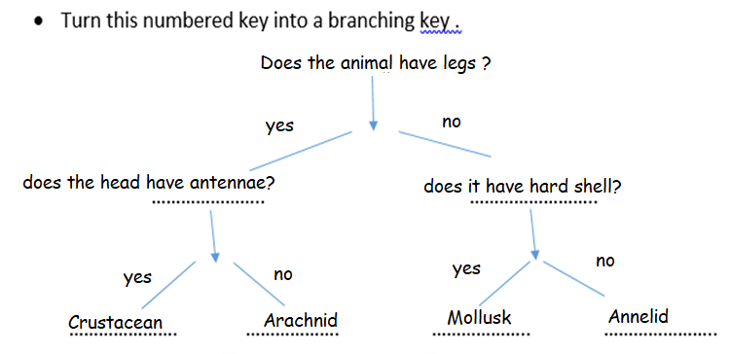
D
Arachnid
Mollusk
Crustacean
Annelid

Slide 14
Anopheles
Pediculus
Ornithodorus
Pulex
Musca
Periplaneta

Slide 16
A simple dichotomous key used to identify different groups of mammals is provided. An organism that gives birth to live young but does not possess a pouch and has no wings is discovered. Using this dichotomous key, determine which group it is most likely to belong to.

Slide 17
A simple dichotomous key used to identify different groups of mammals is provided. An organism that gives birth to live young but does not possess a pouch and has no wings is discovered. Using this dichotomous key, determine which group it is most likely to belong to.

