Slide 1
Classification of living things
Classification

Slide 2



Slide 3
Classification of Living Things
Scientists estimate that there are between
3-100 million species of organisms on Earth.
So, how do scientists classify (organize) all these millions of species?

Slide 4
Reminder: why classify?
To help us see relationships, similarities and differences among organisms.

Slide 5
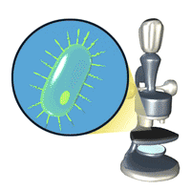

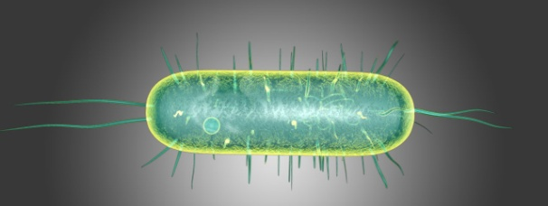

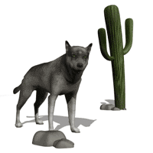
5 Kingdoms of Organisms
Monera (bacteria)
protists
Fungi
Plants
Animals

Slide 6
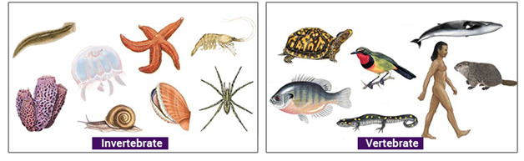
ANIMALS
Invertebrates (no backbone)
Vertebrates (backbone)

Slide 7
Vertebrates
Vertebrates
Fish
Amphibians
Reptiles
Birds
Mammals

Slide 8
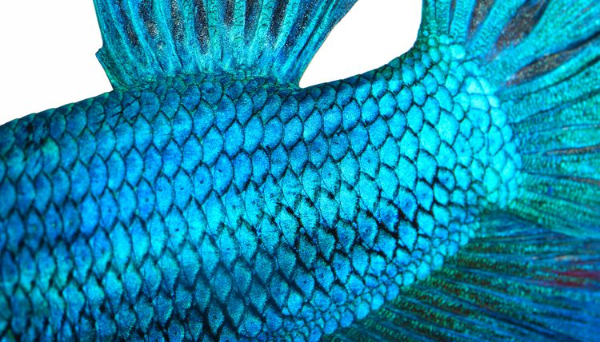
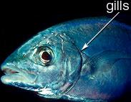
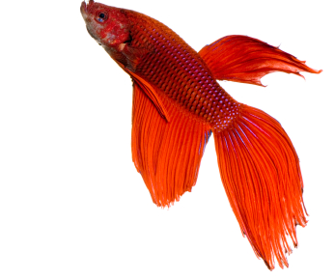
Fish
Fish use gills to breathe.
They have scales and fins.
Eggs laid in water.
They are cold-blooded which means that they can’t control their own body temperature which changes based on the temperature of the environment.

Slide 9
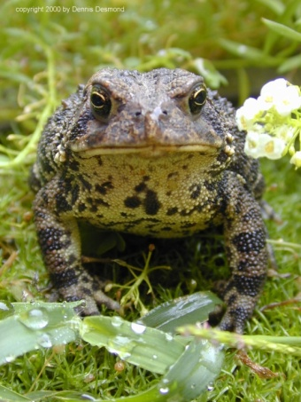
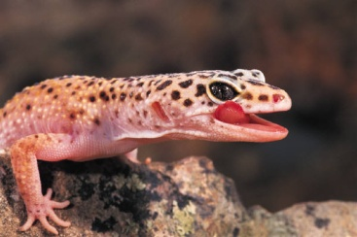
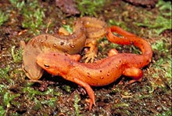
Amphibians
These animals have smooth, moist skin
Lay eggs
Baby amphibians breathe using gills. Adults breathe using lungs.
They are cold-blooded.
Includes: Frogs, Toads, Salamanders, and Newts.
Salamander
newts
toad

Slide 10
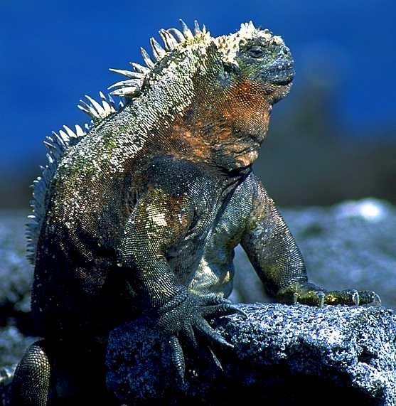
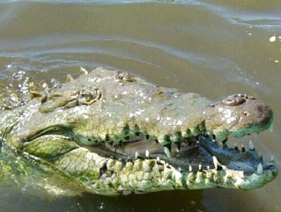
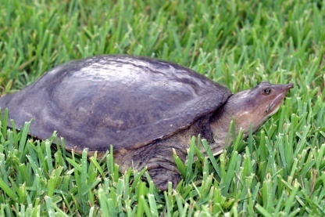
Reptiles
These animals have dry, scaly skin.
Breathe using lungs.
Most reptiles lay soft-shelled eggs.
They are cold-blooded.
Includes: Lizards, Snakes, Turtles, and Crocodiles.
Turtle
Crocodile
Iguana/ lizard

Slide 11
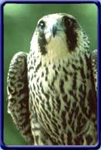
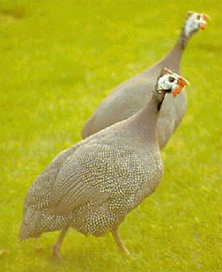
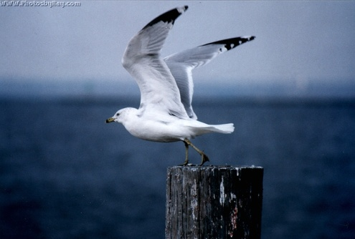
Birds
They have beaks, wings and feathers.
Birds are born from hard-shelled eggs.
Have two legs. Breathe using lungs.
They are warm-blooded, they can maintain a constant body temperature.
Includes: Raptors, Gulls, Songbirds, and Fowl.
Raptor
Gull
Fowl

Slide 12
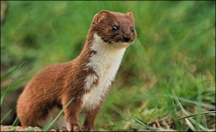
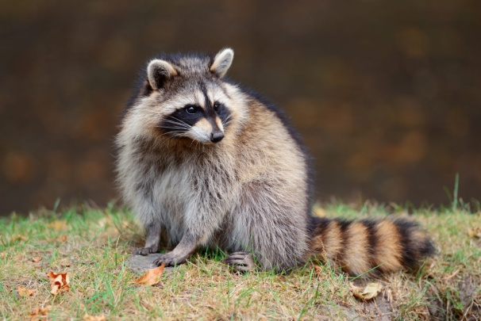
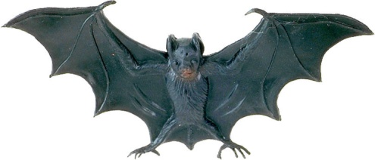
Mammals
These animals usually have hair/fur.
They give birth to live young and feed their young with milk.
Breathe using lungs.
They are warm blooded.
Includes: Rodents, Bats, Rabbits, Weasels, Raccoons, Bears, Dogs, and Cats.

Slide 13
Invertebrates
worms
Cnidaria
Molluscs
Echinoderms
Arthropods

Slide 14
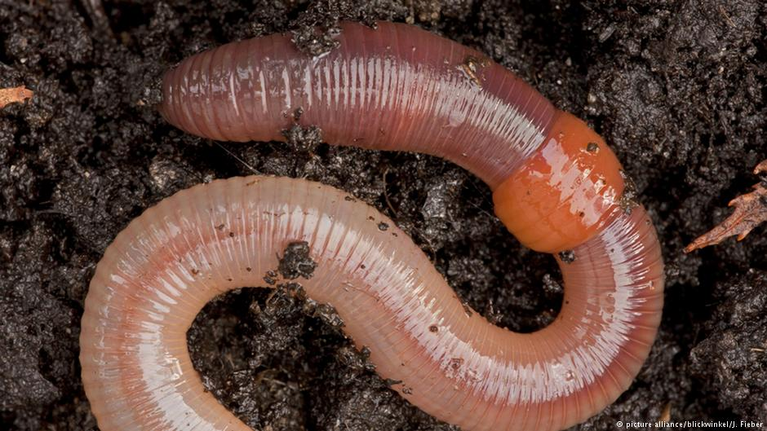
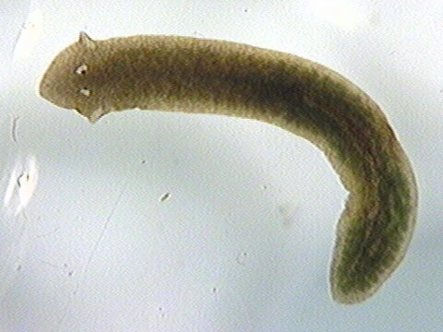
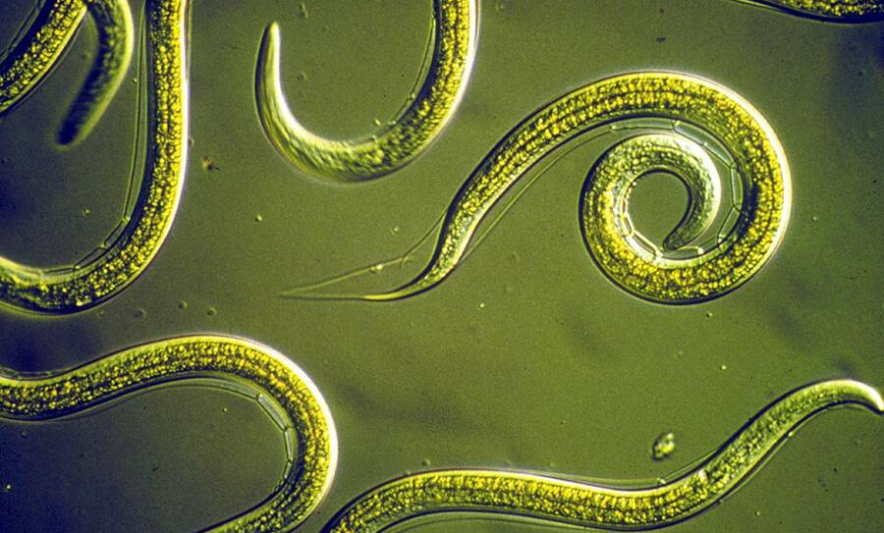
Worms
Annelids
Flatworms
Nematodes
They have no legs, and long bodies.
They may be flat (Flatworm) , rounded (Nematodes) or segmented (Annelids).
Ex. Earthworm, tapeworms

Slide 15
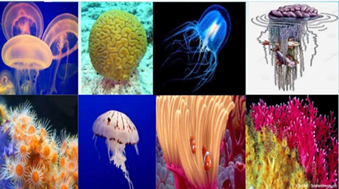
Cnidaria (stinging creatures)
This group of animals all live in the sea.
They have tentacles and no legs.
Examples: jellyfish, sea anemones, coral.

Slide 16
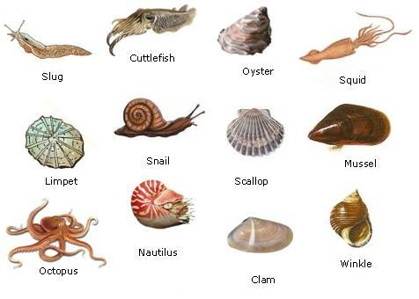
Molluscs
They have soft bodies without legs.
Some species, such as slugs and snails, live on land. Others, like squids and octopuses, live underwater.
They often have a shell.

Slide 17
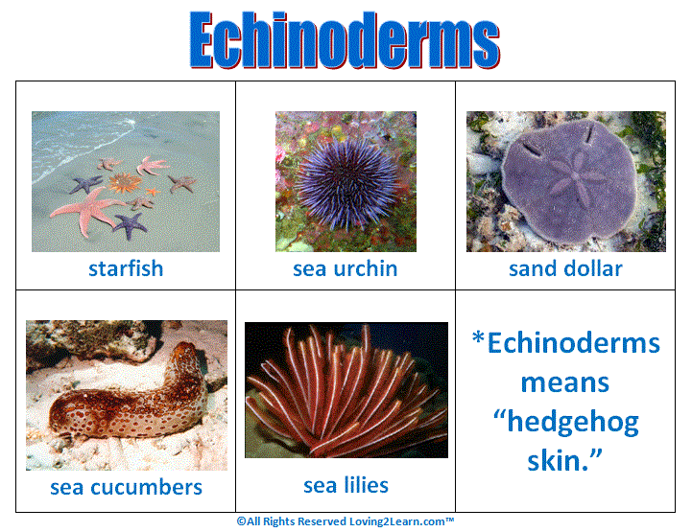
Echinoderms (spiky skin)
They are aquatic animals
Some of them are covered with spikes for defense.

Slide 18
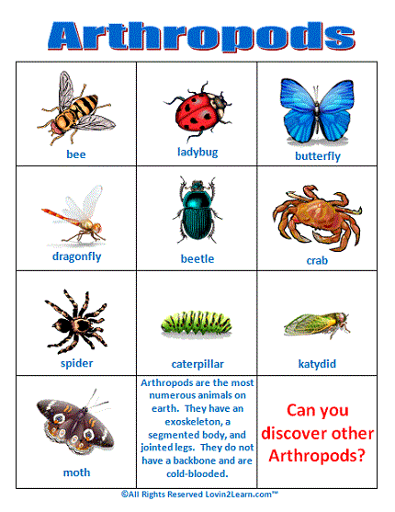
Arthropods
The most abundant animals on Earth.
Their bodies are covered with an external skeleton.

Slide 19
Arthropods classes
Their bodies are covered with an external skeleton.
They are classified by the number of legs they have.
6 legs ( insects ) , like ants & flies.
8 legs ( arachnids ) , like spiders & scorpions.
10 legs ( crustaceans ) , like crabs & lobsters.
More than 10 legs ( myriapods ) , like millipedes & centipedes.

Slide 20
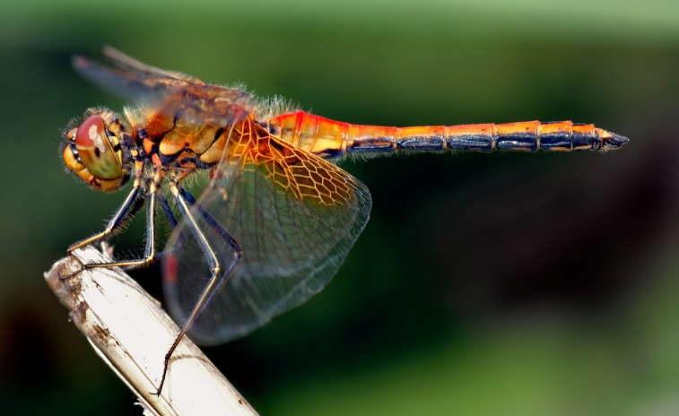
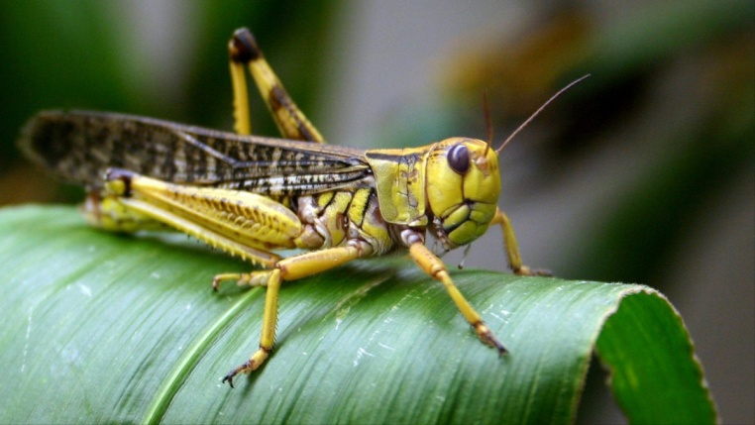
Insects
Examples
  Dragon fly
  Locust
Key features
  Three pairs of legs
  Many have wings
  One pair antennae
  Body 3 segments – head, thorax and abdomen

Slide 21
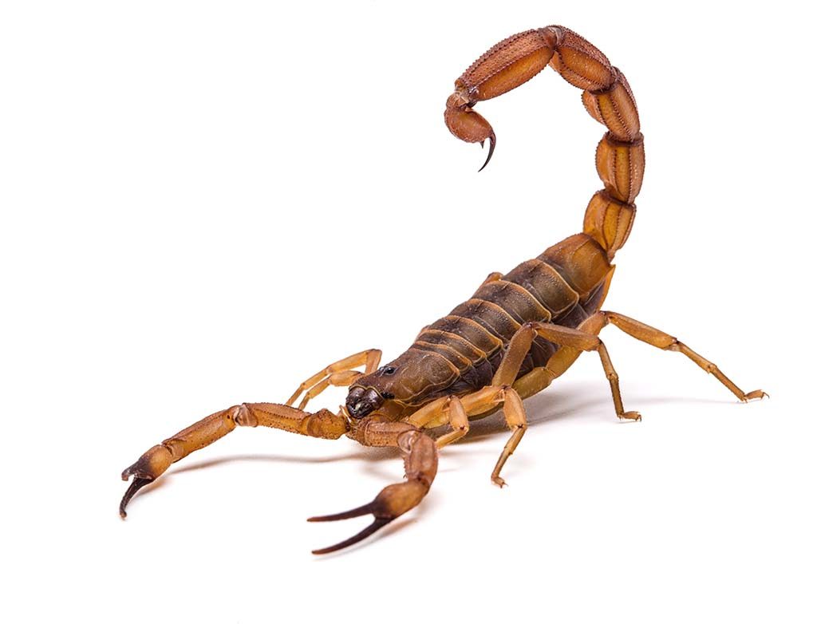
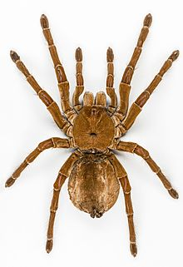
Arachnids
Examples
  Spider
  Tick
Key features
  Four pairs of legs
  Body divided into two segments; head and abdomen

Slide 22
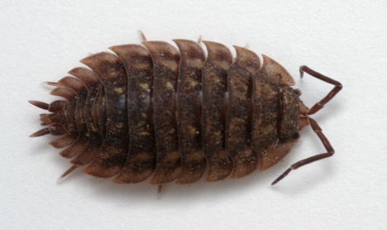
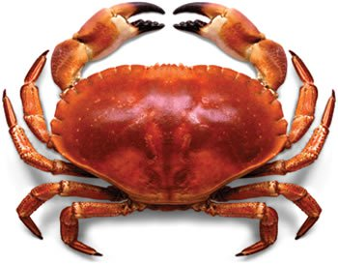
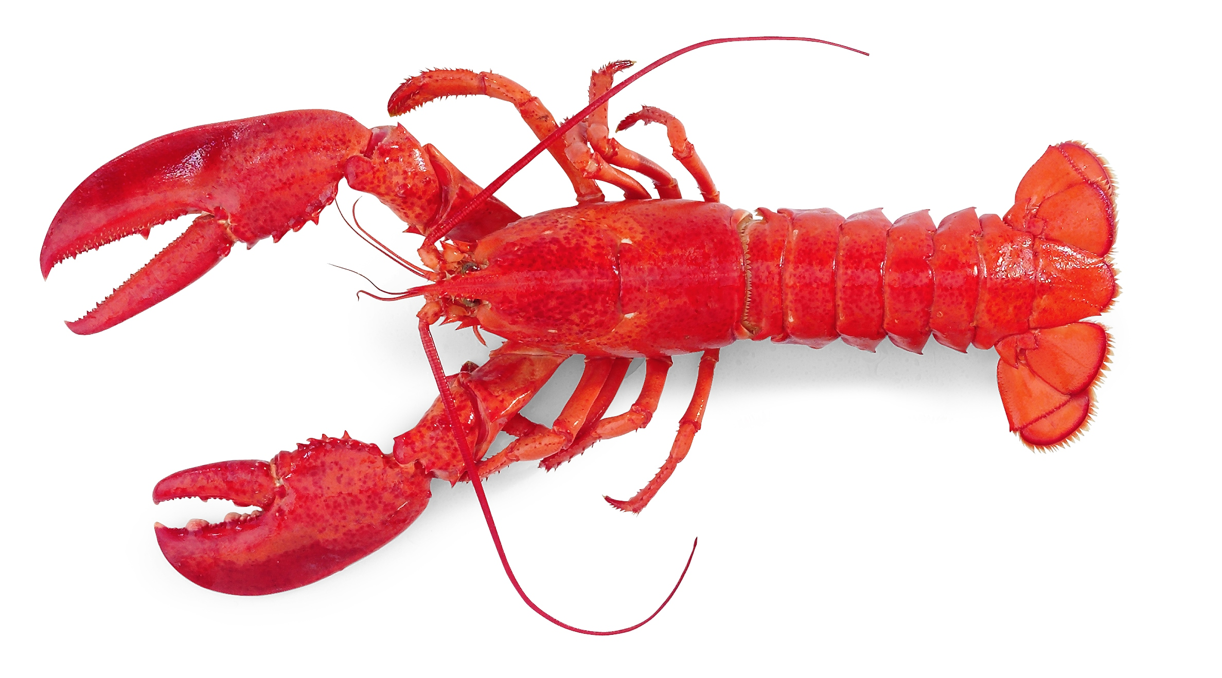
Crustaceans
Examples
  Crab
  Woodlouse
Key features
  Five or more pairs of legs
  Two pairs of antennae
  Body 2 segments; Head and abdomen

Slide 23
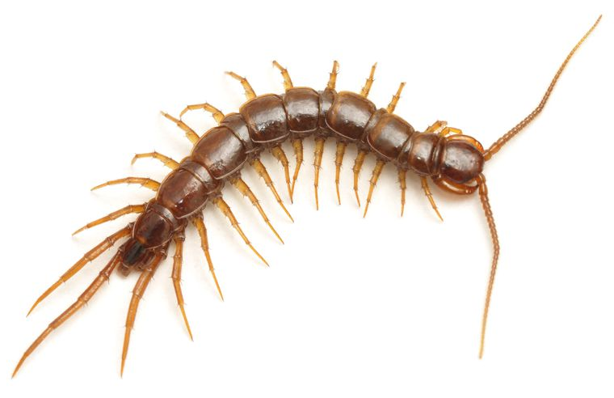
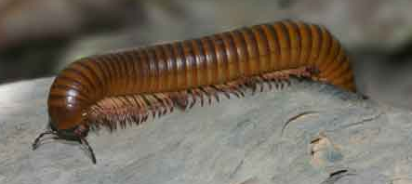
Myriapods
Examples
  Centipede
  Millipede
Key Features
  Ten or more pairs of legs
  One pair of antennae

