Slide 1
Lesson: (Naming compounds)
Objectives:
To be able to name compounds
Write the chemical formula of different compounds.

Slide 2
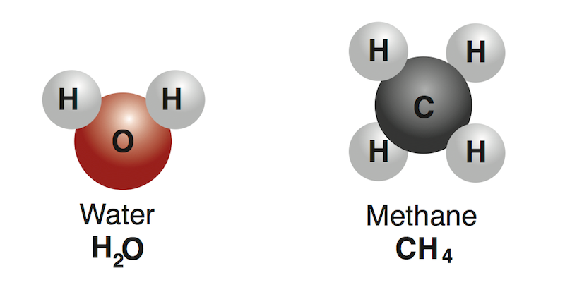
Compounds
A compound is a substance composed of two or more elements combined in a specific ratio and held together by chemical bonds.
Familiar examples of compounds are water and salt (sodium chloride).

Slide 3
Naming Compounds (metal and non-metal)
Remember that some compounds consist of two different elements.
(metal and non-metal)
1) Name the first element that appears in the formula.
2) Name the second element that appears in the formula, changing its ending to –ide.
Examples:
AlF3 Aluminum fluoride
MgCl2 Magnesium Chloride

Slide 4
Naming Compounds
Remember that some compounds consist of two different elements, one of them is oxygen.
1) Name the first element that appears in the formula.
2) Write oxygen, changing its ending to –ide.
Examples:
CaO Calcium oxide
K2O Potassium oxide

Slide 5
Naming Compounds
Remember that some compounds consist of three different elements, one of them is oxygen:
Name the first element that appears in the formula.
Name the second element that appears in the formula. changing its ending to –ate.
Examples:
NaNO3 Sodium nitrate
K3PO4 Potassium phosphate

Slide 6
Name the following compounds:
KCl
NaCl
CaO
MgBr2
CaF2
K2S
LiBr
Mg(NO3)2

Slide 7
Name the following compounds:
KCl - potassium chloride
NaCl - sodium chloride
CaO - calcium oxide
MgBr2 - Magnesium bromide
CaF2 - calcium fluoride
K2S - potassium sulfide
LiBr - lithium bromide
Mg(NO3)2 - magnesium nitrate

Slide 8
Compounds containing non-metals only
Some compounds are made up of non-metals only. To name these compounds, you need to know the numbers of atoms of each element in a compound.
Prefixes are used to show how many atoms are present in each molecule.
Mono (or no prefix) – 1
Di – 2
Tri – 3
Tetra – 4
Do not use mono on the first element.
CO2 – carbon dioxide
CO – Carbon monoxide

Slide 9
Compounds containing non-metals only
Do not use mono on the first element.
Molecule of compound made up of… | Name of compound
1 atom of sulfur and 2 atoms of oxygen
1 atom of sulfur and 3 atoms of oxygen
1 atom of phosphorus and 3 atoms of chlorine
2 atoms of nitrogen and 4 atoms of oxygen

Slide 10
Compounds containing non-metals only
Molecule of compound made up of… | Name of compound
1 atom of sulfur and 2 atoms of oxygen | Sulfur dioxide
1 atom of sulfur and 3 atoms of oxygen | Sulfur trioxide
1 atom of phosphorus and 3 atoms of chlorine | Phosphorus trichloride
2 atoms of nitrogen and 4 atoms of oxygen | Dinitrogen tetroxide

Slide 11
Name the following compounds
SO2 SO3 CO
CO2
NO
NO2

Slide 12
Name the following compounds
SO2 – sulfur dioxide SO3 – sulfur trioxide CO – carbon monoxide
CO2 – carbon dioxide
NO - nitrogen monoxide
NO2 – nitrogen dioxide

Slide 13
Name the following compounds
N2H4 N2O3 PCl3
CS2
N2O

Slide 14
Name the following compounds
N2H4 – dinitrogen tetrahydride N2O3 – dinitrogen trioxide PCl3 – phosphorus trichloride
CS2 – carbon disulfide
N2O – dinitrogen monoxide

