Slide 1
https://wordwall.net/ar/resource/7565478

Slide 6
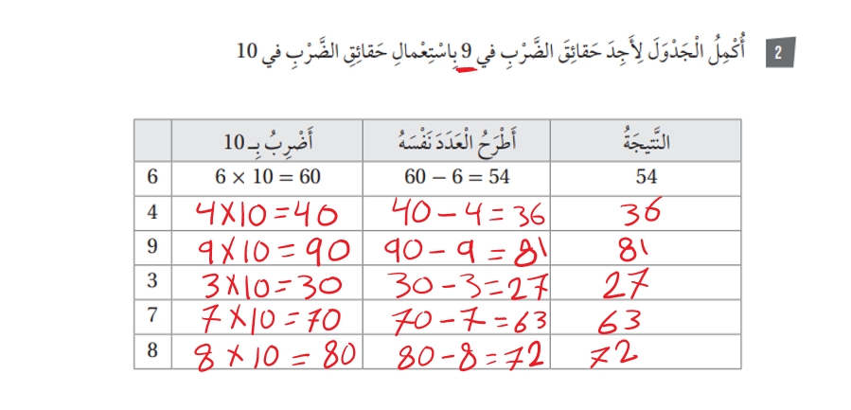

Slide 8
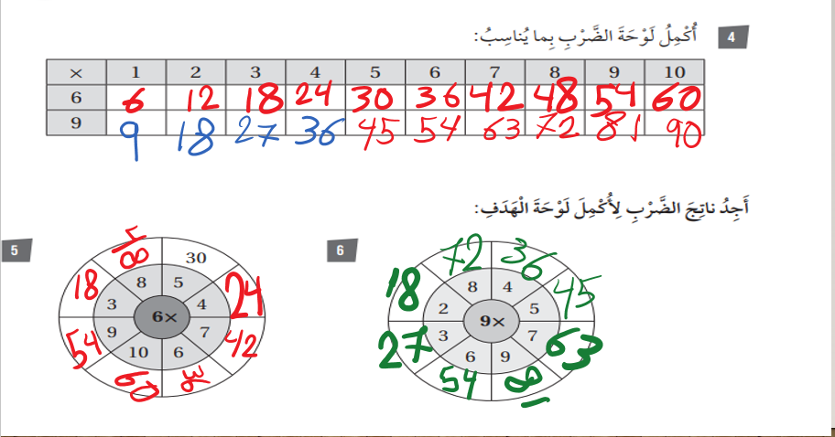

Slide 9
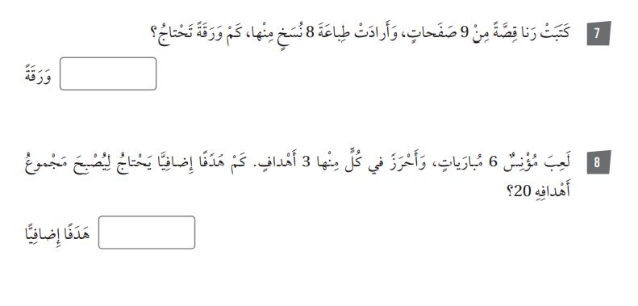
72 صفحة=9×8
18=6×3
18+2=20

