Slide 1
الضرب في2

Slide 4
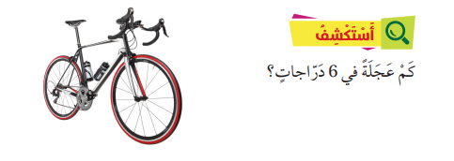

Slide 6
10
20 قلما=2*10

Slide 7
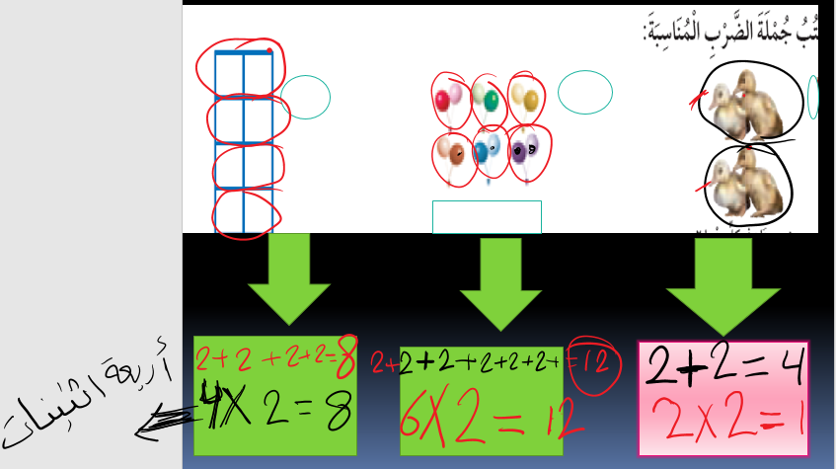

Slide 8
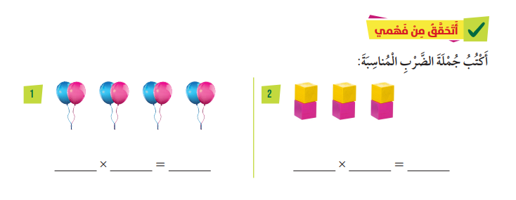
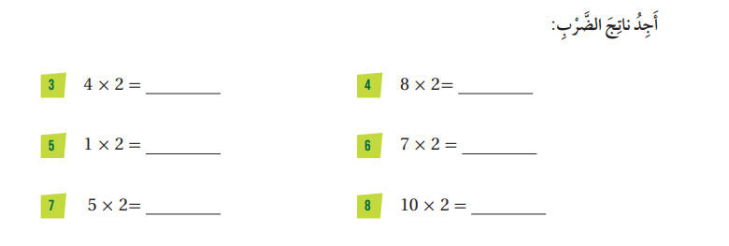
4
8
3
2
6
2
16
8
2
14
10
20

Slide 9
https://wordwall.net/ar/resource/27244362

Slide 10
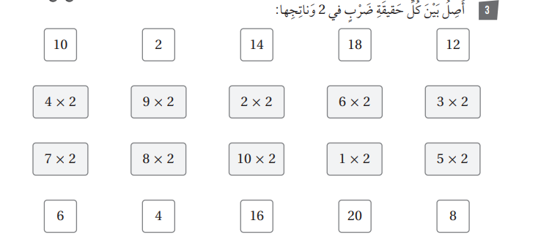
9
18
7
14
8
18
4
12
6
14
16
20
2
10

Slide 11
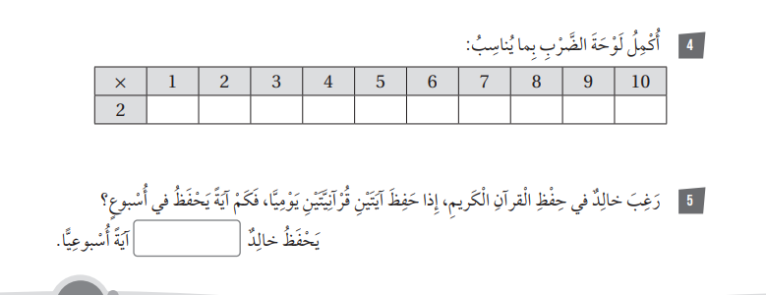
2
4
6
8
10
12
14
16
18
20
14 آية=2×7
14=2+2+2+2+2+2+2
https://wordwall.net/resource/11872903

