Slide 1
Unit 11: Ratio and proportion

Slide 2
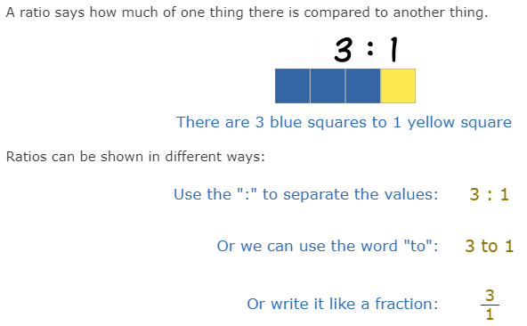

What is ratio?
A ratio compares values.

Slide 3
Example: A Recipe for pancakes uses 3 cups of flour and 2 cups of milk.
So the ratio of flour to milk is 3 : 2
To make pancakes for a LOT of people we might need 4 times the quantity, so we multiply the numbers by 4:
3×4 : 2×4 = 12 : 8
In other words, 12 cups of flour and 8 cups of milk.
The ratio is still the same, so the pancakes should be just as yummy.

Slide 4
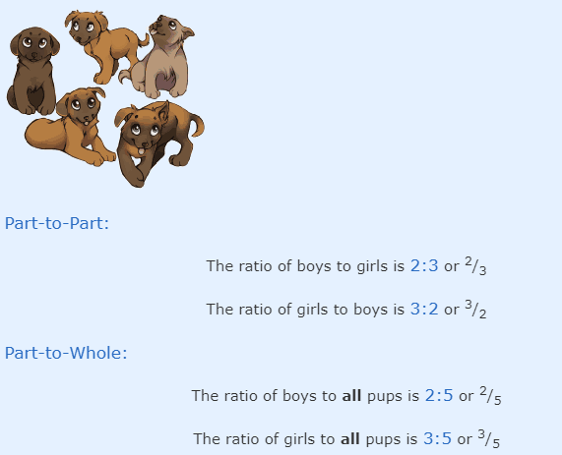
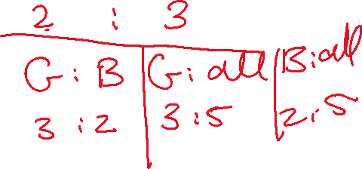
Example: There are 5 pups, 2 are boys and 3 are girls

Slide 5
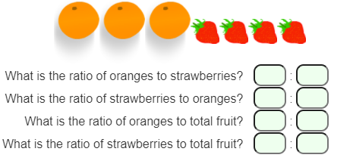
Try it yourself!

Slide 6
Simplifying ratio
Ratios can be fully simplified just like fractions.
To simplify a ratio, divide all of the numbers in the ratio by the same number until they cannot be divided any more.
A quick way of doing this in just one step is to divide by the highest common factor (HCF) of all the numbers in the ratio.
Some ratios contain decimals. If they contain decimals they are not in the simplest form. If you are asked for the ratio 1.5 : 5 in its simplest form, you multiply both parts by the smallest number possible to create a whole number or you can multiply by a power of 10 to get rid of the decimal and then simplify.
Fractions ratio can also be simplified. But first you need to ensure that the fractions have a common denominator.
To be in its simplest form, a ratio shouldn’t include decimals, fractions or percentages. It should contain only whole numbers (check examples 3 and 4 from the book page 179 + 180).

Slide 7

To review watch the video below:
https://www.youtube.com/watch?v=6uwnkOC5hLI
P.180, Ex. 11A
Q1 + 2 + 6 + 7 + 10

Slide 8
Dividing a quantity in a given ratio.
You can divide a quantity into two amounts using ratio to decide how much is in each amount.
Example: Rebecca and Amy share £280 in a ratio 5:2.
How much money will they each receive?
The answer:
1. Add up the ratio to find the total number of parts:
5 + 2 = 7 parts
2. Divide the total amount by the number of parts:
£280 ÷ 7 = £40
Each part is worth £40
3. Multiply by the ratio to find each person’s share:
5 × £40 = £200 (Rebecca's share)
2 × £40 = £80 (Amy’s share)
4. Check these add up to the original amount:
£200 + £80 = £280

Slide 9
So, to share an amount in a ratio, follow these steps:
Add up the ratio to find the total number of parts
Divide the total amount by the number of parts
Multiply by the ratio to find each person's share
Check these add up to the original amount.
To review watch the video below:
https://www.youtube.com/watch?v=G3YTHk8puFo
P.182, Ex. 11B
Q1 + 2 + 3 + 6 + 7 + 8

