Slide 1
Unit 9 “Decimals and percentages”

Slide 2
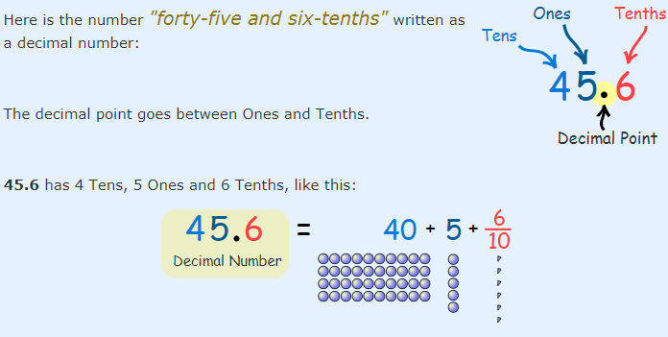
A Decimal Number (based on the number 10) contains a Decimal Point.

Slide 3
Place value.
When we write numbers, the position (or "place") of each digit is important.
For example:
In the number 327:
the "7" is in the Ones position, meaning 7 ones (which is 7),
the "2" is in the Tens position meaning 2 tens (which is 20),
and the "3" is in the Hundreds position, meaning 300.

Slide 4
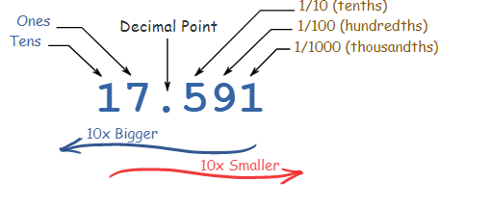
If we have a decimal number:

Slide 5
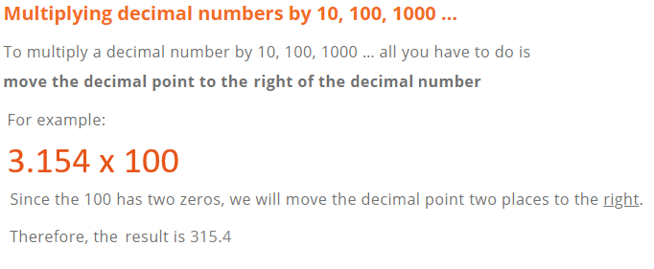
Multiplying and dividing decimals by powers of 10.

Slide 6
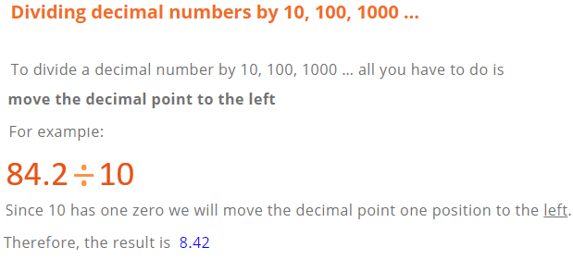
P. 131, Ex 9A
Q1 + 2 + 3

Slide 7
Rounding
Rounding means making a number simpler but keeping its value close to what it was.
The result is less accurate but easier to use.

Slide 8
How to round numbers?
Decide which is the last digit to keep.
Leave it the same if the next digit is less than 5 (this is called rounding down).
But increase it by 1 if the next digit is 5 or more (this is called rounding up).
P. 133, Ex 9B
Q2 + 3 +4 + 9 + 10

Slide 9
Understanding percentages
a percentage is a number or ratio that represents a fraction of 100. It is often denoted by the symbol "%" or simply as "percent" or "pct."
For Example:
35% is equivalent to the decimal 0.35, or the fraction $\frac{35}{100}$
To review watch the video below:
https://www.youtube.com/watch?v=JeVSmq1Nrpw
P. 134, Ex. 9C
Q1 + 3 + 4 + 5

Slide 10
Changing fractions to percentages.
It is easy to write a fraction with a denominator of 100 as a percentage.
For Example:
$\frac{67}{100}$ = 67%
You can change any fraction to a percentage by writing it with a denominator of 100.
P. 135, Ex. 9D
Q1 + 2 + 3 + 4 + 5 + 6 + 7

Slide 11
Expressing decimals as percentages.
To write decimals as percentages you can first write your decimal as a fraction with denominator 100.
For Example:
0.5 as a percentage
$\frac{5}{10}$ = $\frac{50}{100}$ = 50%
A quicker way to change a decimal to a percentage is to multiply by 100.
For Example:
0.471 as a percentage:
0.471 x 100 (move the decimal point to the right 2 decimals places)
So, 0.471 x 100 = 47.1%

Slide 12
To review watch the video below:
https://www.youtube.com/watch?v=-Xt4UDk7Kzw
P. 135, Ex. 9D
Q1 + 3 + 4 + 5 + 7 + 8
P.137, Ex. 9E
Q1 + 3 + 4 + 5 + 7 + 8

Slide 13
Finding percentages of amounts.
Percentages are often used in everyday transactions.
For example:
In each case you have to find the percentage of an amount to find the discount or the tax.
Example:
Find 25% of 100 JD.
$\frac{25}{100}$ x 100 = 25 JD.
Discount
10%
Tax
15 %

Slide 14
To review watch the video below:
https://www.youtube.com/watch?v=rR95Cbcjzus
P. 140, Ex. 9F
Q1 + 2 + 3 + 5 + 6 + 7 + 8 + 10 + 11 + 13

Slide 15
Comparing decimals and fractions
A good way to compare decimals is to write all the numbers with the same number of decimal places.
One way to compare two fractions is to write them with the same denominators.
P. 143, Ex. 9H
Q1 + 2 + 3 + 6
P.144, Ex. 9I
Q2 + 6 + 7

Slide 16
Adding and subtracting decimals.
Adding or subtracting decimals is similar to adding or subtracting whole numbers.
Write down the numbers, one under the other, with the decimal points lined up.
Put in zeros so the numbers have the same length.
Then add, using column addition, remembering to put the decimal point in the answer.

Slide 17
To review watch the video below:
https://www.youtube.com/watch?v=PnwLv6khwk8
P. 145, Ex. 9J
Q1 + 2 + 4 + 5 + 6

Slide 18
Multiplying decimals.
If you already know how to multiply, then multiplying decimals will be easy, there is just one extra step you need to take:
Multiply normally, ignoring the decimal points.
Then put the decimal point in the answer - it will have as many decimal places as the two original numbers combined.
Example: 3.12 x 2.1=
Multiply without the decimal points: 312 x 21 = 6552
3.12 has two decimal places , 2.1 has one decimal place.
So, the answer has three decimal places = 6.552

Slide 19
To review watch the video below:
https://www.youtube.com/watch?v=dSFja7Jsg6c
P. 147, Ex. 9K
Q4 + 5 + 6

Slide 20
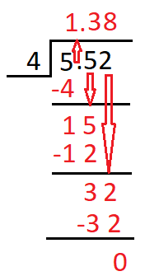
Dividing decimals.
The rules to divide a decimal by a whole number are:
Divide as in division of numbers ignoring the decimal point.
When you reach the tenths digit, place the decimal in the quotient.
Example: 7.52 ÷ 4

Slide 21
To review watch the video below:
https://www.youtube.com/watch?v=IheBIlt2s20&feature=emb_logo
P. 148, Ex. 9L
Q1 + 2 + 3 + 4 + 5 + 6 + 7

