Slide 1
Unit 1 “Integers, powers and roots”

Slide 2
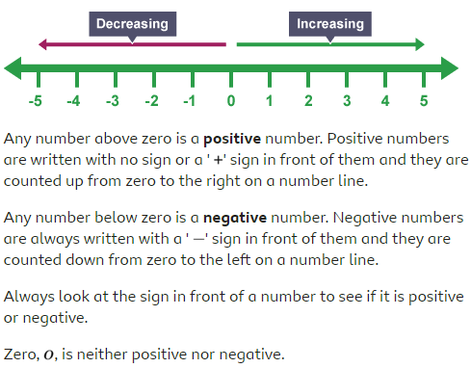
What are positive and negative numbers?

Slide 3
Example: Decide what number is greater?
a) -3 __<_ 1 b) 12 __>__ -20
c) 10 _>__ -3 d) -5 __<_ 5
e) 14 _>__ -25 f) -15 _<__ -2

Slide 4
Adding negative numbers
In adding negative numbers, remember that:
Same signs add the numbers and put the common sign.
Example:
-2 + (-3) (here we have the same signs so we will add)
-2 + (-3) = -5

Slide 5
Subtracting negative numbers.
If we have different signs subtract the numbers and the sign of the answer is according to the sign of the bigger number.
Example:
-7 + 3 (here we have different signs so we will subtract)
-7 + 3 = -4 (the answer is negative because the bigger number (7) is negative)

Slide 6
When we have two negative signs (- -) turn the sign to positive (+).
Example:
6 - - 7 = ( - - becomes + )
So it will be:
6 + 7 = 13
Ex. 1A, P. 9
Q2 + 3 + 5 + 7

Slide 7
Multiplying and dividing negative numbers.
if you have same signs (+ +) or (- -) The sign of the answer is positive (+).
Example:
7 x 2 (same signs the answer is +)
7 x 2 = +14
-2 x (-5) (same signs the answer is +)
-2 x (-5) = +10

Slide 8
If you have different signs (+ -) The sign of the answer is negative (-)
Example:
-7 x 3 = (different signs, the answer is -)
-7 x 3 = - 21
-25 ÷ (-5) (same signs, the answer is +)
-25 ÷ (-5) = +5
Ex. 1B, P. 11
Q 4 + 5 + 7

Slide 9
To review watch the video below:
https://www.youtube.com/watch?v=_BgblvF90UE

Slide 10
The order of operations
The order you should do your calculation is:
Brackets
Indices
Division and multiplication. (Start on the left and work them out in the order that you find them)
Addition and subtraction.
Ex. 1D, P. 13
Q1 + 2 + 6

Slide 11
To review watch the video below:
https://www.youtube.com/watch?v=dAgfnK528RA

Slide 12
Multiples and factors.
The multiples of a number are all the numbers from its timetable.
For example, the multiples of 4 are:
1 x 4 = 4
2 x 4 = 8 4, 8, and 12 are the multiples of 4
3 x 4 = 12
The first seven multiples of 8.
8, 16, 24, 32, 40, 48, 56

Slide 13
Factors.
The factors of a number are all the whole numbers that divide into it.
For example. 1, 2, 3, and 6 all divide into 6, so they are all factors of 6.
Find all the factors of 12.
When we multiply:
2 x 6 = 12
3 x 4 = 12
1 x 12 = 12
So, the factors of 12 are:
1, 2, 3, 4, 6 and 12

Slide 14
Prime number.
Prime number is the number that has only two factors; 1 and the number itself.
Example: Is 5 a prime number?
We have only 1 x 5 = 5
So, 5 is a prime number because we have only two factors 1 and the number itself (5)

Slide 15
Composite number.
A number that has more than two factors.
Example: Is 16 a composite number?
We have 4 x 4 = 16
8 x 2 = 16
1 x 16 = 16
Here 1, 2, 4, 8, and 16 are the factors of 16, so 16 is a composite number.

Slide 16
To review watch the video below:
https://www.youtube.com/watch?v=9vG0QoWB6ZU

Slide 17
The highest common factor (HCF)
Look at the factors of 20 and 30.
Factors of 20: 1, 2, 4, 5, 10, 20
Factors of 30: 1, 2, 3, 5, 6, 10, 15, 30
The common factors of 20 and 30 are: 1, 2, 5, 10
The highest common factor (HCF) is 10

Slide 18
The lowest multiple (LCM)
To find the lowest common multiple (LCM) of two numbers, you need to look at their multiples.
For example:
Multiples of 6:6, 12, 18, 24, 30, 36, 42,...
Multiples of 8: 8, 16, 24, 32, 40, 48, 56, …
The common multiples of 6 and 8 are: 24 and 48
The LCM of 6 and 8 is 24
Ex. 1E, P. 15
Q1 + 2 + 9

Slide 19
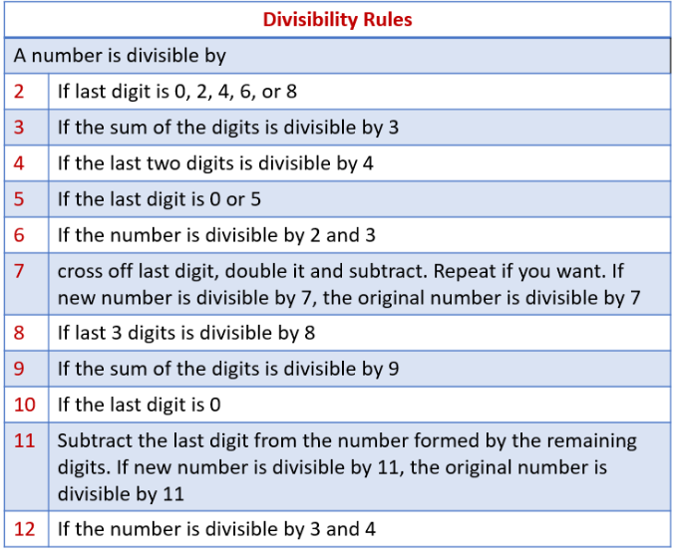
Divisibility tests.

Slide 20
To review watch the video below:
https://www.youtube.com/watch?v=Y1pAKJ4rf-M
Ex. 1F, P. 17
Q1 + 3 + 4 + 5

Slide 21
Square numbers and square roots
To square a number you multiply it by itself.
For example:
4 x 4 = 4² = 16
5 x 5 = 5² = 25
8 x 8 = 8² = 64
12 x 12 = 12² = 144
4² is read as “four squared”

Slide 22
Square root.
The inverse of the square of a number is called its square root.
For example:
6 square 36
6 square root 36
Ex. 1G, P. 18
Q1 + 2 + 4 + 5

Slide 23
Cube number.
A cube number is the result when a number has been multiplied by itself three times. The symbol for cubed is ³. For example, 8 is a cube number because it's 2 x 2 x 2 (2 multiplied by itself twice).
For example:
3³ = 3x3x3 = 27
Cube root.
The cube root is the reverse of the cube of a number and is denoted by ∛. For example, ∛216, that is, the cube root of 216 = 6 because when 6 is multiplied by itself three times ....

Slide 24
Ex. 1I, P. 21
Q1 + 6
Ex. 1, P. 22
Q1 + 2 + 3 + 4 + 8 + 9 + 11 (a, c, d, e) + 16 + 17 + 19 + 20

Slide 25
The End ☺

