Slide 1
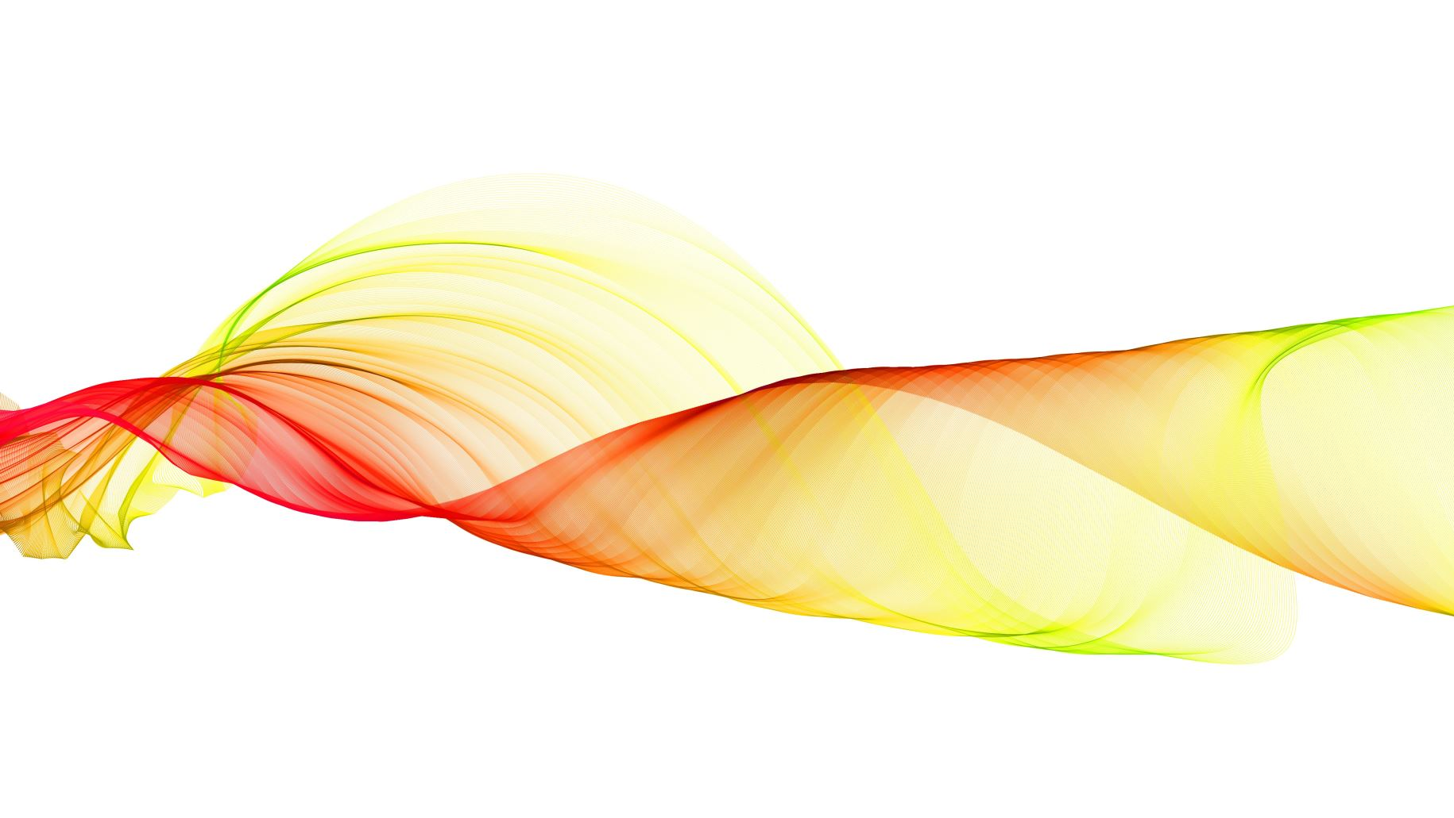
Energy transfer and the Law of Conservation of Energy

Slide 2
Remember:
Energy is the ability to do work. It is what makes matter move or change.
The unit of energy:
The unit of energy is Joules, and it is often measured in Kilo joules.
1000 Joules = 1 KJ

Slide 3
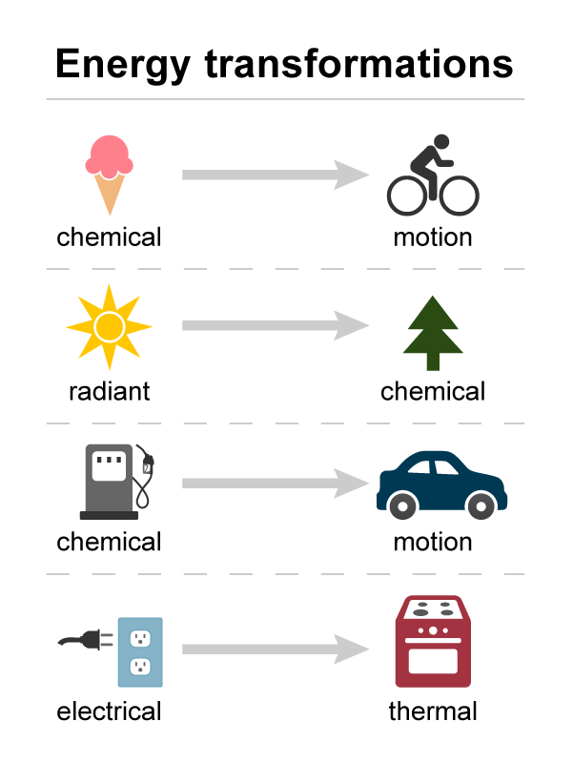
The law of conservation of energy:
Energy can be transformed from one form/ type to another, but it can never be destroyed or created.

Slide 4
The law of conservation of energy
When we talk about conservation of energy we do not necessarily mean saving energy.
Instead we are talking about the law that says Energy is neither created nor destroyed it is only converted from one form of energy to another.

Slide 5
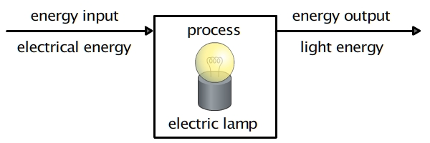
Conservation of Energy Cont.
The total amount of energy always stays the same
Total energy input = total energy output

Slide 6
Conservation of Energy Cont.
Electrical
Energy
Light Energy
Thermal
Energy
But we all know that light bulbs get hot when we use them for a longer period.
That means that the electrical energy is not only converting to light but also to thermal energy.

Slide 7
Useful energy and dissipated (wasted) energy
Electrical
Energy
Light Energy
Thermal
Energy
Using the previous example we can see that the light energy is the useful energy since that is what the purpose of a light bulb.
And the thermal energy is the wasted energy because we don’t want the light bulb to give heat instead of light.

Slide 8
If we take the TV for example the energy diagram for it would be:
The useful energy would be:
  Light Energy
  Sound Energy
The wasted energy would be:
  Thermal Energy
Electrical
Energy
Light Energy
Sound
Energy
Thermal
Energy

Slide 9
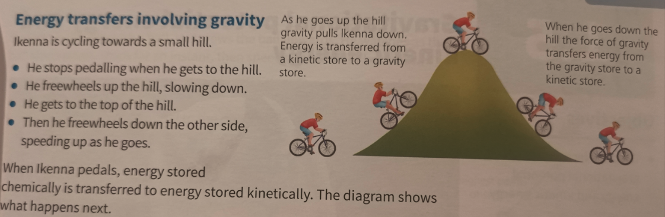
As he goes up the hill gravity pulls him down. Energy is transferred from a kinetic energy to gravitational energy .
When he goes down the hill. Energy is transferred from a gravitational energy to kinetic energy .
When he pedals ,the chemical energy is transferred to kinetic energy .

