Slide 3
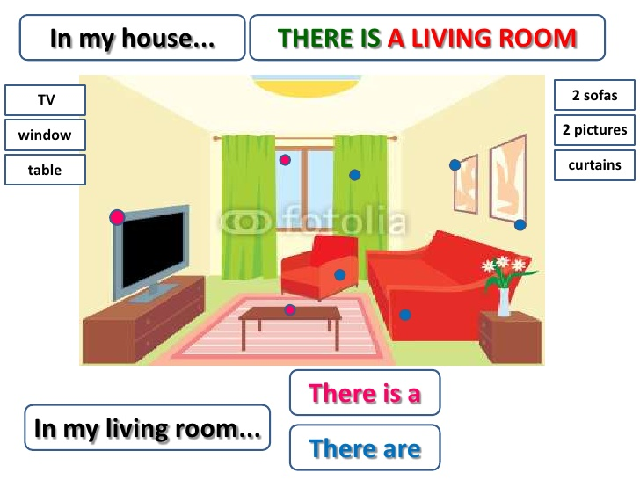

Slide 4
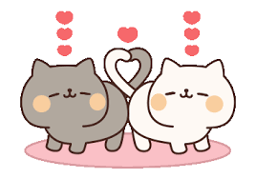
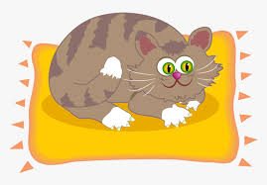
There is
There are
Singular noun
Plural nouns
There is a cat on a mat.
There are two cats on a mat.

Slide 5
To say something exist or doesn’t exist.

Slide 6
* ……….….. a ball. * …………. four flowers. * …………….….. three yellow dogs. * ………………… a black spider. * an elephant in the picture.
**Complete the sentences with There is / There are
There is
There are
There are
There is
There is

