Slide 1
Ratio and proportion
Chapter 12

Slide 2
Objectives:
Learn how to Use different units of measurements in ratios
Learn how to Simplify ratios.
Understand the relationship between ratio and proportion.
Learn how to use equivalent ratios.
Learn how to share in a given ratio.

Slide 3
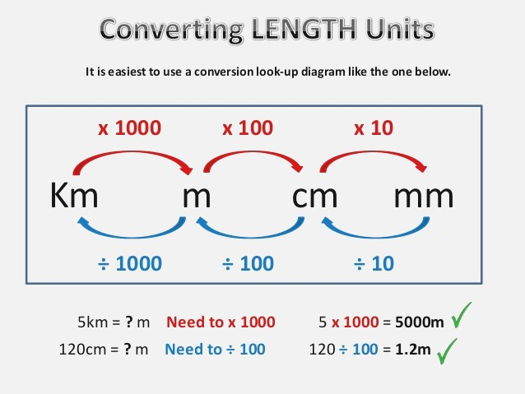
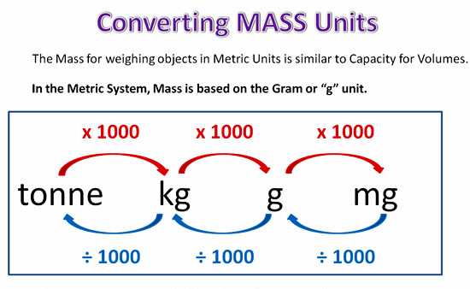
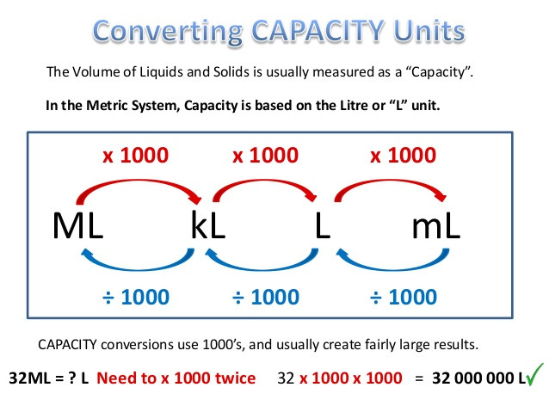
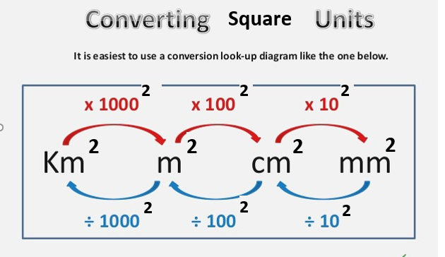
Converting units (Metric system)

Slide 4

  2350
  87
  7
  120
  400
  13000
  0.546
  56,000,000,000
  9.4
Examples:
  2.35 km = _____________________ m
  87000 ml = ____________________ litres
  420 minutes = _________________ hours
  5 days = ______________________ hours
  0.4 tonnes = ___________________ kg
  1.3 m² = _______________________ cm²
  546000 mm² = _________________ m²
  56 km³ = ______________________ m³
  9400000000mm³ = _________________ m³
Solve P. 185 Ex.12A:
Q1(a,b,c,f)Q3 (All)

Slide 5
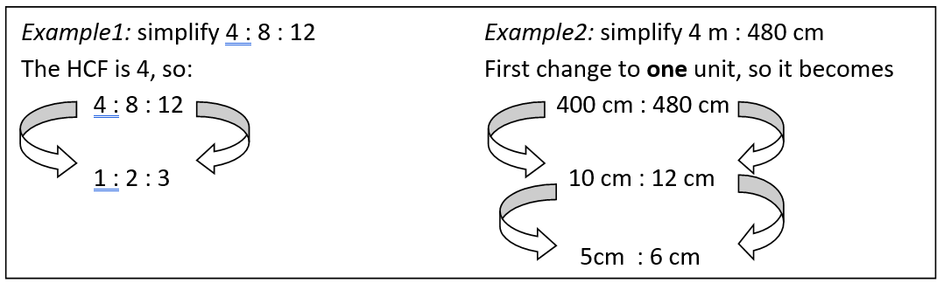
Simplifying ratios
Ratios are simplified the same way fractions are, by dividing them by a common factor to reach the simplest form, or better yet, by dividing them by the highest common factor for less division steps. If units are included in the ratios, make sure you convert to one unit before simplifying.
RATIO & EQUIVALENT RATIOS | GRADE 6 - YouTube
GCSE Maths - What are Ratios & How to Simplify Them (Part 1) #81 - YouTube

Slide 6

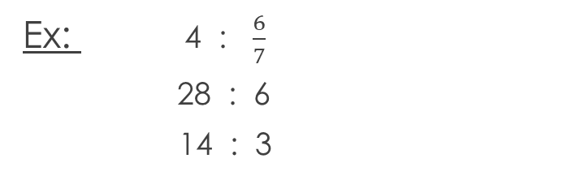

Note: ratios in the simplest form should always be whole numbers (no decimals, no fractions). So you should think of the best way to change the numbers into whole ones.
To get rid of the denominator in the fraction, you should multiply the ratio by 7. Then you can simplify.
Ex: 4 : $\frac{6}{7}$
28 : 6
14 : 3
Ex: 1.3 : $\frac{1}{5}$
13 : 2
Ex: $\frac{1}{3}$ : $\frac{2}{7} : \frac{3}{4}$
1 : $\frac{6}{7}$ : $\frac{9}{4}$
7 : 6 : $\frac{63}{4}$
28 : 24 : 63
Simplifying Ratios Decimals - YouTube
Simplifying ratios involving fractions - YouTube

Slide 7
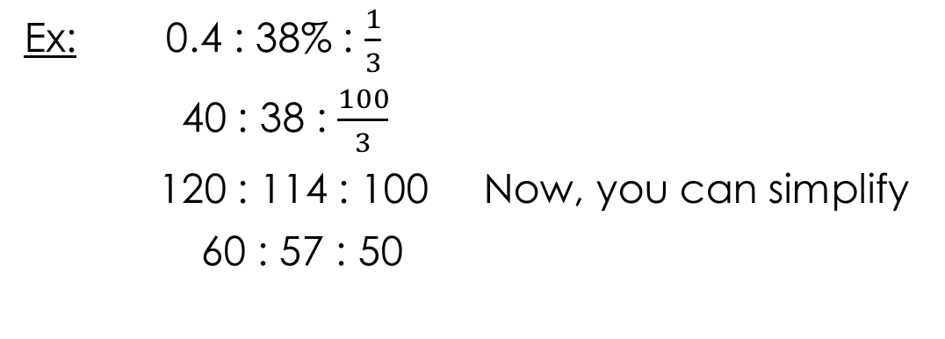
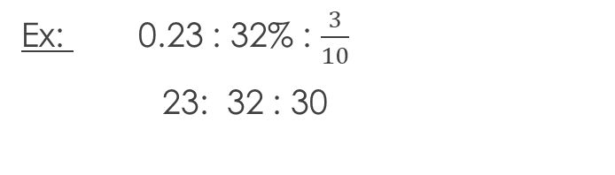
Solve P. 186 Ex.12B:
Q1(f, g), Q2(b),Q3, Q5, 6(a,b,c),Q7(a,c,e)
Solve P. 187 Ex.12C:
Q1, Q2(b), Q3(e,f,g,h), Q4(a,b,d), Q5, Q6(b,c)
More examples:
If you look at the numbers, you can tell that they can all be multiplied by 100 so that they ALL become whole.
Ex: 0.23 : 32% : $\frac{3}{10}$
23: 32 : 30
Ex: 0.4 : 38% : $\frac{1}{3}$
40 : 38 : $\frac{100}{3}$
120 : 114 : 100 Now, you can simplify
60 : 57 : 50
If you look at the numbers, you can tell that you can get rid of the decimal and percentage by multiplying them by 100. When you’re left with a denominator of 3 then it makes sense to multiply all numbers by 3. Remember, what you do to one number, you have to do the same to the rest of the numbers.

Slide 8
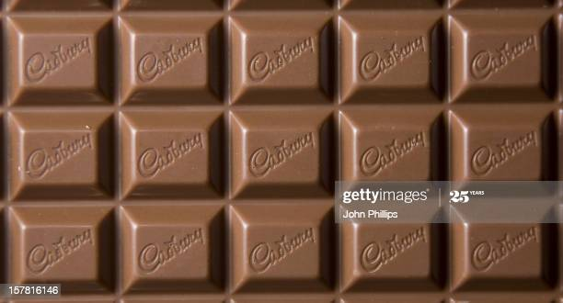
Dividing a quantity in a given ratio
EXAMPLE: You have a chocolate bar. The bar has a total of 15 squares in it. you want to share it between you and your friend in the ratio of 2 : 3. How many squares will each of you get?
So, from the ratio you can conclude that you took less than your friend.
Basically it means that for every two pieces that you take, you give your friend three pieces until you run out of square chocolates.
But that will take too long if the quantity given is a big number.
https://www.youtube.com/watch?v=1htzC_LMBoA

Slide 9
EXAMPLE : You have a chocolate bar. The bar has a total of 15 squares in it. you want to share it between you and your friend in the ratio of 2 : 3. How many squares will each of you get?
Instead, you can follow the below steps to find how much each of you get:
  Find out how many equal parts you should divide the chocolate bar into. You do this by adding the numbers in the ratio, so 2 + 3 = 5 parts.
  Now lets see how many squares each part will have. Since you have 15 squares, then 15 ÷ 5 = 3 squares.
  Since the ratio is 2 : 3, you get 2 parts (which includes 2 x 3 = 6 squares), and your friend has 3 parts (which includes 3 x 3 = 9 squares).
  To make sure your answer is correct, add your chocolate squares (which is 6) and your friend/s chocolate squares (which is 9), and the sum should be 15 as shown in the picture ☺

Slide 10
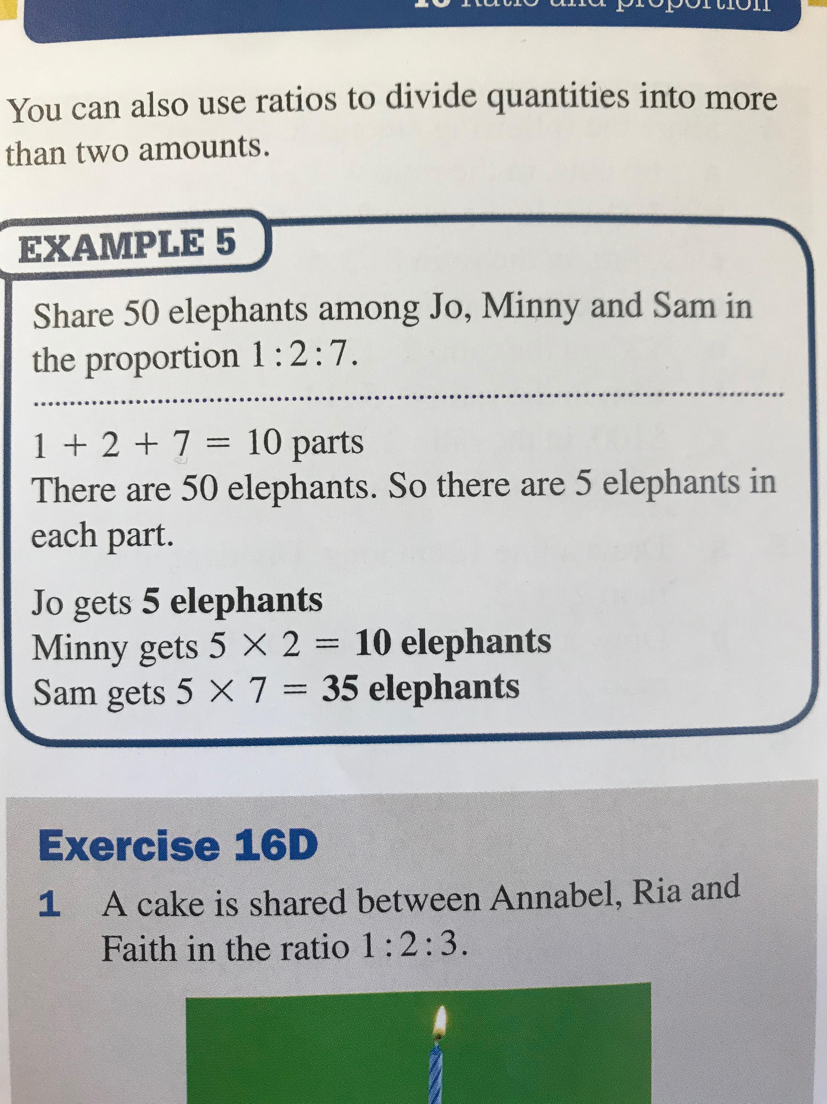
Solve P. 188 Ex.12D:
Q1, Q2 (a,c,d,f), Q4, Q5, Q6.
Example:
Add the numbers in the ratio together to find out how many parts the quantity is divided to. (1 + 2 + 7 = 10)
Divide the quantity by the total parts to know how much each part contains. (50 ÷ 10 = 5)
Multiply your answer in step 2 by each number in the ratio. (1x5=5 and 2x5=10 and 7x5=35)
To check your answer, add the answers you get in step 3, they should be the same as the original quantity given in the question. (5 + 10 + 35 = 50)

Slide 11
Proportion
You need to be able to express a ratio as a proportion. Meaning you write the ratio as a fraction of the total. This will also enable you to write it as a percentage.
Watch the video to learn more then solve the questions in the book.
Solve P. 189 Ex.12E:
Q1, Q2, Q3, Q4, Q6
Ratios as Percents - YouTube

Slide 12
End of Chapter 12 ☺

