Slide 1

The Automation Paradox

Slide 2
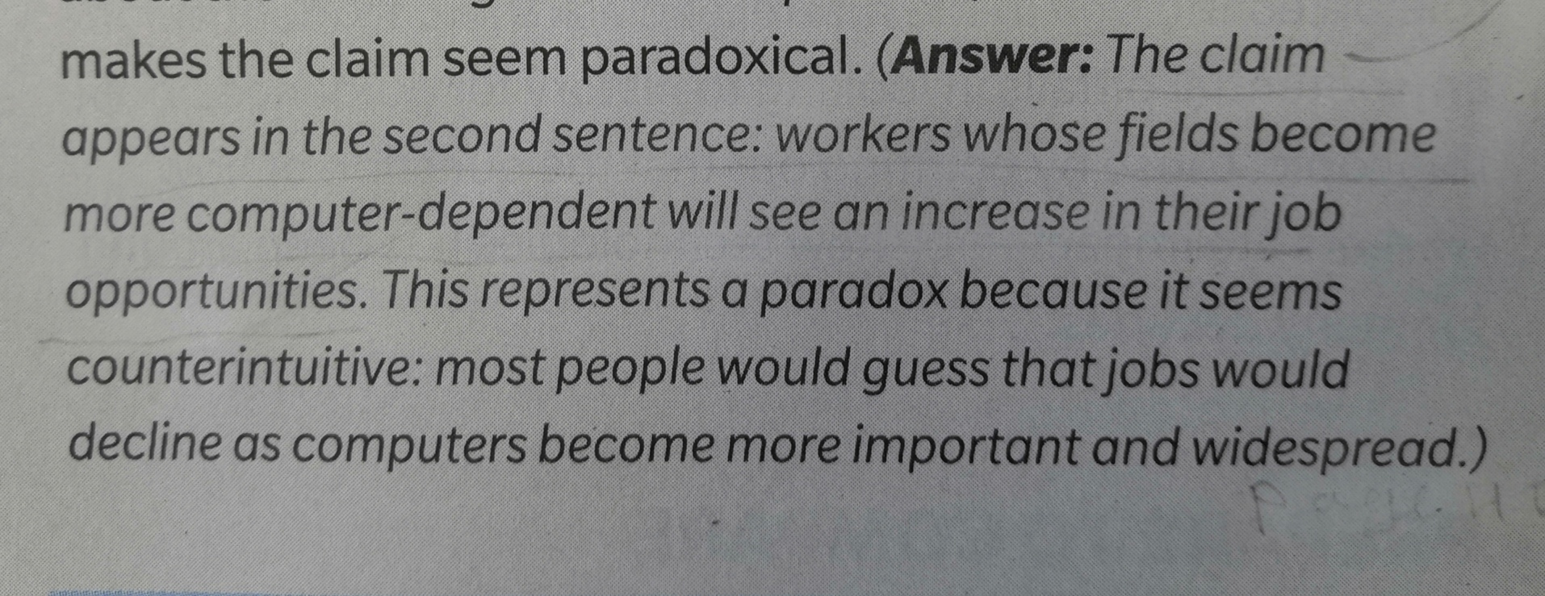
Page 40 Analyze

Slide 3
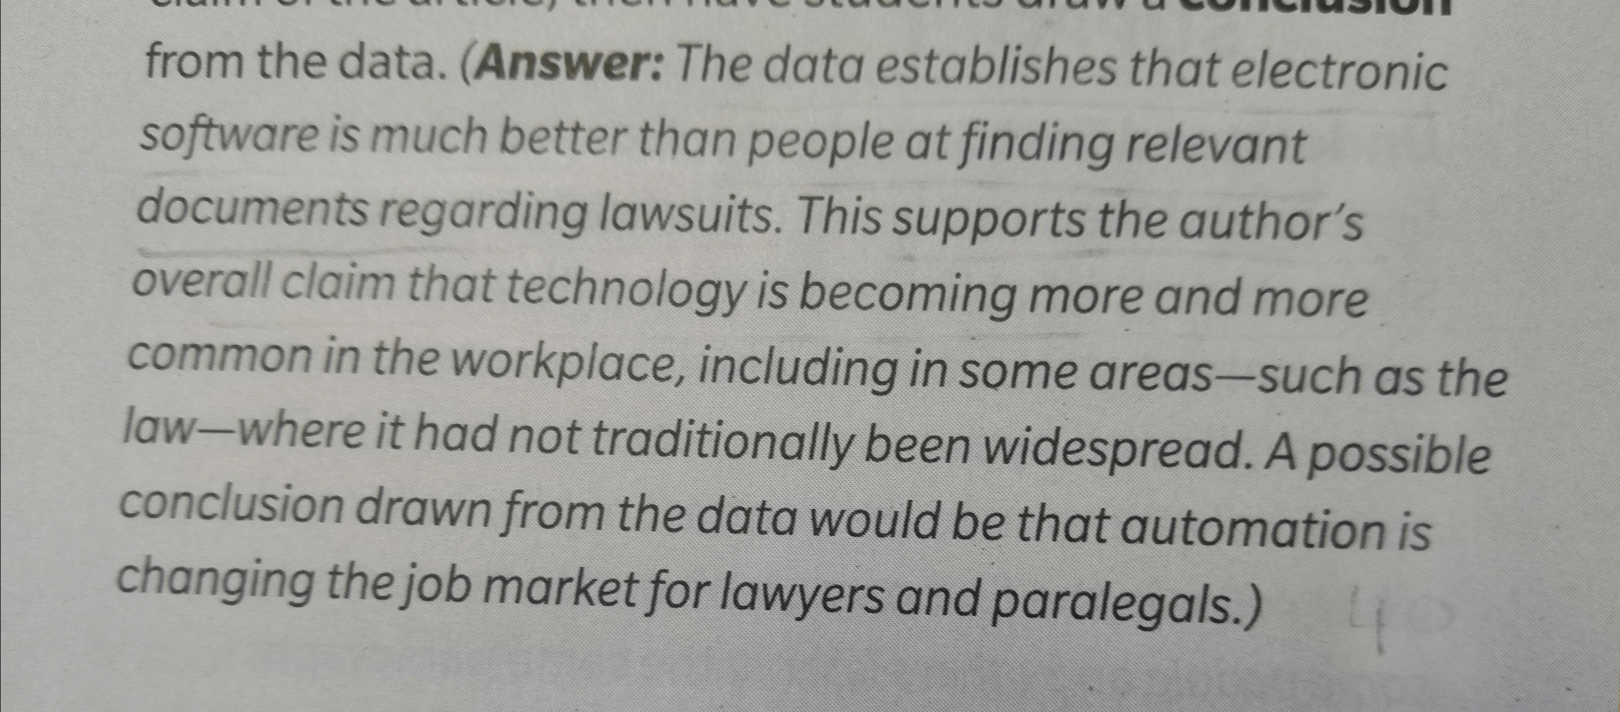
Page 40 Number and Stats

Slide 4
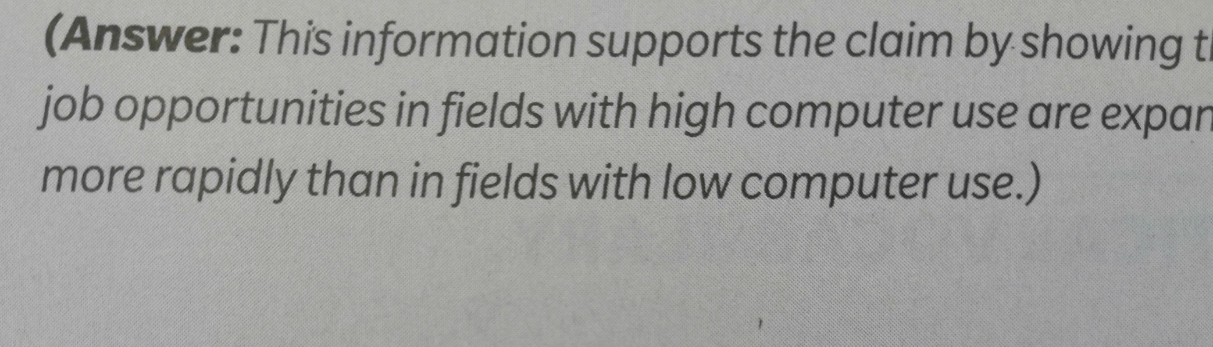
Page 40 Analyze Graphic Features

Slide 5
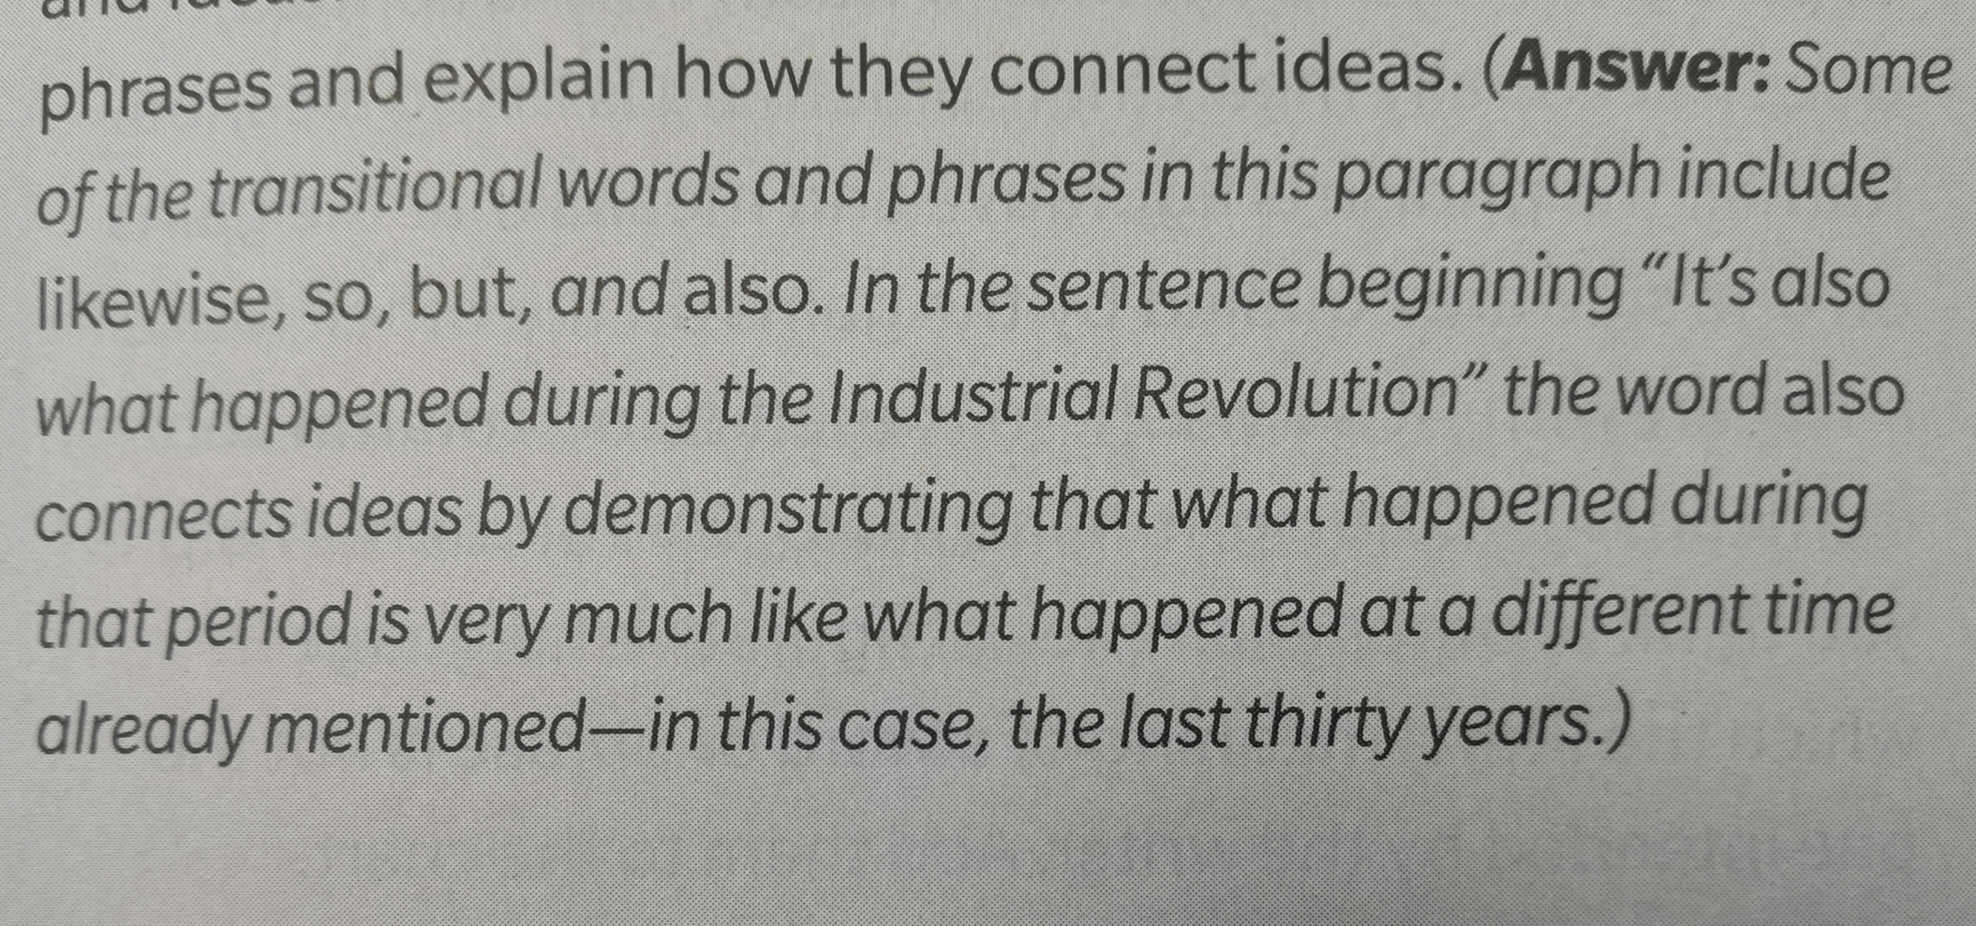
page 41 Language Conventions

Slide 6
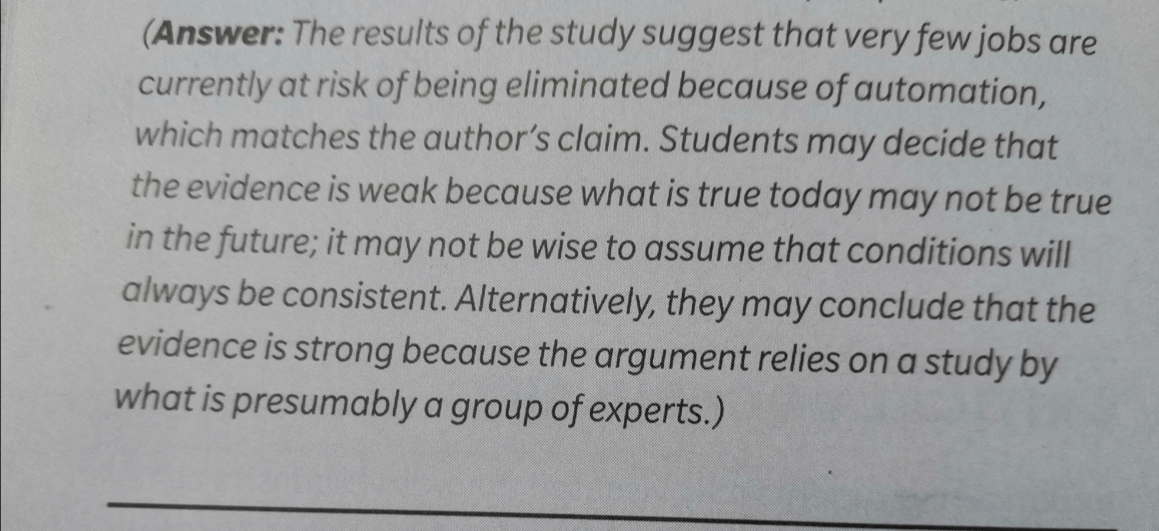
page 42 Numbers and stats

