Slide 1
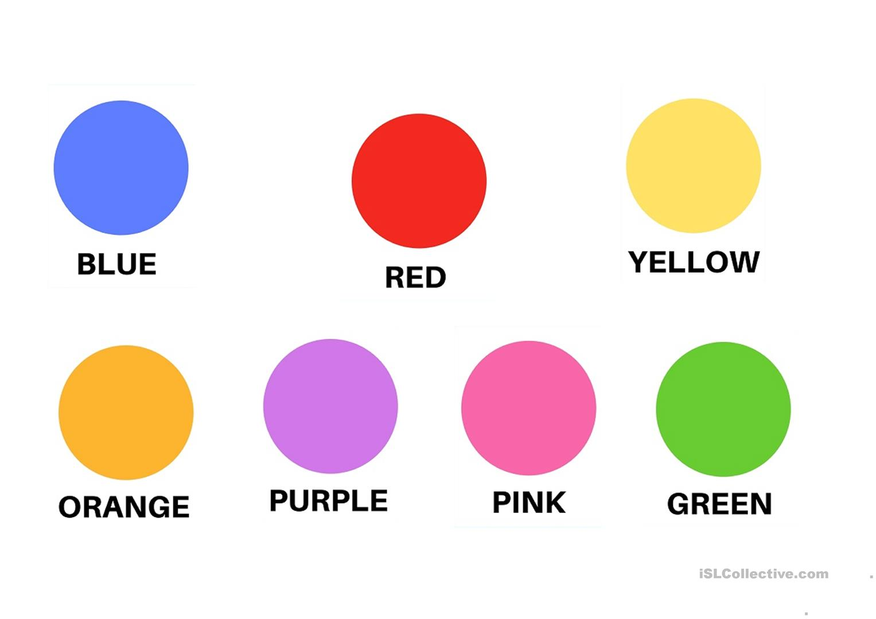
Unit 2 Where can we see colours?

Slide 2
red
*There are six red butterflies, can you see?

Slide 3
green
*There are five green lizards, can you see?

Slide 4
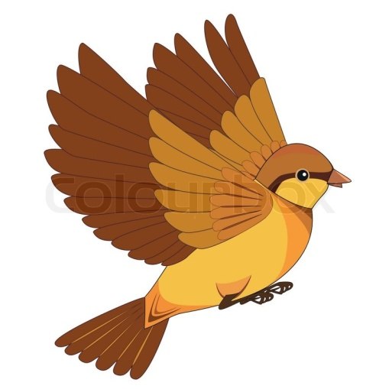
brown
*There are four brown birds, can you see?

Slide 5
purple
*There are three purple cats, can you see?

Slide 6
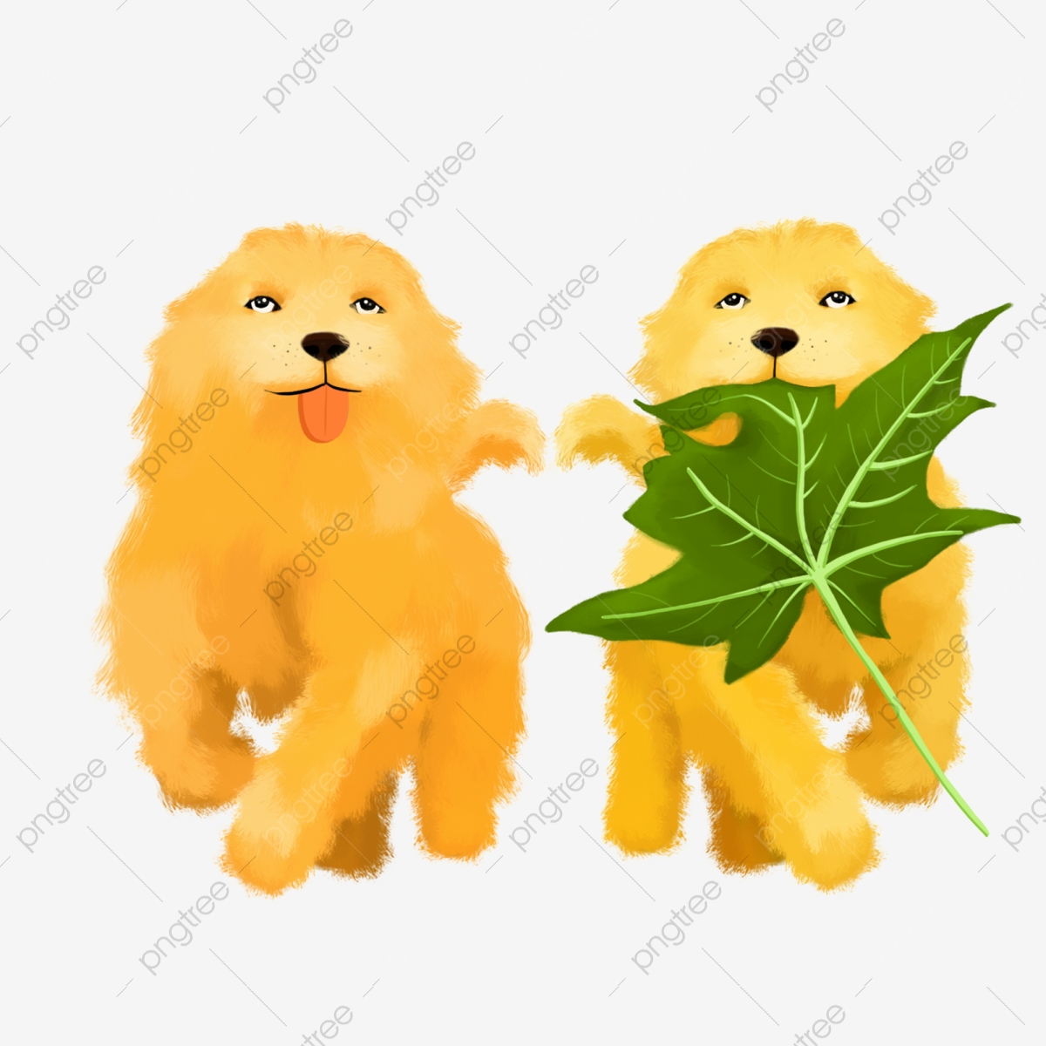
yellow
*There are two yellow dogs, can you see?

Slide 7
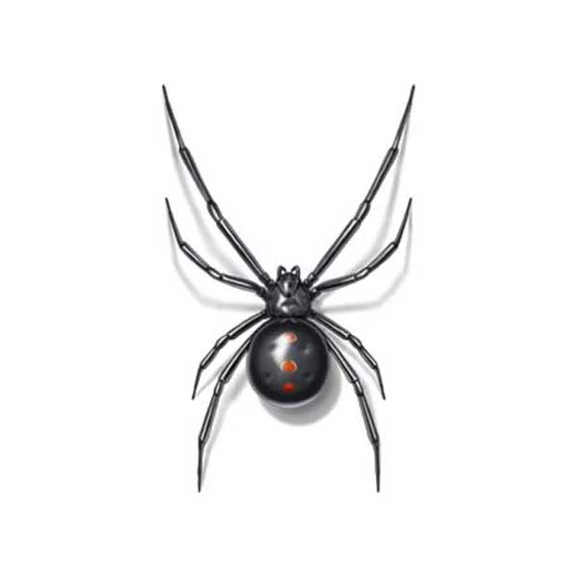
black
*There are four black spiders.

Slide 8
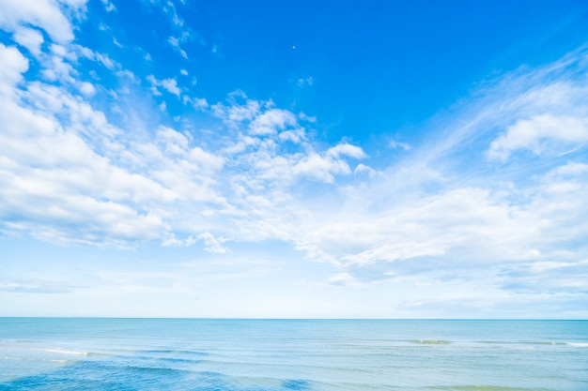
blue
*I like blue, I like the sky.

Slide 9
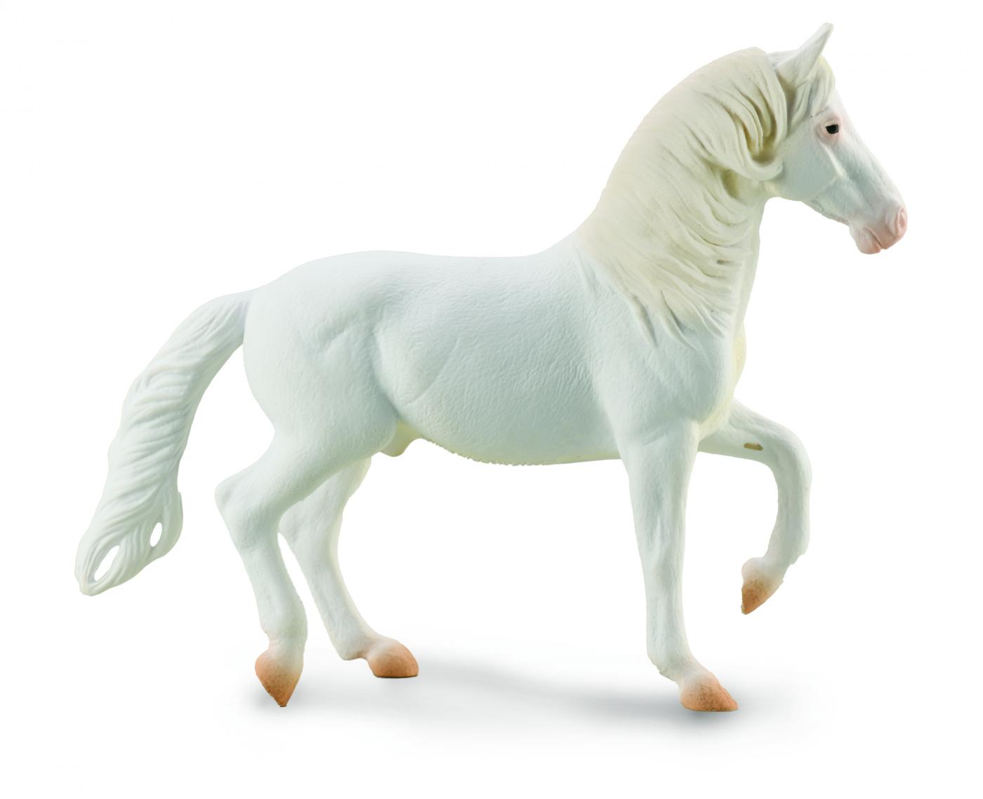
white
*There is a white horse.

Slide 10
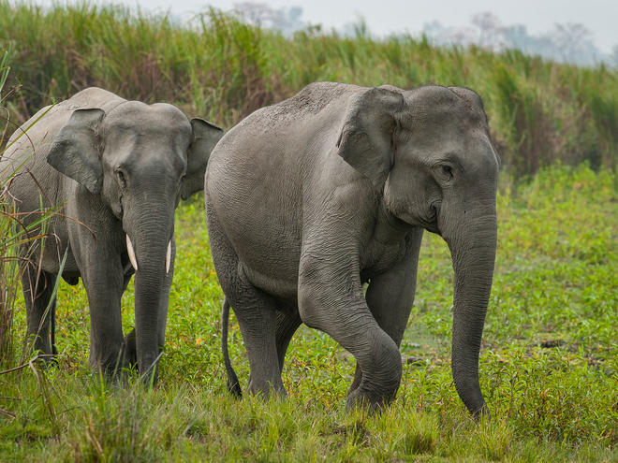
grey
*There are two grey elephants.

Slide 11
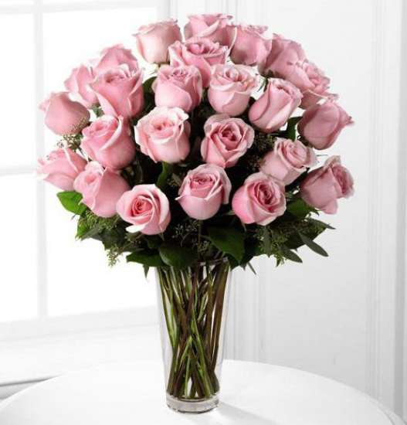
pink
*There are pink flowers in the vase.

Slide 12
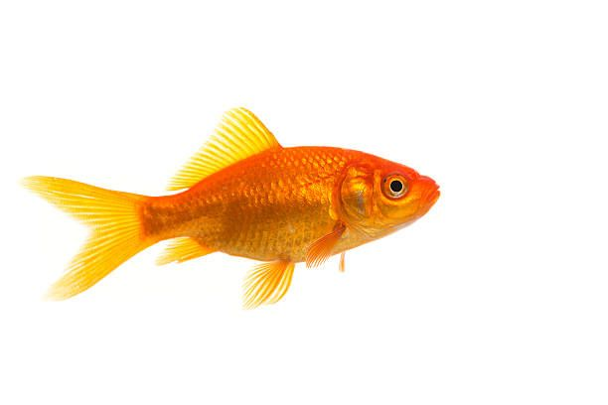
orange
*There is one orange fish.

Slide 13
dark blue light blue

