Slide 1
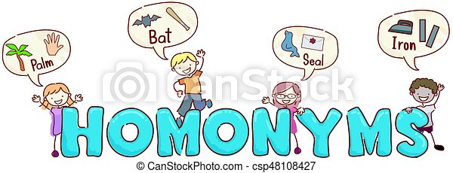
Homonyms Unit 3 page 35

Slide 2
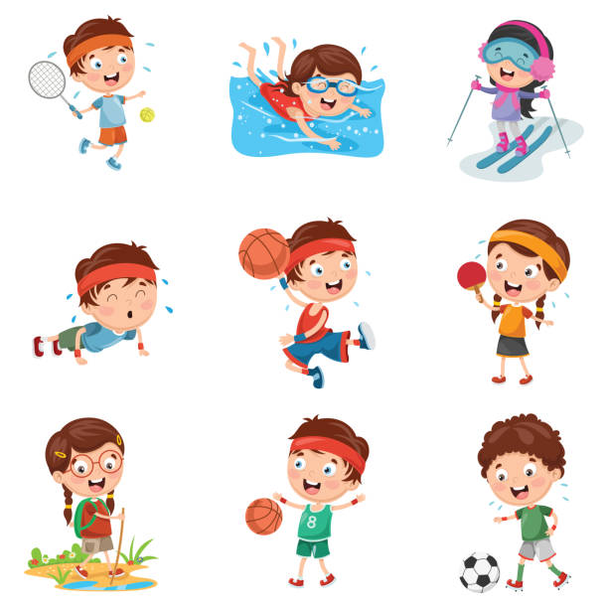
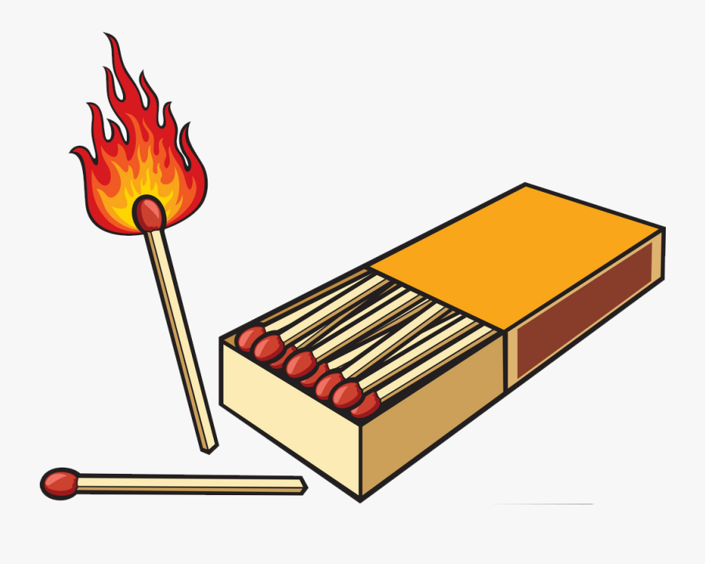
Match
Something you use to make flame.
A sports Contest

Slide 3
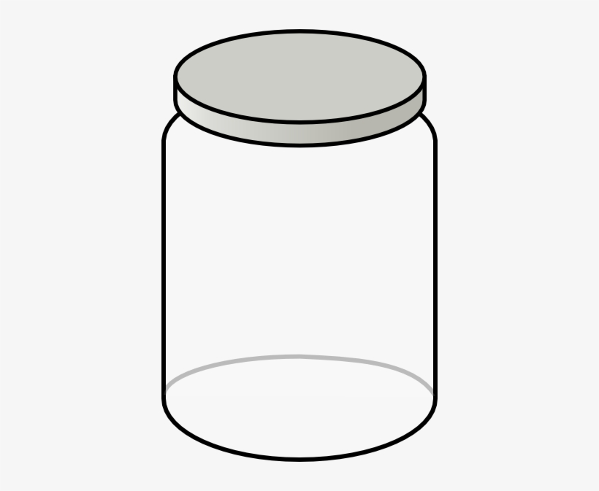
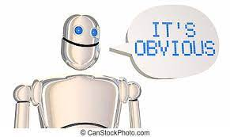
Clear
Empty or free from things
Plain and obvious

Slide 4
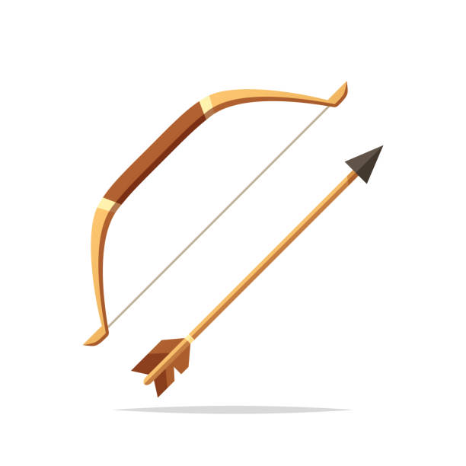
Bow
Something made of wood and string used to shoot an arrow.
A ribbon tied in a special way

Slide 5
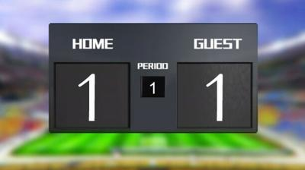
Tie
In sport when teams get same number of points
A piece of clothing men wear around their necks.

