Slide 1
Film Review

Slide 2
A review is a short description of a film, play, book, etc., it’s either formal or informal, depending on the reader it is dressed to.

Slide 3
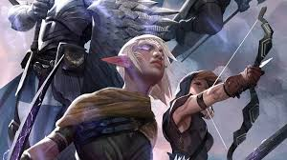
Introduction : in which you give all the information of the story. ( setting, type, characters, etc.

Slide 4
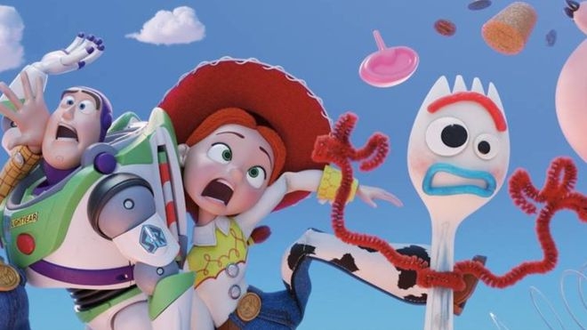
A Main body: consisting of two paragraphs in which all the main points of the plot are presented in time sequence as well as comments on acting , plot, directing.

Slide 5
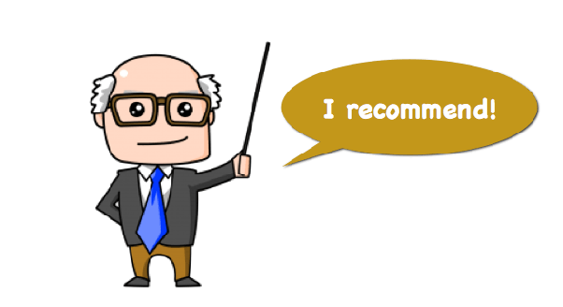
A conclusion: in which the writer recommends or does NOT recommend the film/ book/ performance etc. giving reason.

Slide 6
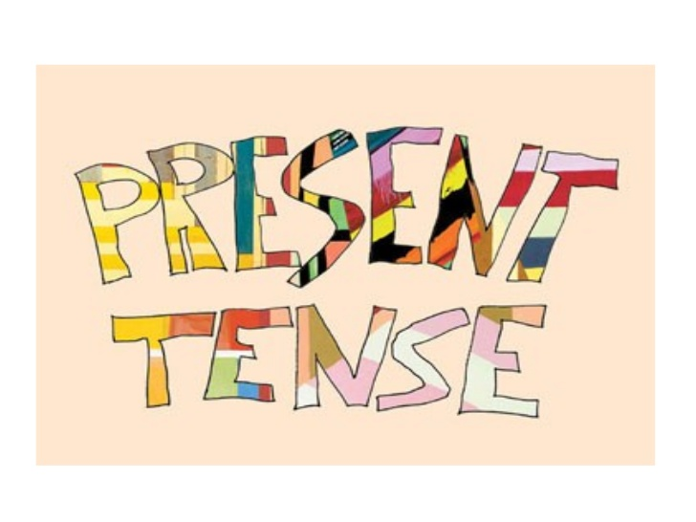
Present tenses are normally used in a review.

Slide 7
Type of Movies

Slide 8
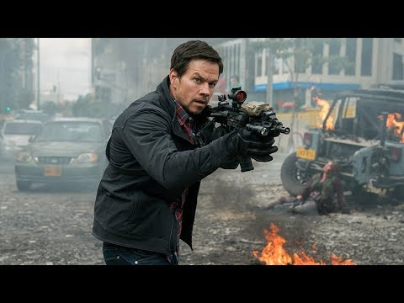
Action

Slide 9
Adventure

Slide 10
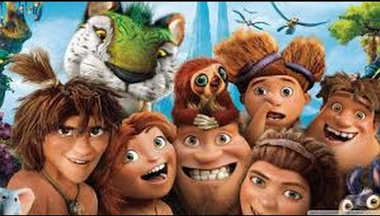
Comedy

Slide 11
Crime

Slide 12
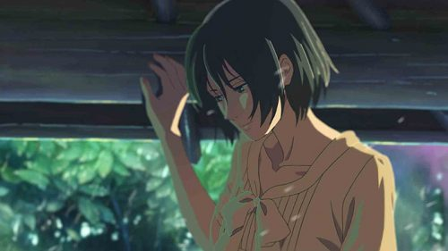
Drama

Slide 13
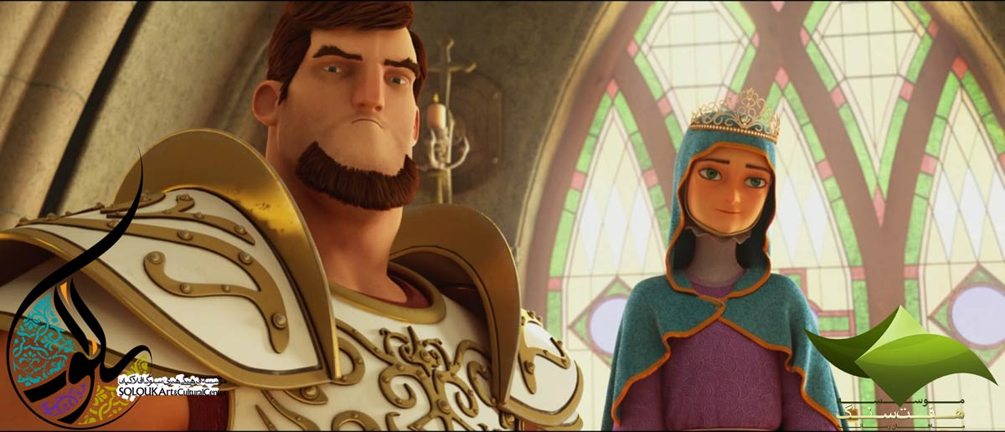
Historical

Slide 14
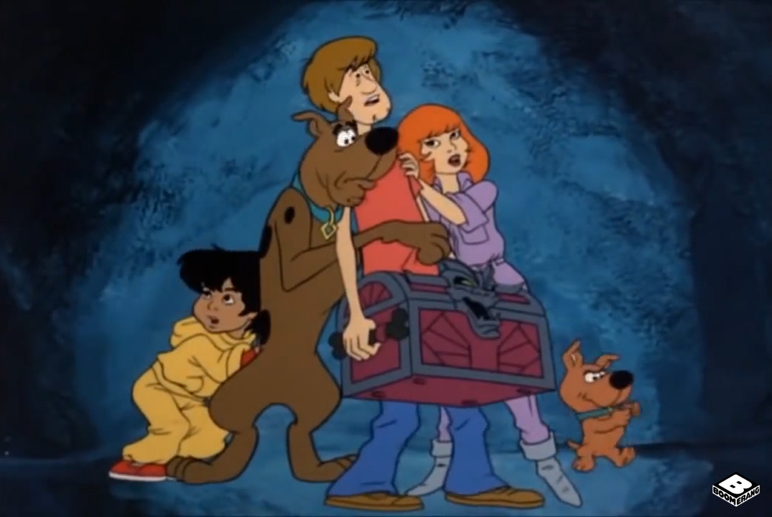
Horror

Slide 15
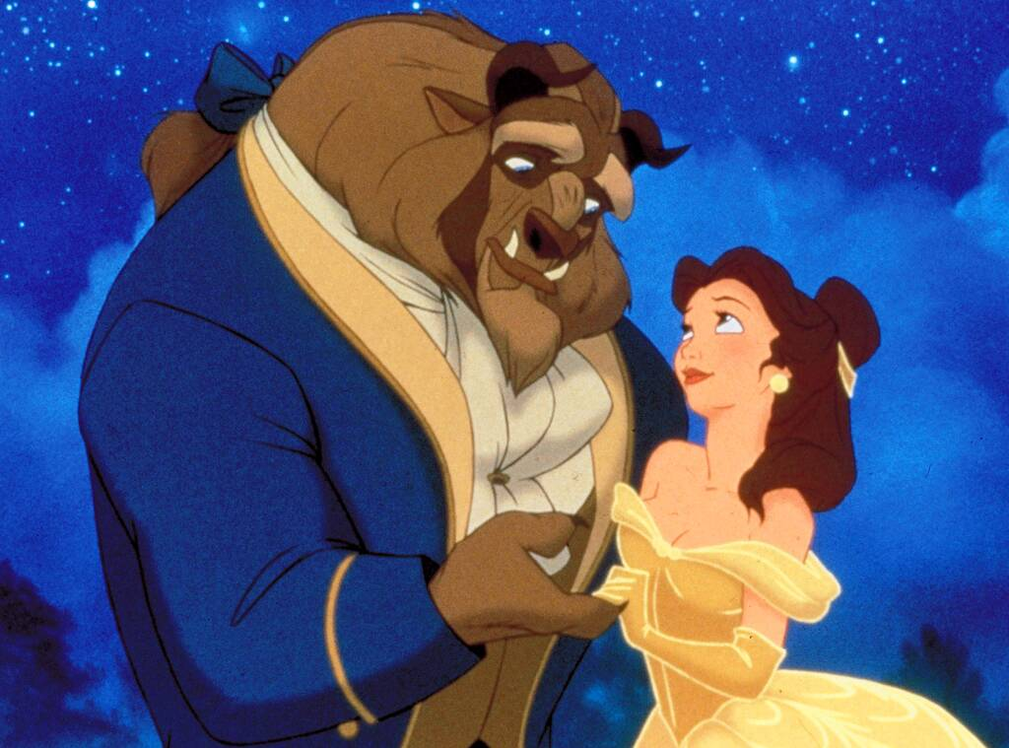
Romance

Slide 16
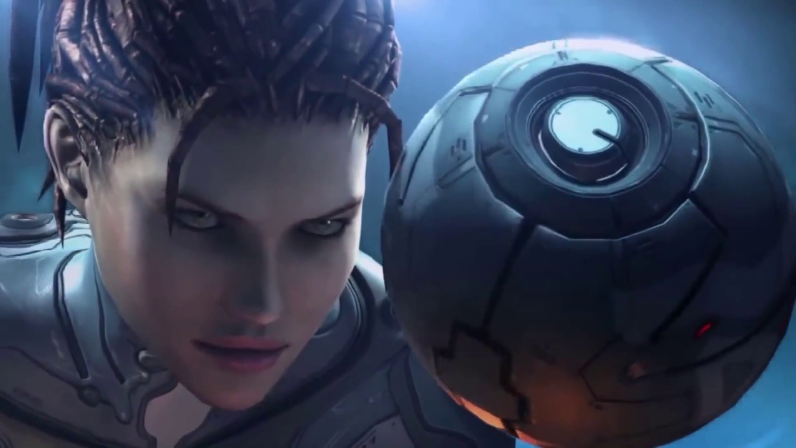
Science Fiction

Slide 17
Thriller

Slide 18
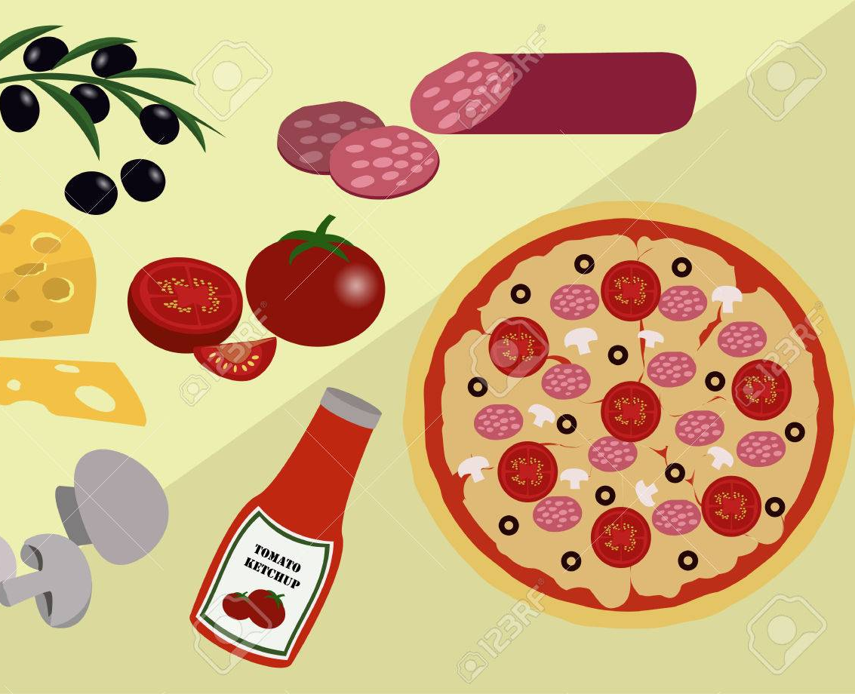
A good review should consist of:

Slide 19
Useful language for reviews

Slide 20
Background: this well written/ the film is set in/ the film tells the story of/ this work is based on…. Etc.

Slide 21
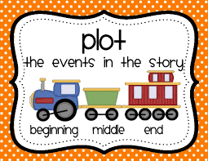
Main points of plot: the plot focuses on/ the story begins/ the film reaches a dramatic climax…. etc.

Slide 22
General comments: it is rather long/ confusing/ slow, the cast is excellent/ weak, the script is dull/ clever, it has a tragic/ surprising end.

Slide 23
Recommendation: Don’t miss it/ it will change the way you see/ it is well worth seeing/ I wouldn’t recommend it

Slide 24
Model : page 106 successful writing Book

Slide 25
