Slide 1
Heartbeat

Slide 2
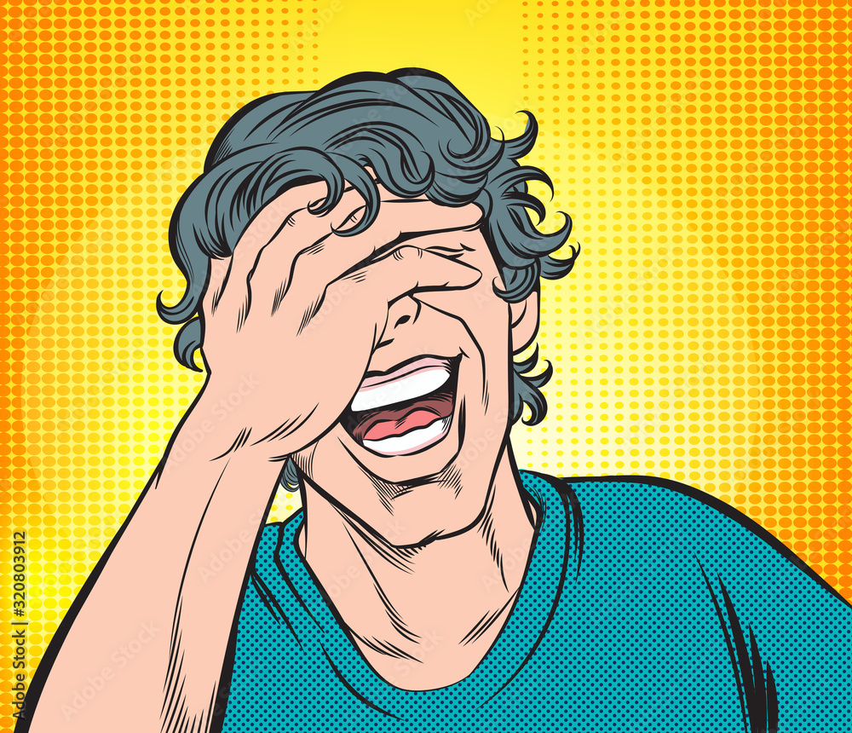
Page 103 Analyze Character

Slide 3
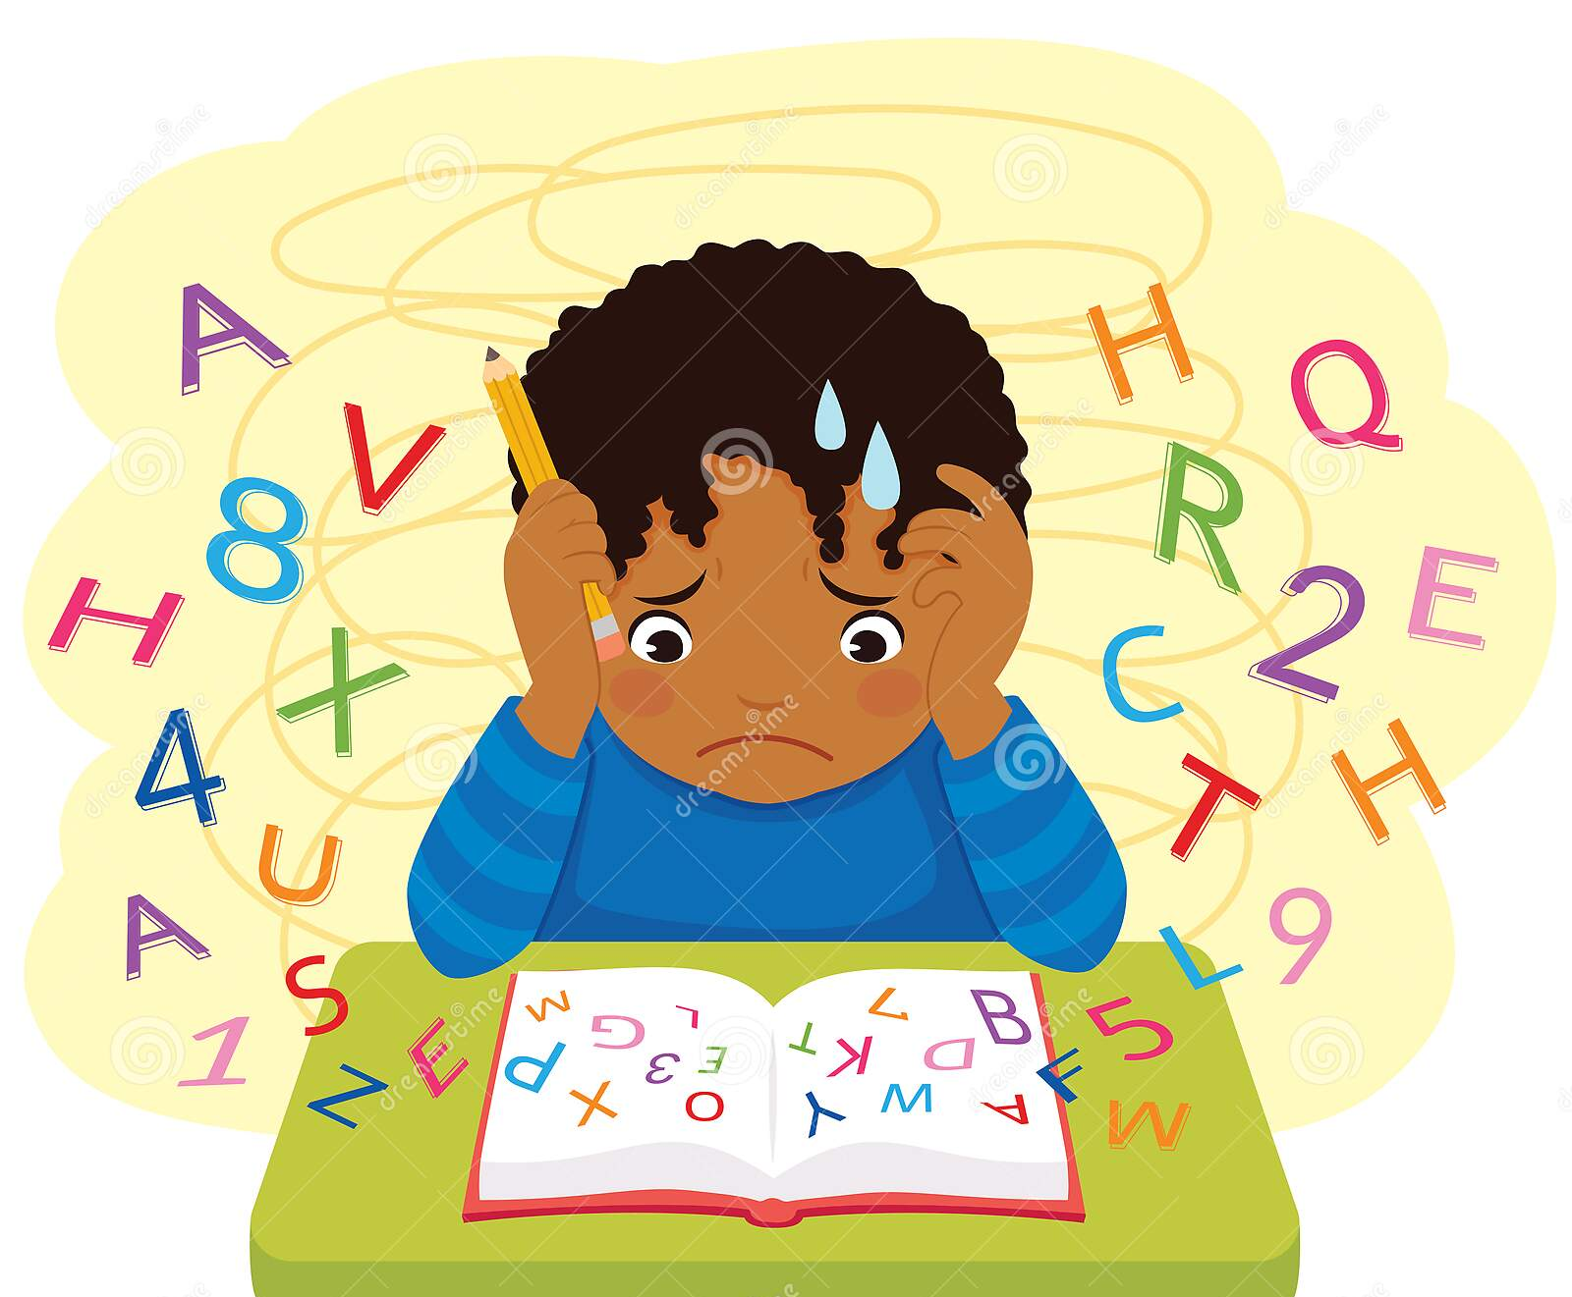
Page 104 Analyze Conflict

Slide 4
Page 105 Again and Again

Slide 5
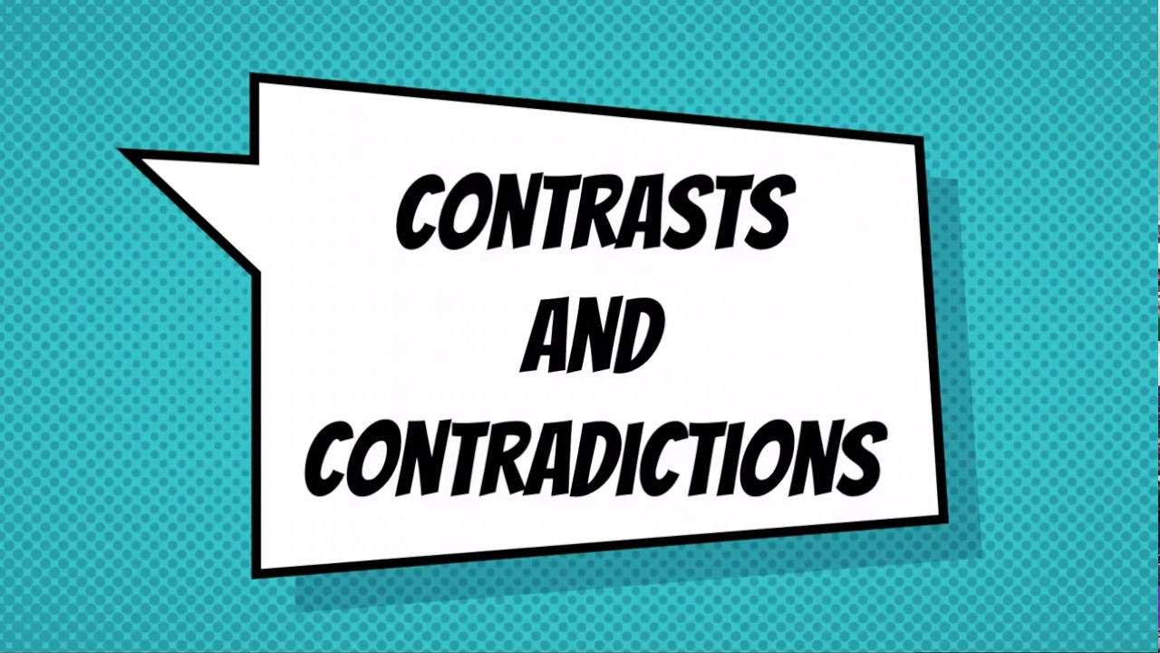
Page 105 Contrast and Contradictions

Slide 6
page 106 Analyze Conflict

Slide 7
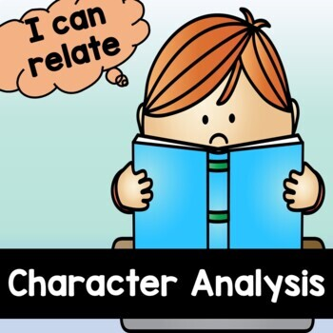
page 107 Analyze Character

