Slide 1
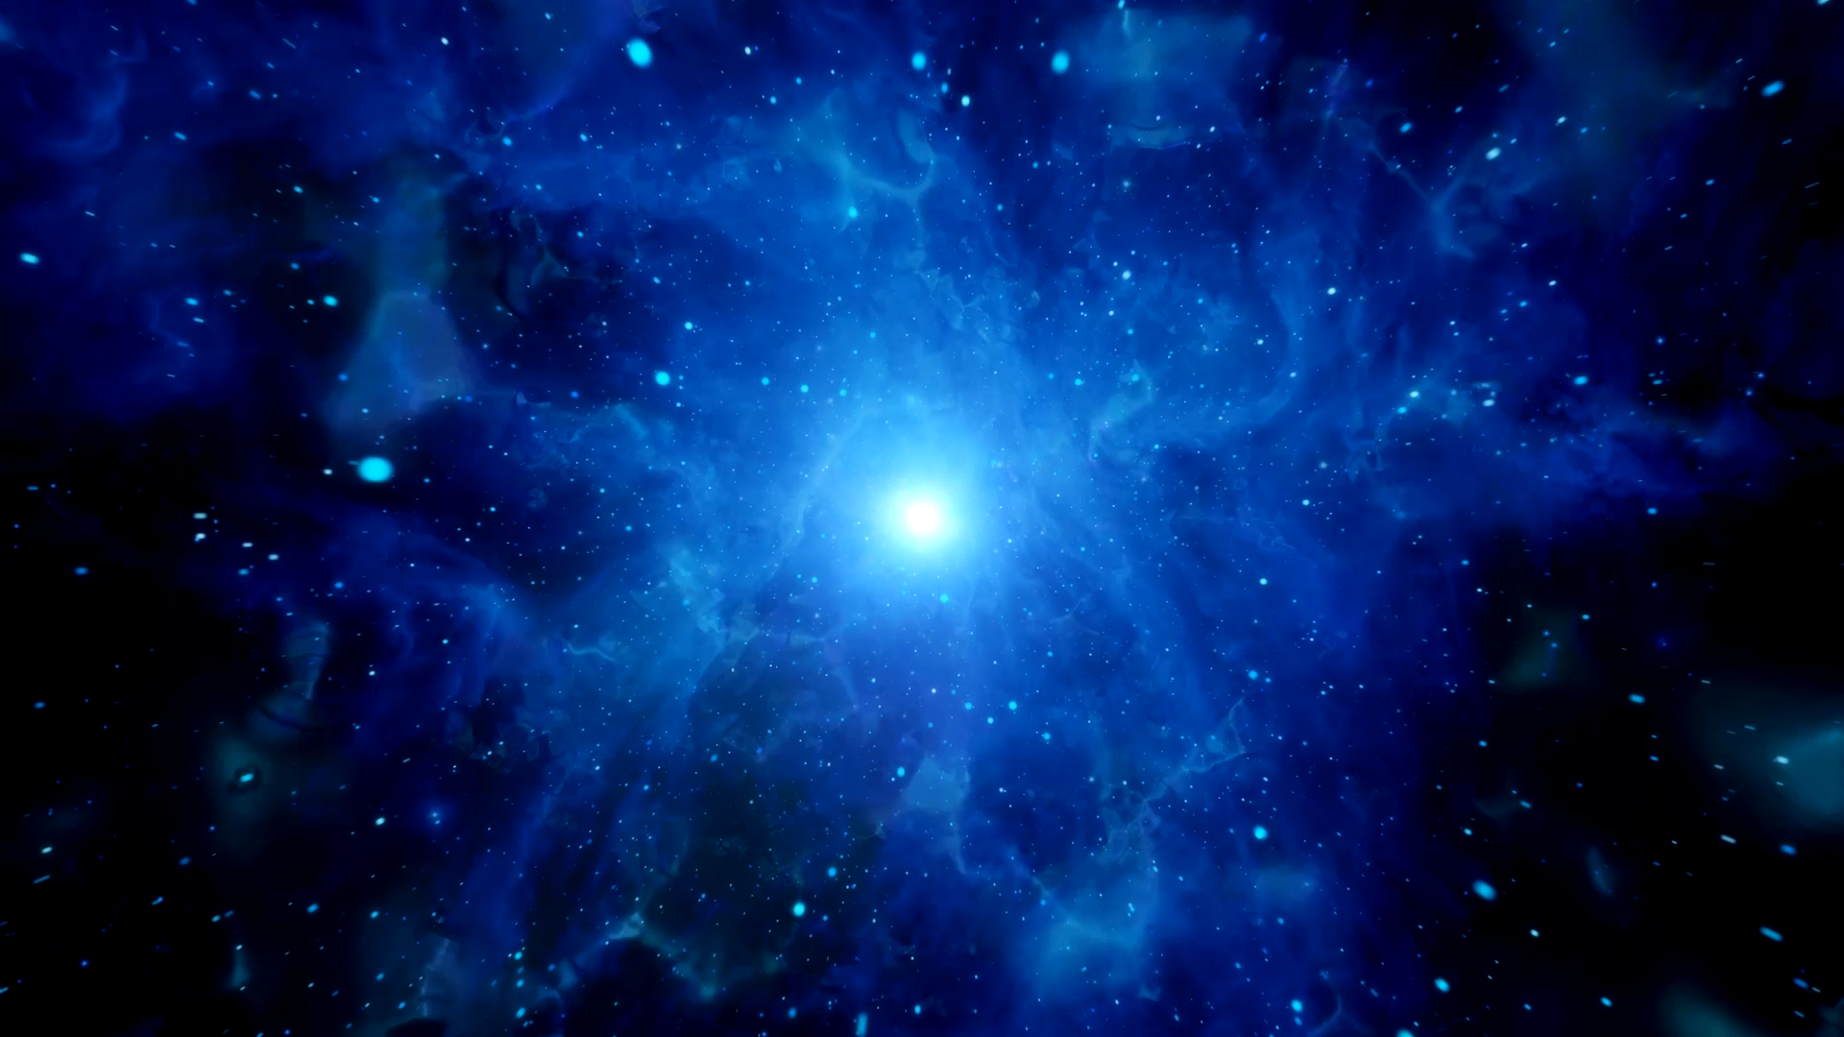
Inside our Planet ?

Slide 2

Answer the questions page 32 Ex. B

Slide 3
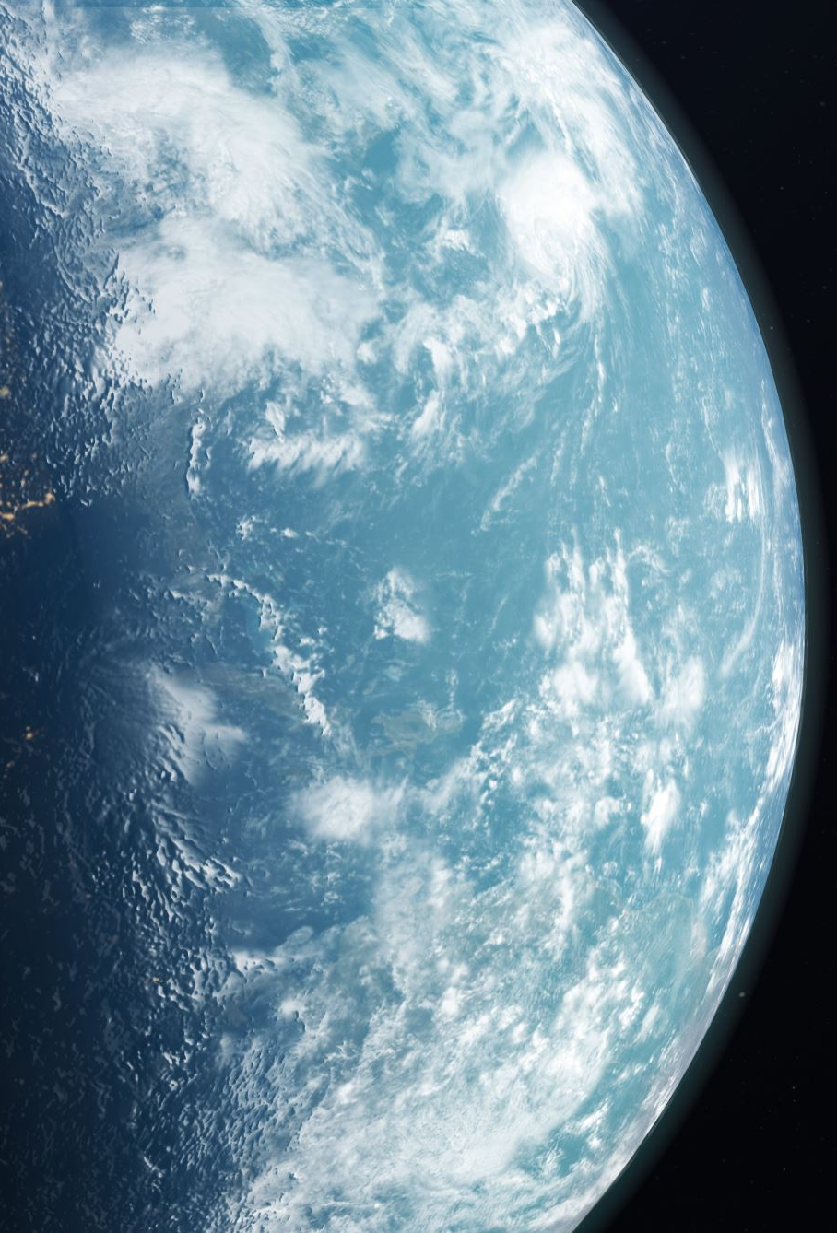
1. The earth has four layers.

Slide 4
2. The inner core is surrounded by the outer core, which is liquid.

Slide 5
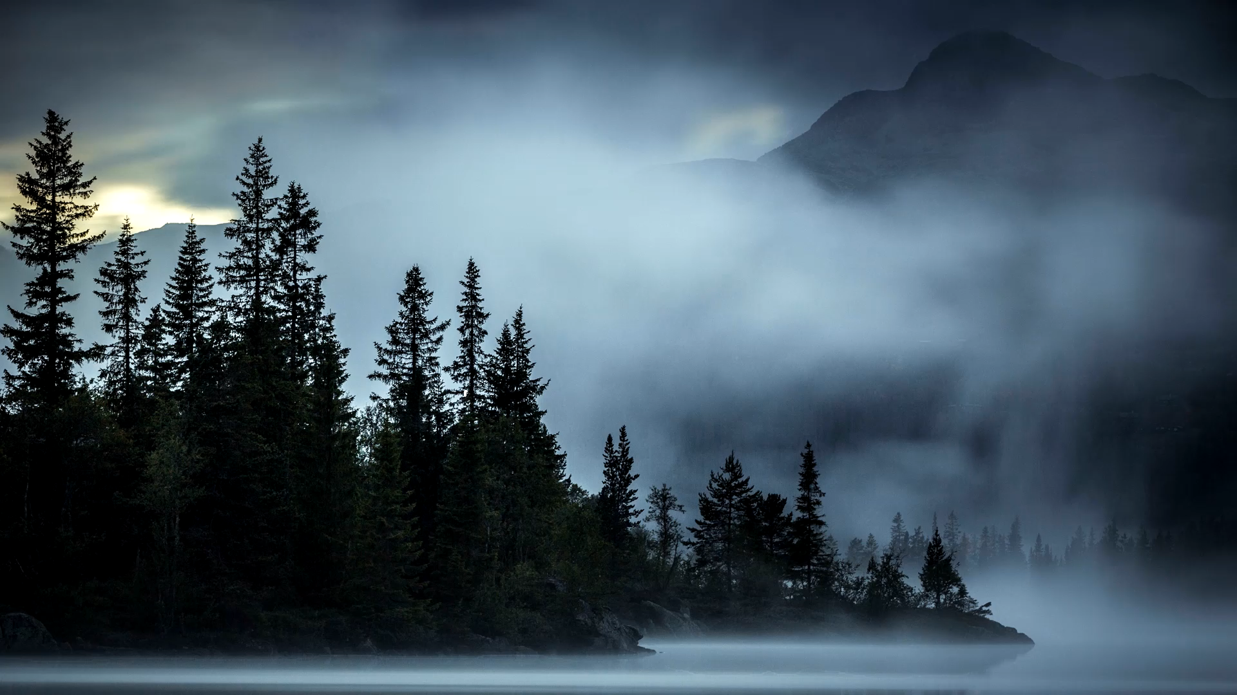
3. Magma collects in pockets called magma chambers.

Slide 6

4. The thickest part of the crust is under the land.

Slide 7
5. Plate tectonic is the movement of plates. As the plates collide, they fold upwards to form mountains

Slide 8
6. The rock cycle is caused by effects on rocks being eroded by weather, worn down by people and animals, and movements in the earth.

