Slide 1
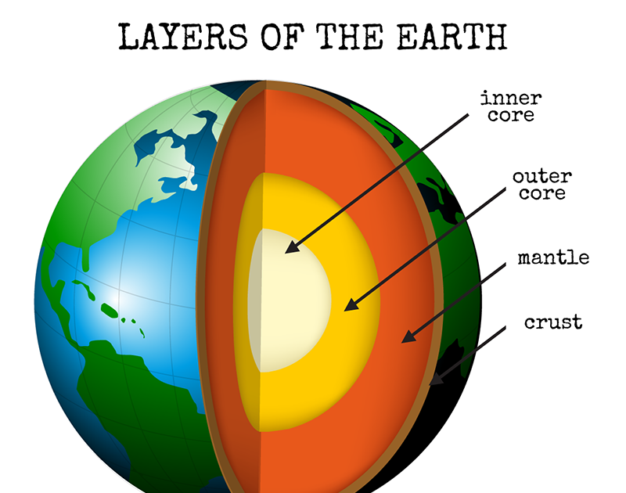
The Earth’s Layers

Slide 2
Layers of the Earth https://www.youtube.com/watch?v=NAHY6965o08
Inside The Layers Of The Earth https://www.youtube.com/watch?v=N9ncfAsmiSg

Slide 3
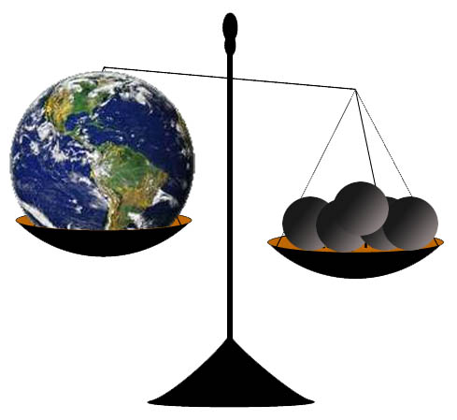
Mass/ crust/ sphere/ comprise/ chamber/ chunk/ geologist/ collide/ pressure/ gradually/ element/ erode/ chemically.

Slide 4

Mass a large quantity, amount, or number.

Slide 5
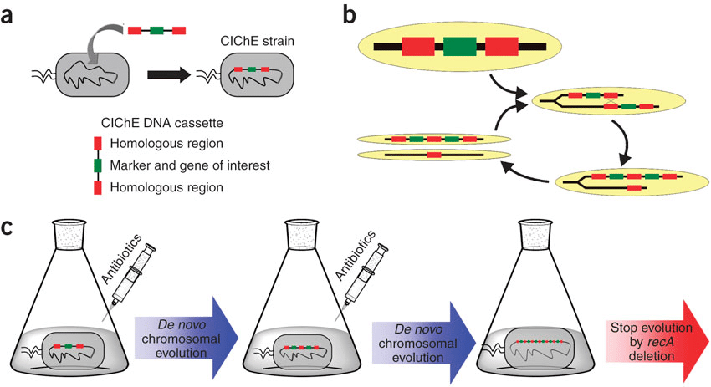
Mass/ crust/ sphere/ comprise/ chamber/ chunk/ geologist/ collide/ pressure/ gradually/ element/ erode/ chemically.

Slide 6
chemically. a substance obtained by a chemical process or producing a chemical effect

Slide 7

Mass/ crust/ sphere/ comprise/ chamber/ chunk/ geologist/ collide/ pressure/ gradually/ element/ erode/ chemically.

Slide 8
Sphere a round solid figure, or its surface, with every point on its surface equidistant from its center.

Slide 9
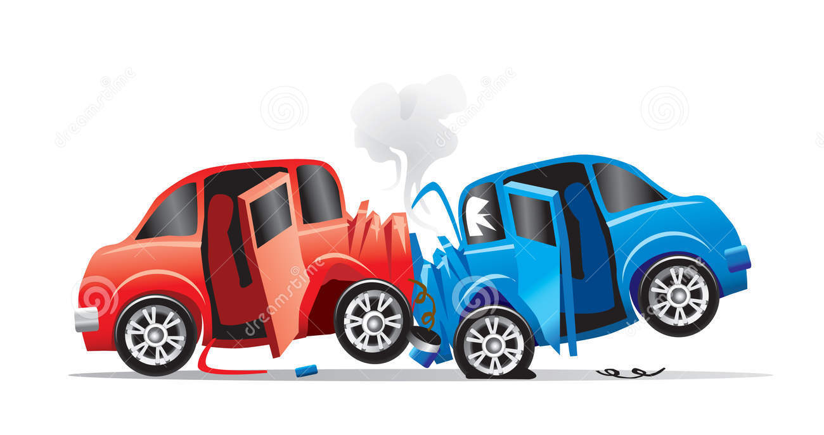
Mass/ crust/ sphere/ comprise/ chamber/ chunk/ geologist/ collide/ pressure/ gradually/ element/ erode/ chemically.

Slide 10
Collide hit with force when moving.

Slide 11
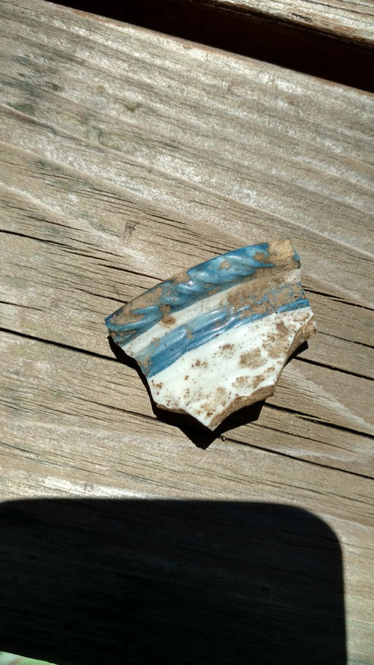
Mass/ crust/ sphere/ comprise/ chamber/ chunk/ geologist/ collide/ pressure/ gradually/ element/ erode/ chemically.

Slide 12
Chunk a thick, solid piece of something.

Slide 13
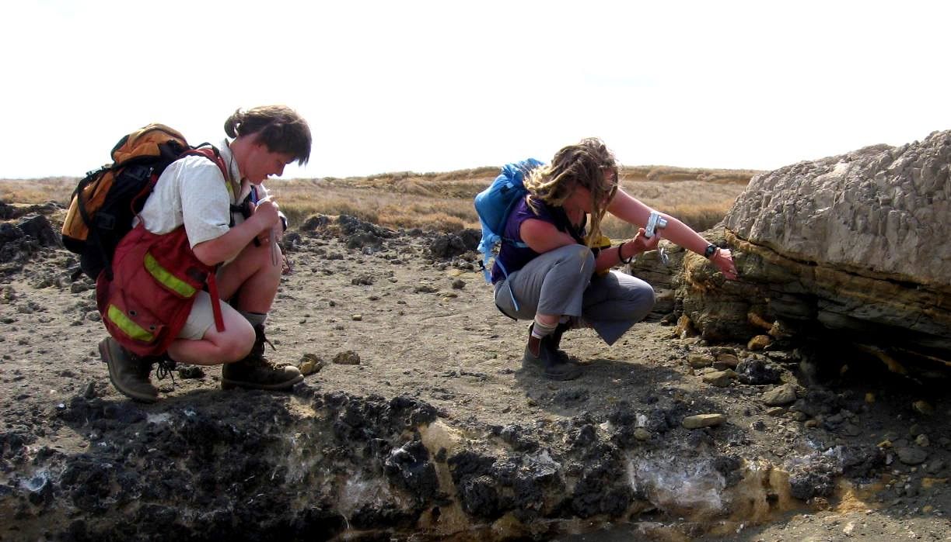
Mass/ crust/ sphere/ comprise/ chamber/ chunk/ geologist/ collide/ pressure/ gradually/ element/ erode/ chemically.

Slide 14
geologist a science that deals with the history of the earth and its life especially as recorded in rocks

Slide 15
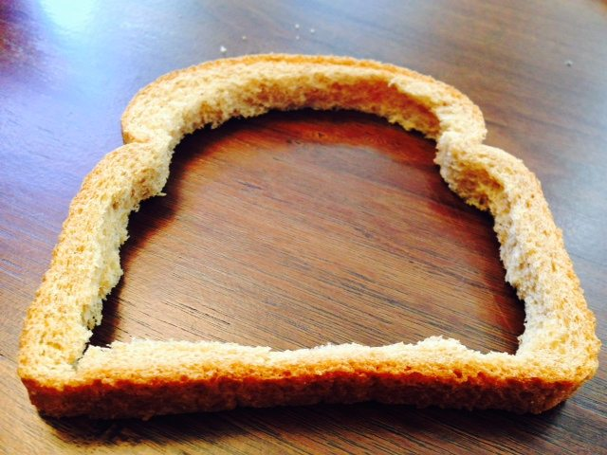
Mass/ crust/ sphere/ comprise/ chamber/ chunk/ geologist/ collide/ pressure/ gradually/ element/ erode/ chemically.

Slide 16
Crust a hard surface layer

Slide 17
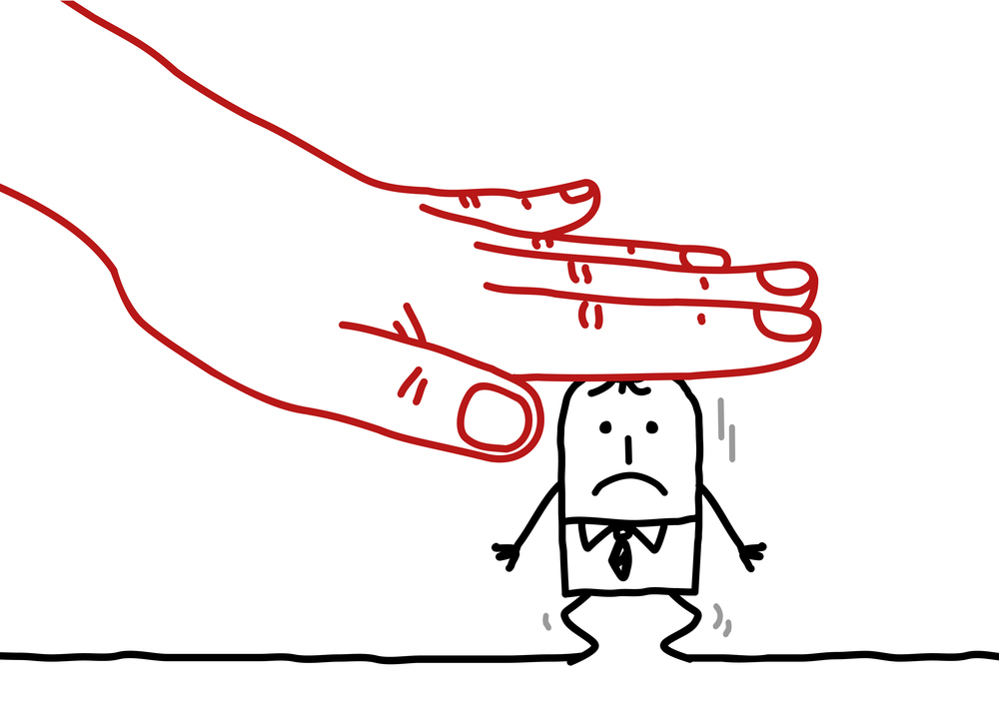
Mass/ crust/ sphere/ comprise/ chamber/ chunk/ geologist/ collide/ pressure/ gradually/ element/ erode/ chemically.

Slide 18
pressure the action of a force against an opposing force

Slide 19
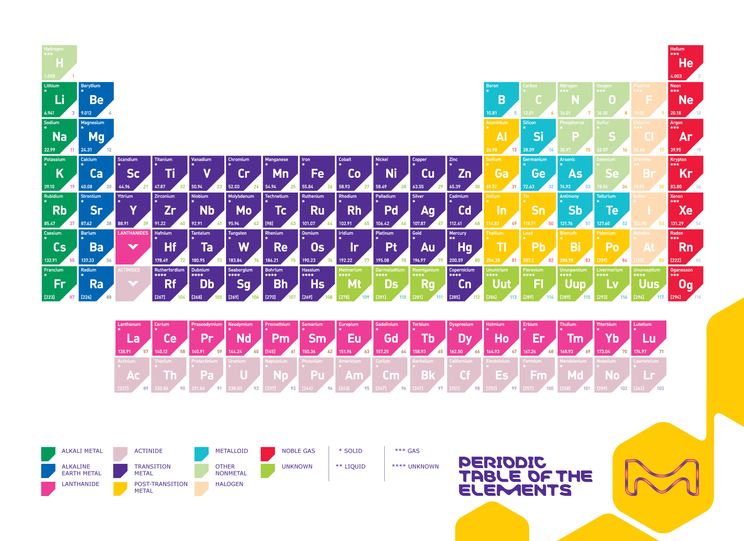
Mass/ crust/ sphere/ comprise/ chamber/ chunk/ geologist/ collide/ pressure/ gradually/ element/ erode/ chemically.

Slide 20


Element a part of something

Slide 21
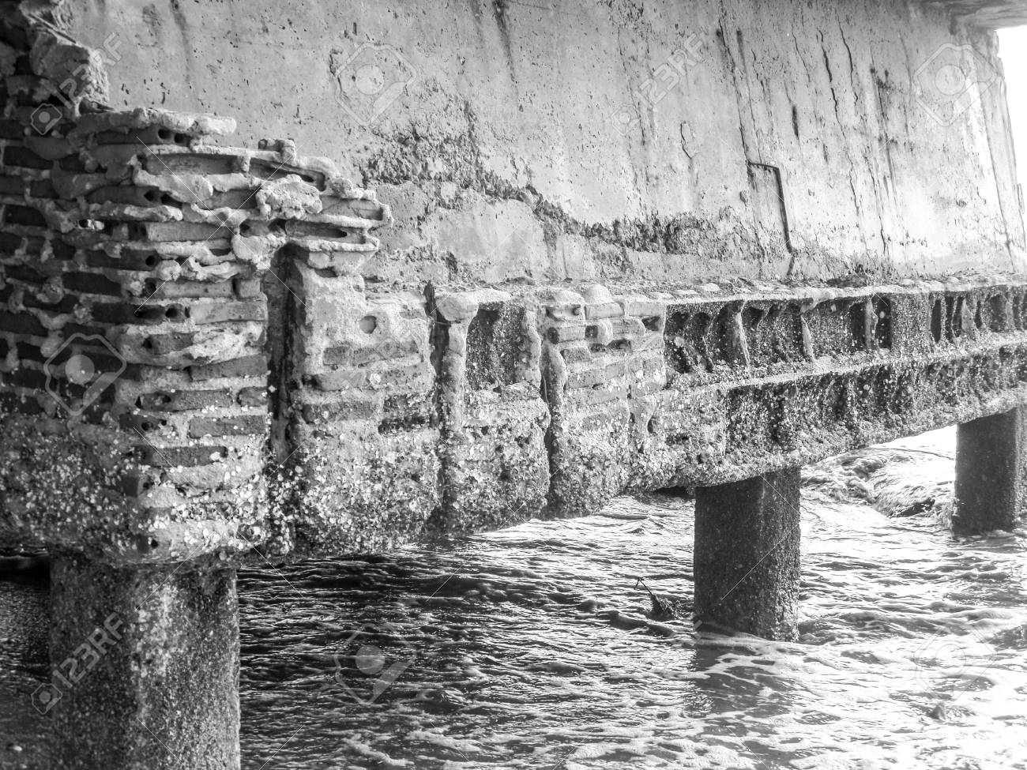
Mass/ crust/ sphere/ comprise/ chamber/ chunk/ geologist/ collide/ pressure/ gradually/ element/ erode/ chemically.

Slide 22

erode to rub or be rubbed away

Slide 23
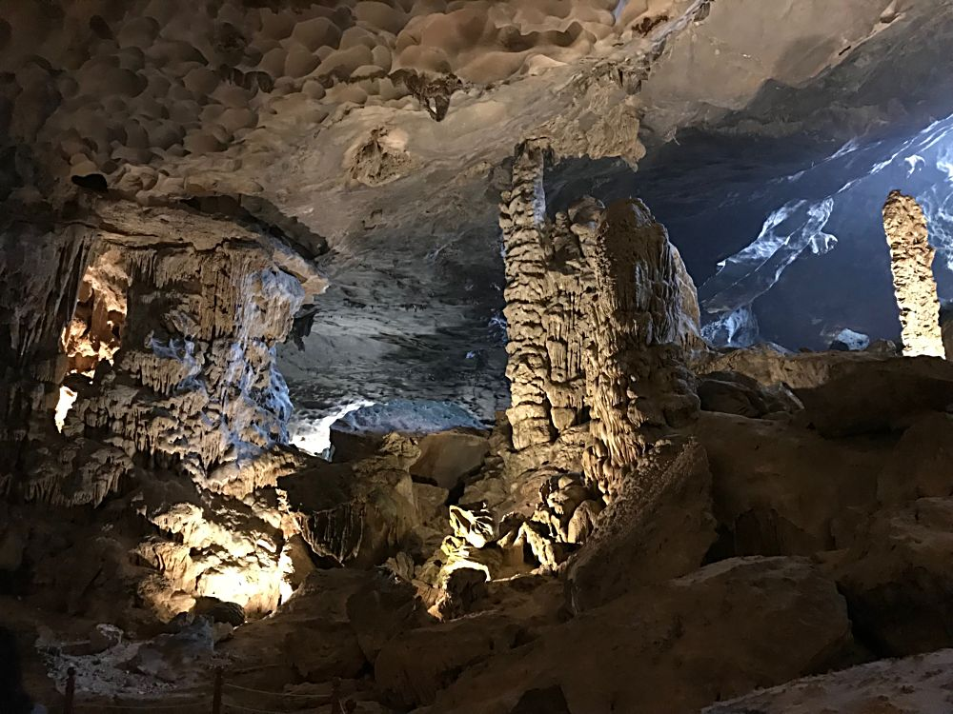
Mass/ crust/ sphere/ comprise/ chamber/ chunk/ geologist/ collide/ pressure/ gradually/ element/ erode/ chemically.

Slide 24

Chamber a room used for a special or official purpose

Slide 25
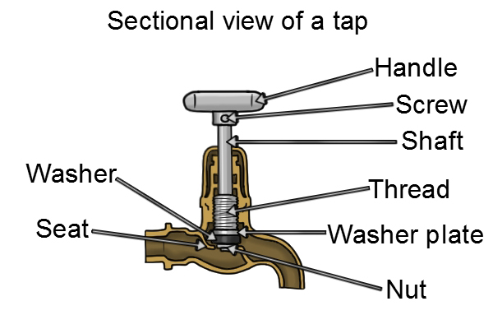
Mass/ crust/ sphere/ comprise/ chamber/ chunk/ geologist/ collide/ pressure/ gradually/ element/ erode/ chemically.

Slide 26

comprise to have things or people as parts or members; to consist of

