Slide 1
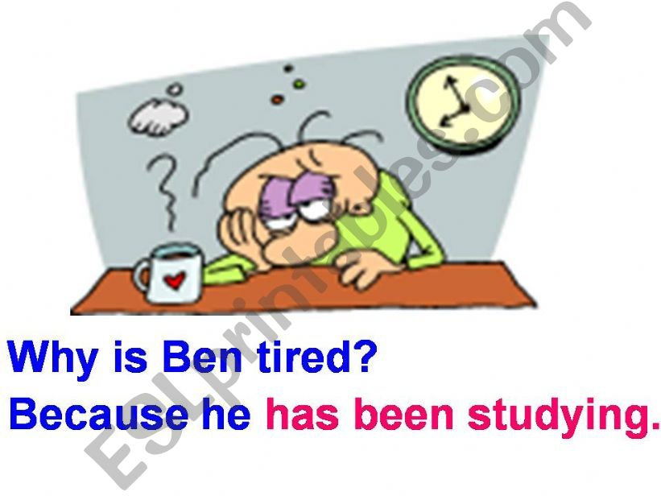
Present Perfect Continuous Tense

Slide 2
Sara has been picking vegetables for two hours.

Slide 3
Is used to put emphasis on the duration of an action which started in the past and continues up to the present, specially with time expressions such as for, since, all morning, all day, etc.

Slide 4
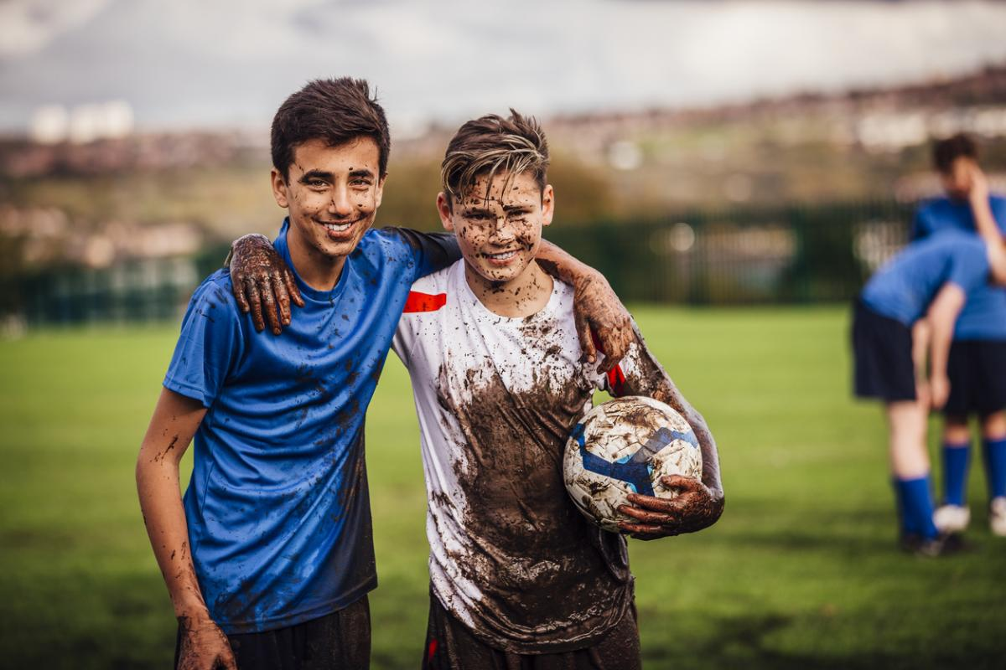
He is dirty. He has been playing football.

Slide 5
For an action that started and finished in the past, and lasted for some time. The result of the action is visible in the present.

Slide 6
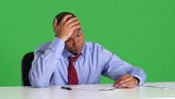
Who has been reading my business
papers?

Slide 7
Is used to express anger, annoyance or irritation

Slide 8
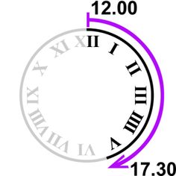
How long have you been learning English?
She has been working here for twenty years.
We have been living here since 1999.
She has been going out a lot lately/ recently.

Slide 9
Group work / Game
https://www.englishclub.com/esl-games/grammar/jumbled-tenses-present-perfect-1.htm

Slide 10
Present Perfect Simple vs Continuous https://www.youtube.com/watch?v=awW-whO083I https://www.youtube.com/watch?v=_oODlA-r7HU
Conversation
https://www.youtube.com/watch?v=cUbV5B8ieck

