Slide 1
Present Perfect Simple tense

Slide 2
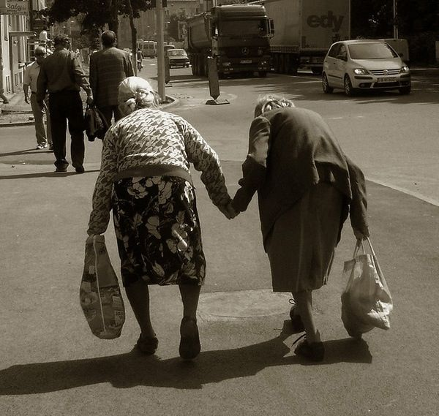
They have been friends for twenty years.

Slide 3
Is used to describe an action which started in the past and continues up to the present.

Slide 4
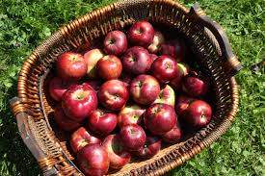
She has picked a lot of apples.

Slide 5
Is used for an action which has recently finished and whose result is visible in the present.

Slide 6
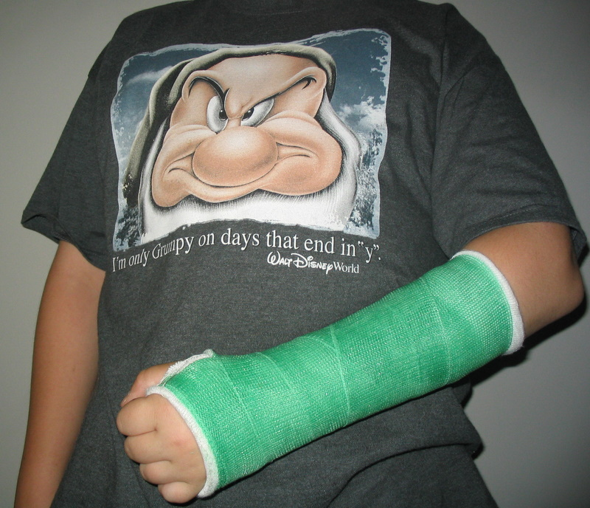
He has broken his arm.

Slide 7
Is used for an action which at an unstated time in the past. The exact time is not important, so it’s not mentioned.

Slide 8
She has received three faxes this morning.

Slide 9
Is used for an action which has happened within a specific time period, which is not over at the moment of speaking, such as today, this morning…. ,etc.

Slide 10
Time Expressions for present Perfect simple, and present Perfect continuous.

Slide 11
How long have you known Jack?
I have known Jack for five years.
They have been married since last April.
Have you seen any good films lately/ recently.
We have already seen this film.
Has Roger left yet?
I have just phoned Jill.
Have you ever been abroad?
She has never been to France.
I have sent twenty invitation so far.

