Slide 1
Elements, molecules, compounds and mixtures
https://www.youtube.com/watch?v=14BEh2EKrM0

Slide 2
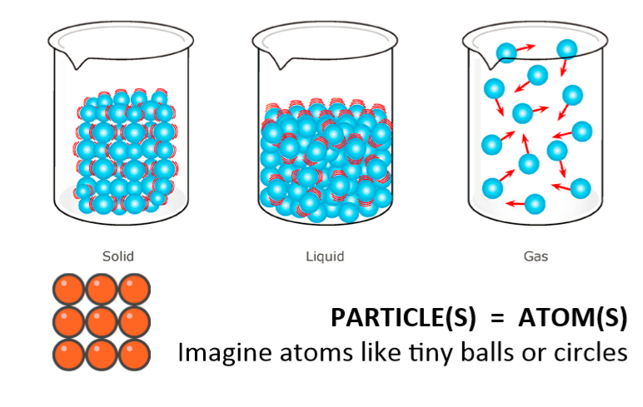
Atoms
An atom is the smallest unit of matter, everything is made up of atoms.

Slide 3
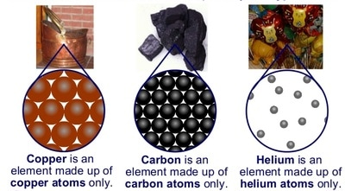
WHAT ARE ELEMENTS ?
Element is a substance made up of only one kind of atom.
Elements are pure substances that cannot be broken down into simpler substances.
** 118 elements are known and they are arranged in a table called the periodic table.

Slide 4
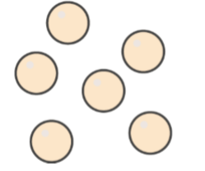
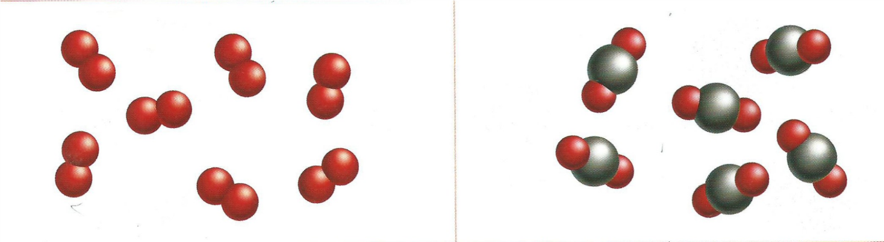
Elements and compounds
Those substances which are made from only one type of atom are called ELEMENTS.
Those substances which are made up of different types of atoms are called COMPOUNDS.
Compounds are chemically joined together by chemical bonds.
ELEMENT COMPOUND

Slide 5
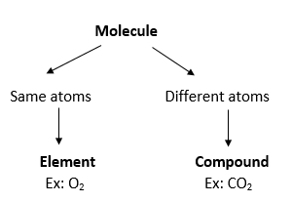
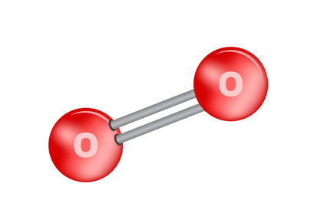
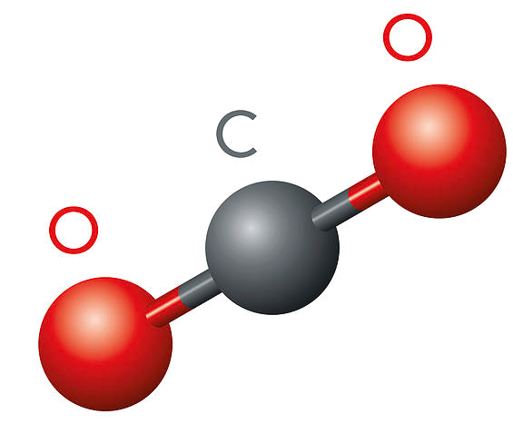
Molecules
Atoms bond together to form larger particles called MOLECULES, and molecules join together in different ways to produce the matter and the different SUBSTANCES.

Slide 6
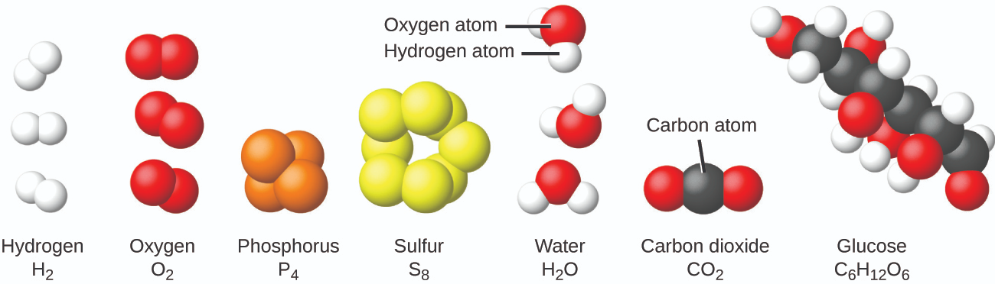
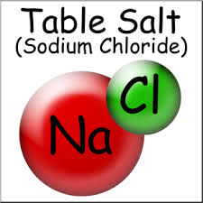
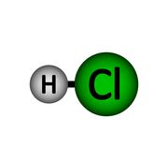
Which ones do you think are molecules of elements?

Slide 7
Oxygen (O₂), element made up of 2 atoms of oxygen.
Water (H₂O), compound made up of 2 atoms of hydrogen and one atom of oxygen.

Slide 8
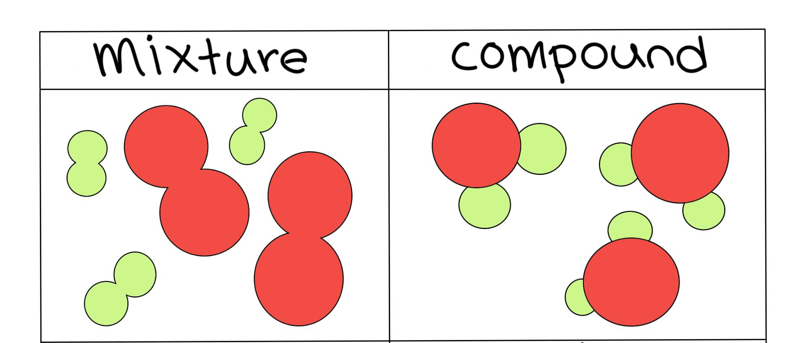
Mixtures
A mixture is a substance containing two or more elements or compounds that are not chemically joined together.

Slide 9
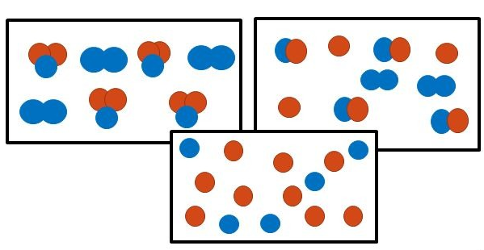
Mixtures
1
2
3

Slide 10
Mixtures
1
2
3
1: A mixture of an element and a compound.
2: A mixture of 2 different elements and a compound.
3: A mixture of 2 different elements.

Slide 11
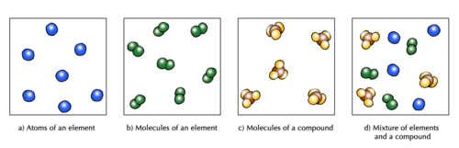

Slide 13
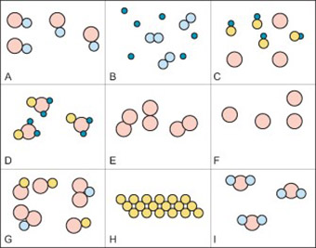
Element, compound or mixture?

Slide 14
Element, compound or mixture?
A: a compound
B: a mixture of 2 different elements
C: a mixture of an element and a compound
D: a compound
E: molecules of an element
F: atoms of an element
G: a mixture of 2 different compounds
H: an element
I: a compound

Slide 15
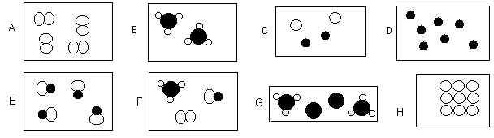
Element, compound or mixture?

Slide 16
A: an element
B: a compound
C: a mixture of two different elements
D: an element
E: a compound
F: a mixture of an element and 2 different compounds
G: a mixture of an element and a compound
H: an element

Slide 17
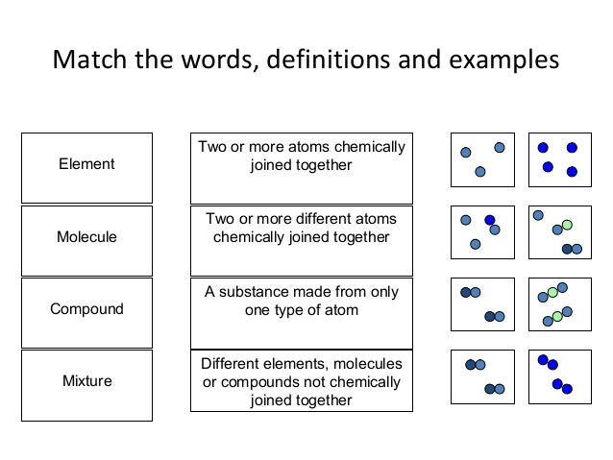
Draw a line to match each concept with its definition then draw another line to match each definition with the suitable diagram.

Slide 18
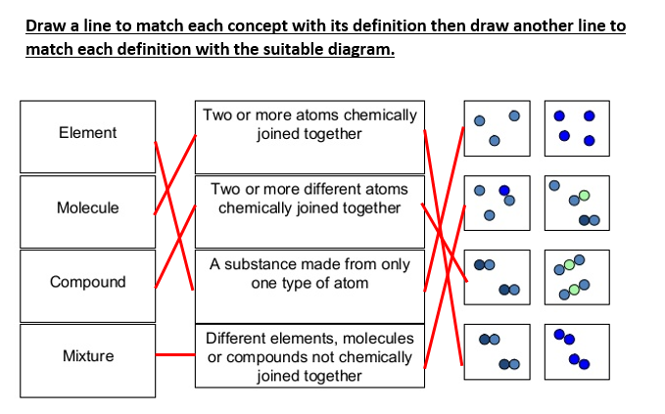

Slide 19
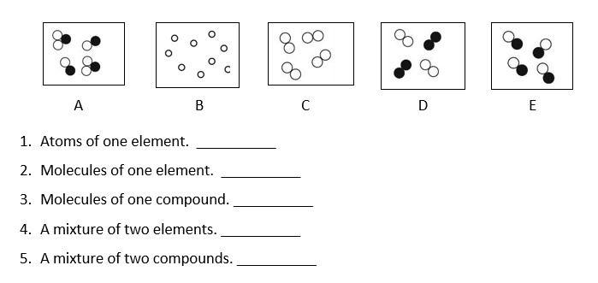
Look at these diagrams of atoms and molecules. Match the answers to the boxes.

Slide 20
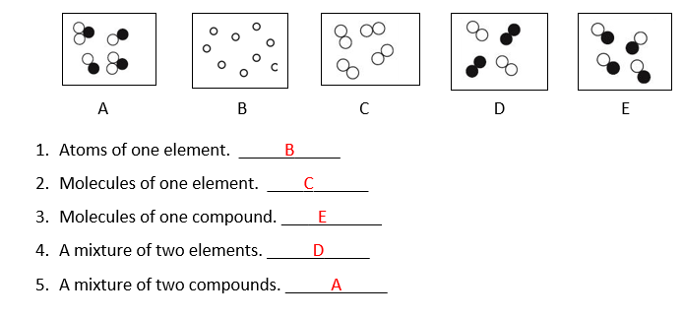
Look at these diagrams of atoms and molecules. Match the answers to the boxes.

Slide 21
Is it a molecule of an element or a compound?
CaCl₂
HCl
P₄
Cl₂
CaSO₄

Slide 22
Is it a molecule of an element or a compound?
CaCl₂ : We have Calcium and Chlorine, so those are two different elements and that makes it a molecule of a compound.
HCl : We have Hydrogen and chlorine, two different elements so that makes it a molecule of a compound.
P₄ : we have 4 phosphorus atoms chemically bonded, it’s a molecule of an element.
Cl₂ : molecule of an element.
CaSO₄ : molecule of a compound.

Slide 23
Is it an element or a compound?
MgCO3
O3
S8
CH4
NaHCO3
CO2

Slide 24
Is it an element or a compound?
MgCO3 – compound
O3- element
S8 - element
CH4 – compound
NaHCO3– compound
CO2– compound

