Slide 1
Daily message
Today , we are going to read new tricky words.

Slide 2
Tricky words

Slide 4
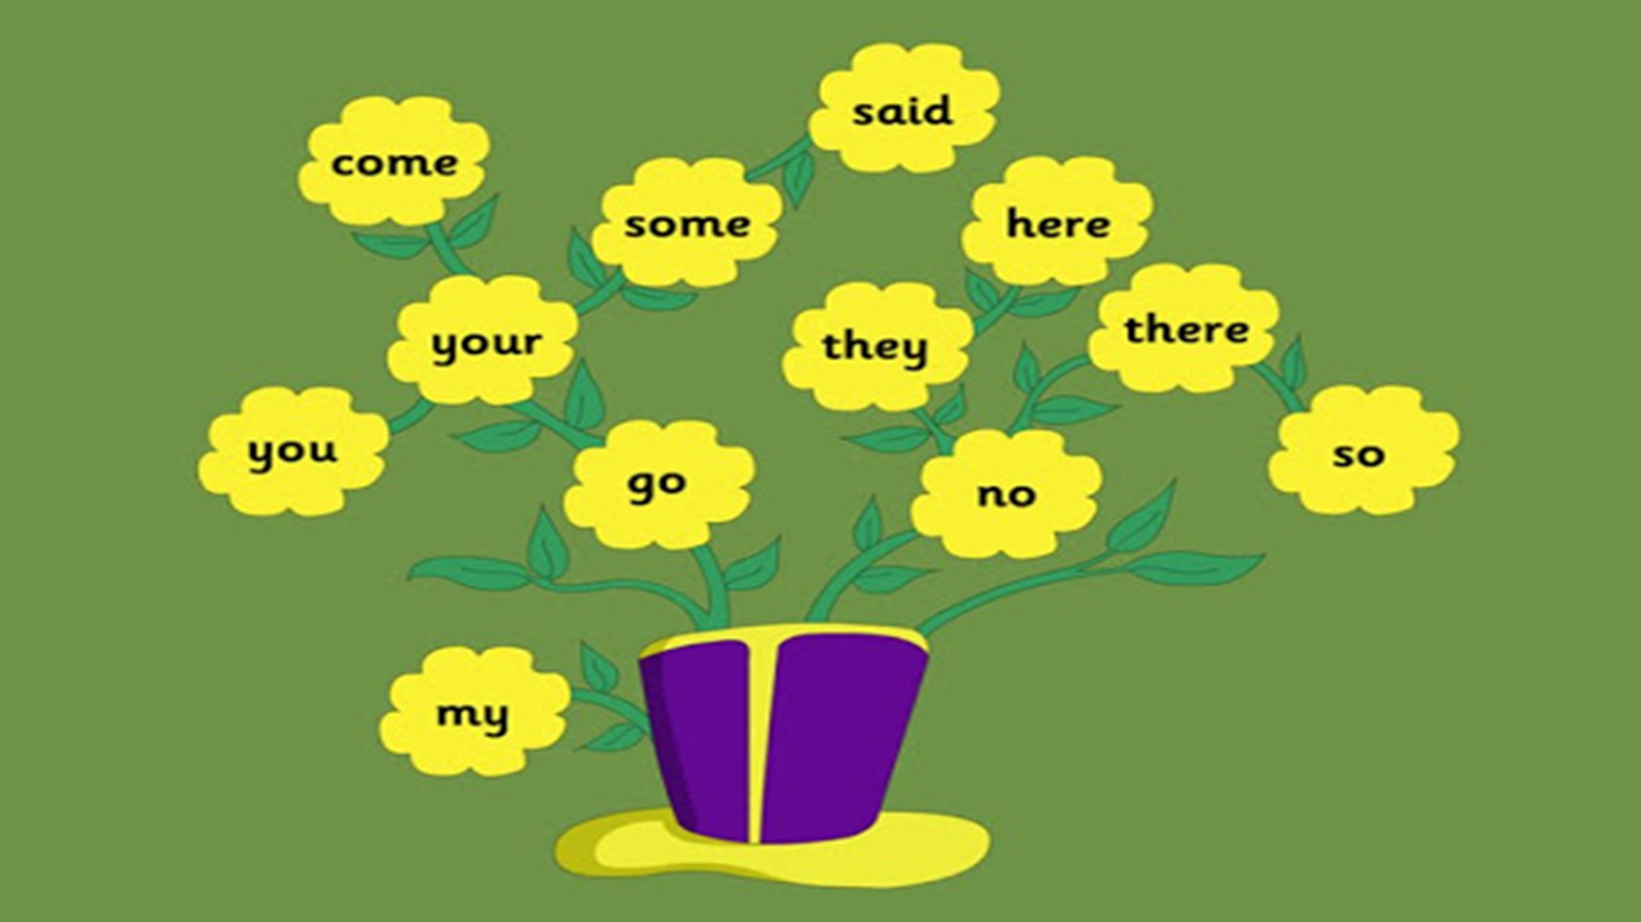

Slide 5
he

Slide 6
be

Slide 7
we

Slide 8
me

Slide 9
she

Slide 10
the

Slide 11
I

Slide 12
to

Slide 13
do

Slide 14
all
o

Slide 15
was

Slide 16
are

Slide 17
come
u

Slide 18
some
u

Slide 19
here

Slide 20
there
a

Slide 21
they
a

Slide 22
said
e

Slide 23
no
Say my name

Slide 24
go

Slide 25
so

Slide 26
You
.
.

Slide 27
Your . .
.

Slide 28
my
i

Slide 29
you
your

Slide 30
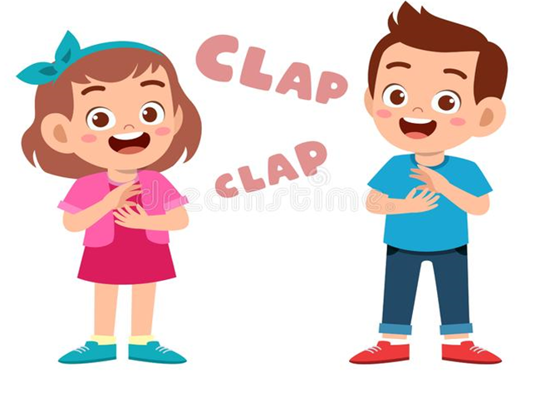
no
so
go

Slide 31
go
no

Slide 32
my
so

Slide 33
so

Slide 34
you
my

Slide 35
you

Slide 36
go

Slide 37
so

Slide 38
my

Slide 39
your

Slide 40
no

Slide 41
you
no
so
my
your
go

