Slide 1
What is the beginning letter s a t i p n
Click on the correct beginning letter
By Rónán Breathnach

Slide 2
What is the beginning letter?
a
n
s
t
i

Slide 3

Well done
You got it right
Next question

Slide 4

Hard Luck
That is not right
Back

Slide 5
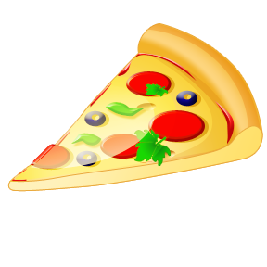
What is the beginning letter?
p
s
a
t
n

Slide 6
Well done
You got it right
Next question

Slide 7
Hard Luck
That is not right
Back

Slide 8
What is the beginning letter?
n
a
p
t
s

Slide 9
Well done
You got it right
Next question

Slide 10
Hard Luck
That is not right
Back

Slide 11

What is the beginning letter?
t
p
n
a
s

Slide 12
Well done
You got it right
Next question

Slide 13
Hard Luck
That is not right
Back

Slide 14
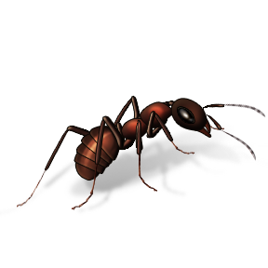
What is the beginning letter?
p
t
i
a
s

Slide 15
Well done
You got it right
Next question

Slide 16
Hard Luck
That is not right
Back

Slide 17
What is the beginning letter?
a
t
n
p
i

Slide 18
Well done
You got it right
Next question

Slide 19
Hard Luck
That is not right
Back

Slide 20
What is the beginning letter?
p
s
n
t
i

Slide 21
Well done
You got it right
Next question

Slide 22
Hard Luck
That is not right
Back

Slide 23
What is the beginning letter?
a
p
n
t
s

Slide 24
Well done
You got it right
Next question

Slide 25
Hard Luck
That is not right
Back

Slide 26
What is the beginning letter?
p
n
a
s
i

Slide 27
Well done
You got it right
Next question

Slide 28
Hard Luck
That is not right
Back

Slide 29
What is the beginning letter?
s
a
t
i
p

Slide 30
Well done
You got it right
Next question

Slide 31
Hard Luck
That is not right
Back

Slide 32
What is the beginning letter?
t
n
i
s
a

Slide 33
Well done
You got it right
Next question

Slide 34
Hard Luck
That is not right
Back

Slide 35
What is the beginning letter?
n
a
p
s
t

Slide 36
Well done
You got it right
Next question

Slide 37
Hard Luck
That is not right
Back

Slide 38
What is the beginning letter?
t
a
s
i
p

Slide 39
Well done
You got it right
Next question

Slide 40
Hard Luck
That is not right
Back

Slide 41
What is the beginning letter?
t
n
i
s
p

Slide 42
Well done
You got it right
Next question

Slide 43
Hard Luck
That is not right
Back

Slide 44
What is the beginning letter?
i
a
p
n
s

Slide 45
Well done
You got it right
Next question

Slide 46
Hard Luck
That is not right
Back

Slide 47
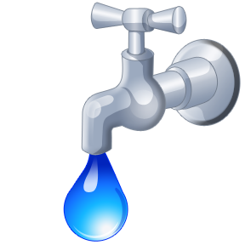
What is the beginning letter?
i
p
s
n
t

Slide 48
Well done
You got it right
Next question

Slide 49
Hard Luck
That is not right
Back

Slide 50
What is the beginning letter?
i
n
a
s
t

Slide 51
Well done
You got it right
Next question

Slide 52
Hard Luck
That is not right
Back

Slide 53
What is the beginning letter?
p
a
n
t
s

Slide 54
Well done
You got it right
Next question

Slide 55
Hard Luck
That is not right
Back

Slide 56
What is the beginning letter?
s
t
i
n
a

Slide 57
Well done
You got it right
Next question

Slide 58
Hard Luck
That is not right
Back

Slide 59
What is the beginning letter?
p
t
s
n
a

Slide 60
Well done
You got it right
Next question

Slide 61
Hard Luck
That is not right
Back

Slide 62
Well done
You are finished

