Slide 1
Proper Nouns
What is a proper noun?

Slide 2
I see a girl in the class.
If I say
I mean any girl.
But if I say
I see Naya in the class.
You know exactly which girl I see in the class.

Slide 3
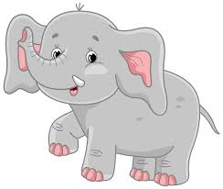
A proper noun is a special noun, that names a particular person, animal or place.
Carol
Sami
Elliot
National Orthodox School
A proper noun always begins with a capital letter.

Slide 4
The names of boys and girls are proper nouns and should be captilized.
Boys and girls are common nouns .
George Ayla
Carlos Naya
Mirelle Shoug
Joseph Carol
Karam Tia
Rayan Ghala
Maya
Natalie
Talia
Laith
Sami

Slide 5
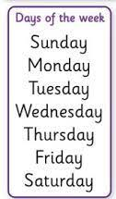
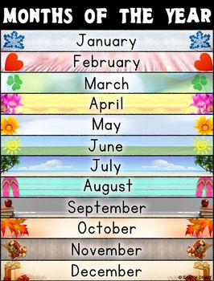
Days and months are proper nouns.

