Slide 1
Past Simple

Slide 2
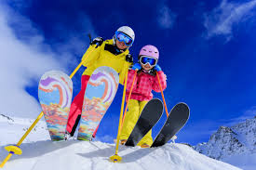
They spent their holiday in Jordan last winter.
They have spent their holiday in Jordan.

Slide 3
For an action which happened at a definite time in the past.

Slide 4
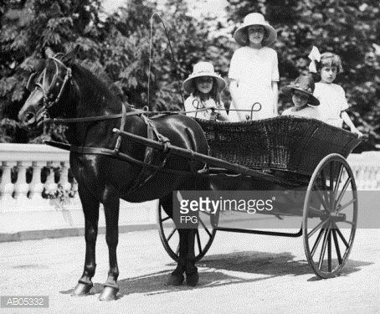
People travelled / used to travel by carriage in those days.

Slide 5
For past habits which are now finished.

Slide 6
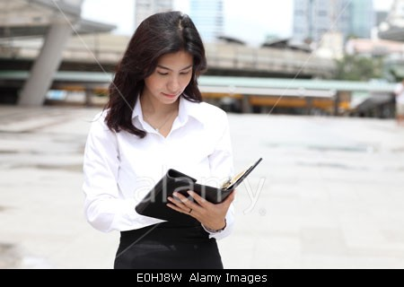
First, she read the message. Then, she called her boss.

Slide 7
For actions happened immediately one after each other in the past.

Slide 8
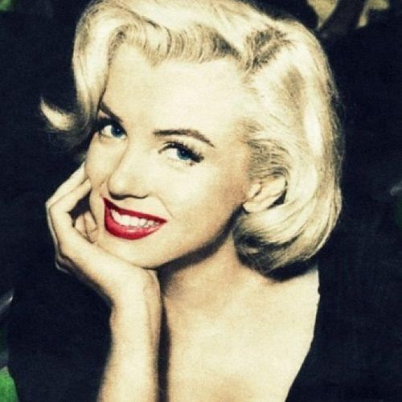
Marilyn Monroe starred in a number of successful films.

Slide 9
To talk about the lives of people who are no longer alive.

