Slide 1
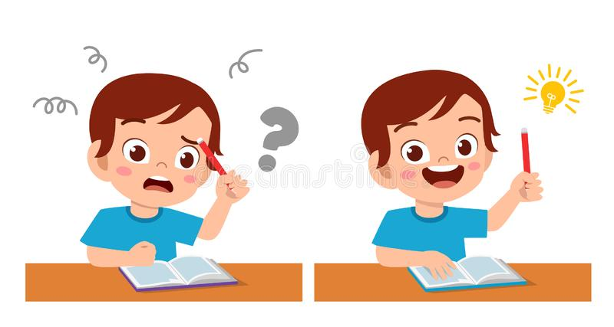
Jolly Phonics
Revision

Slide 2

Let’s review some sounds and words together!

Slide 3
a

Slide 4
ai

Slide 5
e

Slide 6
ee

Slide 7
i

Slide 8
ie

Slide 9
u

Slide 10
ue

Slide 11
o

Slide 12
oa

Slide 13
cake

Slide 14
tube

Slide 15
bite

Slide 16
joke

Slide 17
rope

Slide 18
deep

Slide 19
hen

Slide 20
boat

Slide 21
pin

Slide 22
sat

Slide 23
sunset

Slide 24
tie

Slide 25
statue

Slide 26
chain

Slide 27
shop

Slide 28
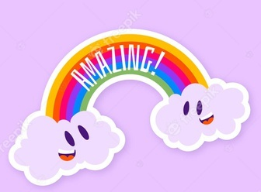
Great job!

