Slide 1
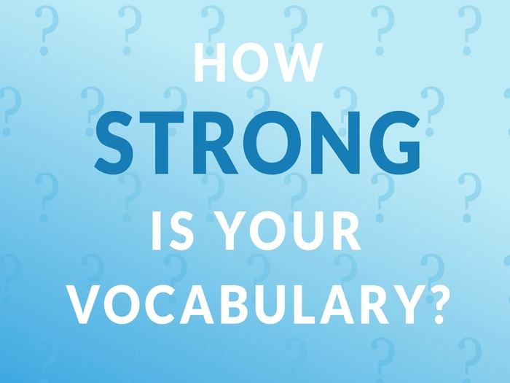
Cemetery/ abandoned/ magician/myths/ legend/archeologist/ theories

Slide 2
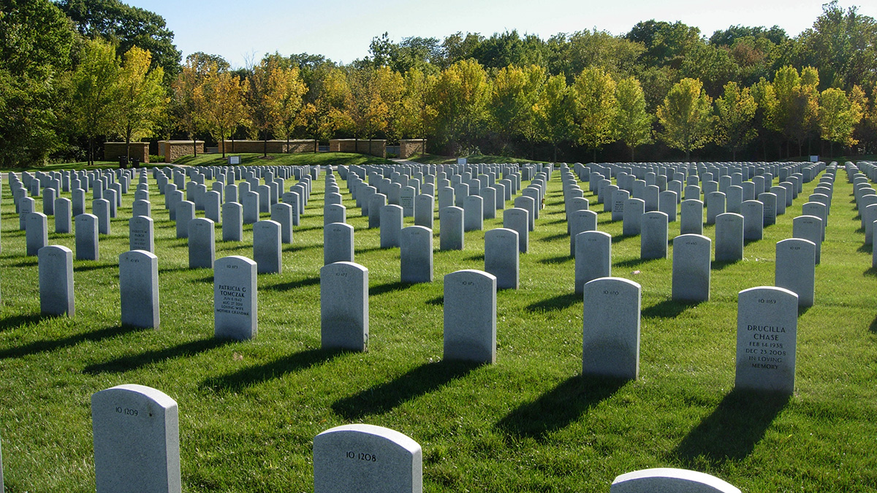
Cemetery/ abandoned/ magician/myths/ legend/archeologist/ theories

Slide 3
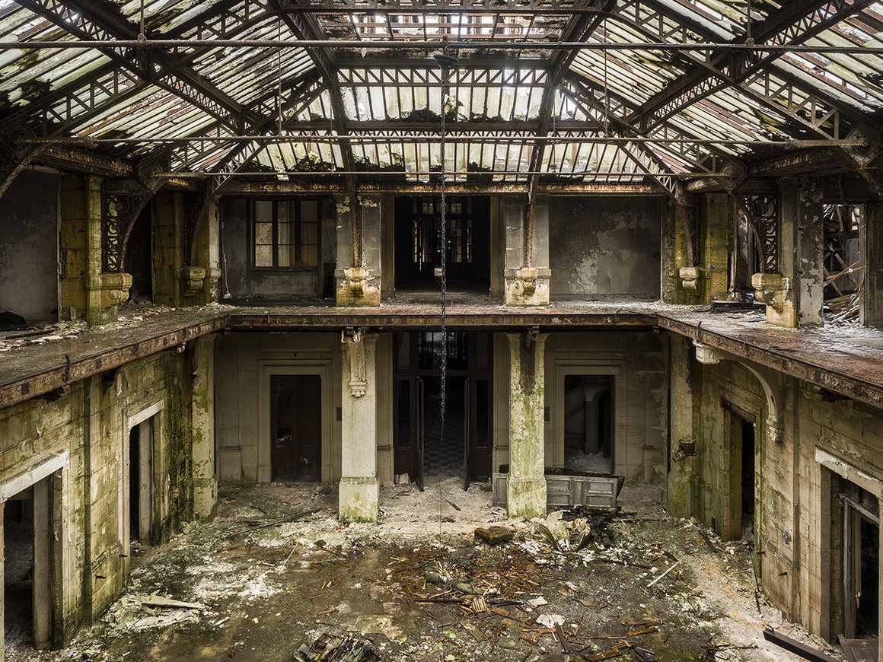
Cemetery/ abandoned/ magician/myths/ legend/archeologist/ theories

Slide 4
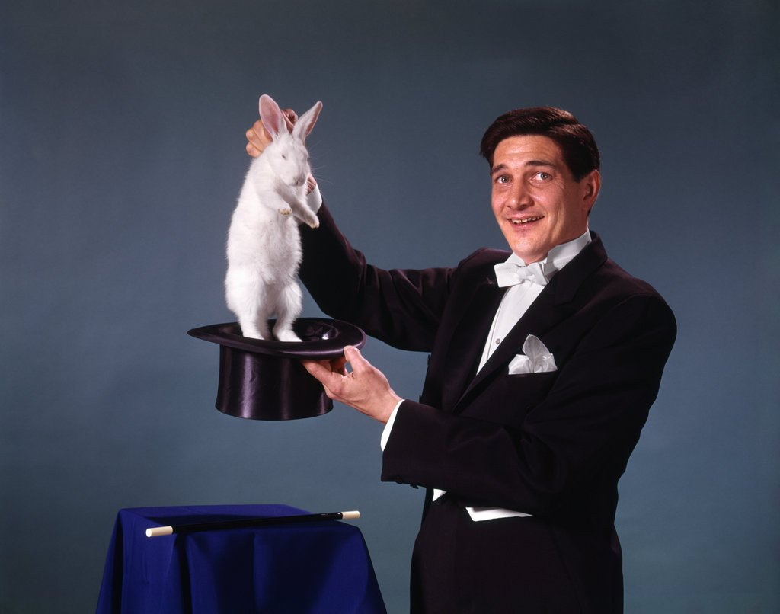
Cemetery/ abandoned/ magician/myths/ legend/archeologist/ theories

Slide 5
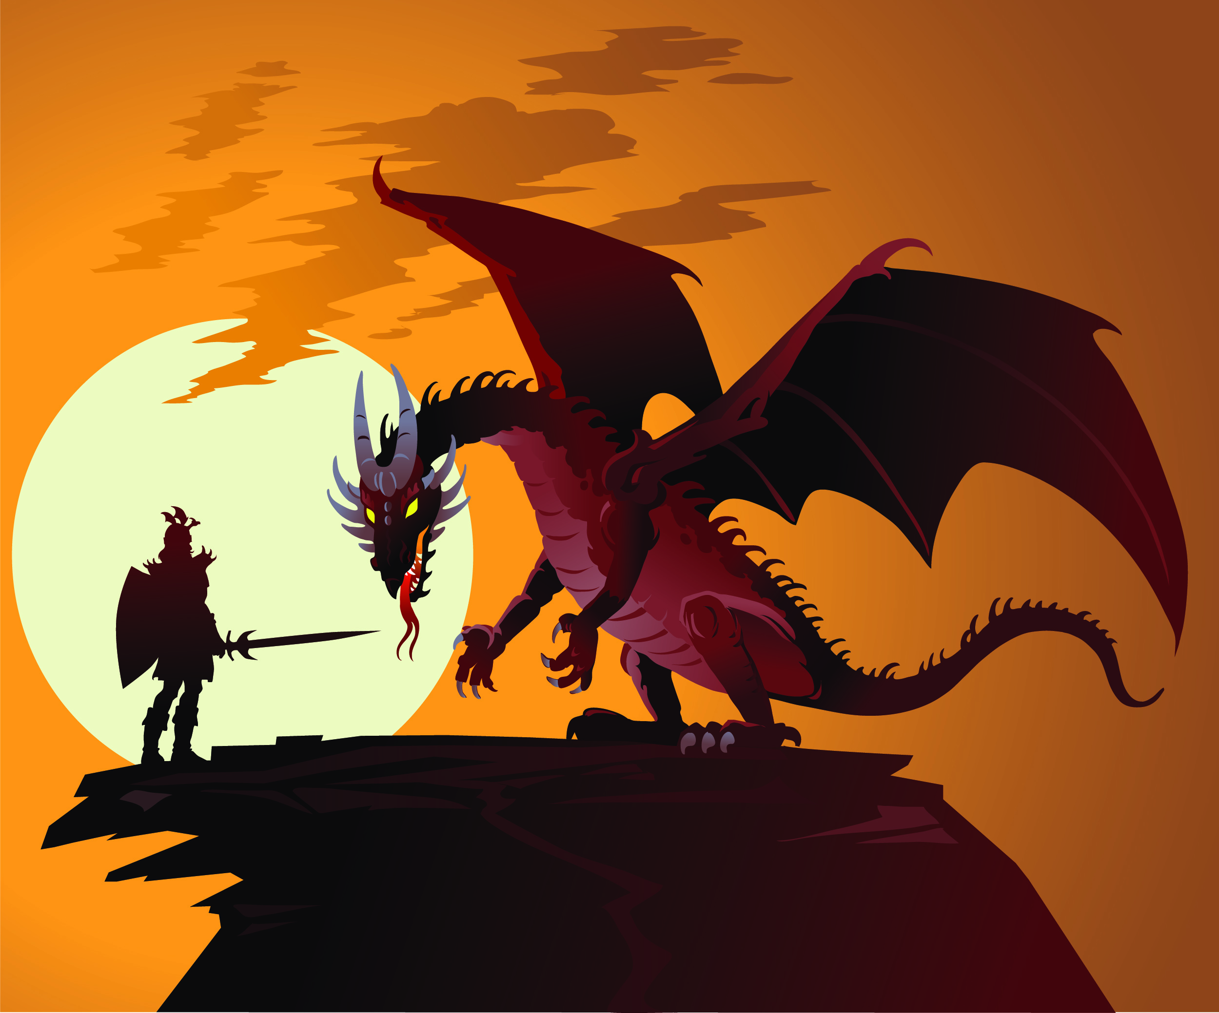
Cemetery/ abandoned/ magician/myths/ legend/archeologist/ theories

Slide 6
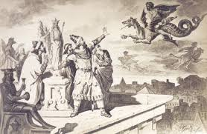
Cemetery/ abandoned/ magician/myths/ legend/archeologist/ theories

Slide 7
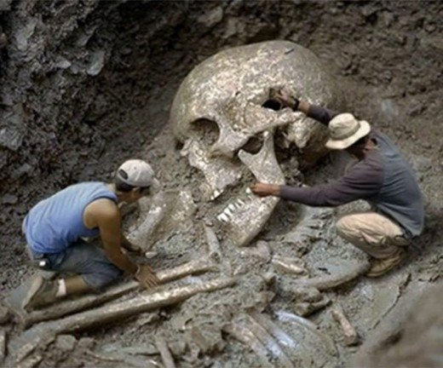
Cemetery/ abandoned/ magician/myths/ legend/archeologist/ theories

Slide 8
Cemetery/ abandoned/ magician/myths/ legend/archeologist/ theories

Slide 9
Cemetery/ abandoned/ magician/myths/ legend/archeologist/ theories
His father is buried in the ……………………… on the hill.
This new evidence lends support to the ………. that she was murdered.
The number of …………….. pets brought to the shelter has doubled.
A team of ………………. are working on a previously undisturbed area of the abbey grounds.
Merlin was the …………… in the stories of King Arthur and the Knights of the Round Table.
She is writing a thesis on Irish…………………and mythology.

