Slide 1
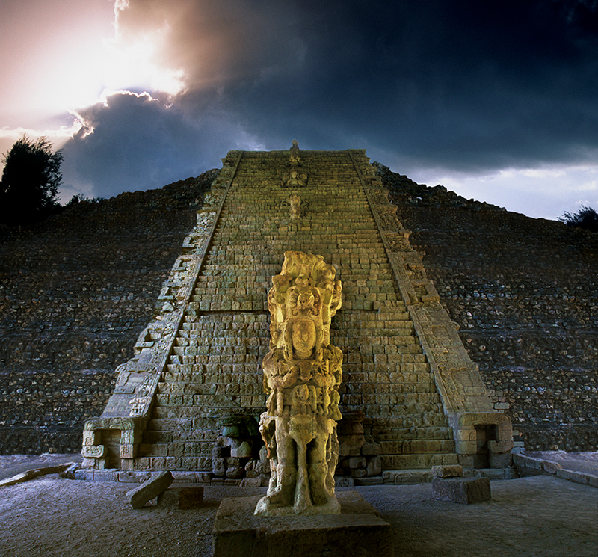

Slide 2
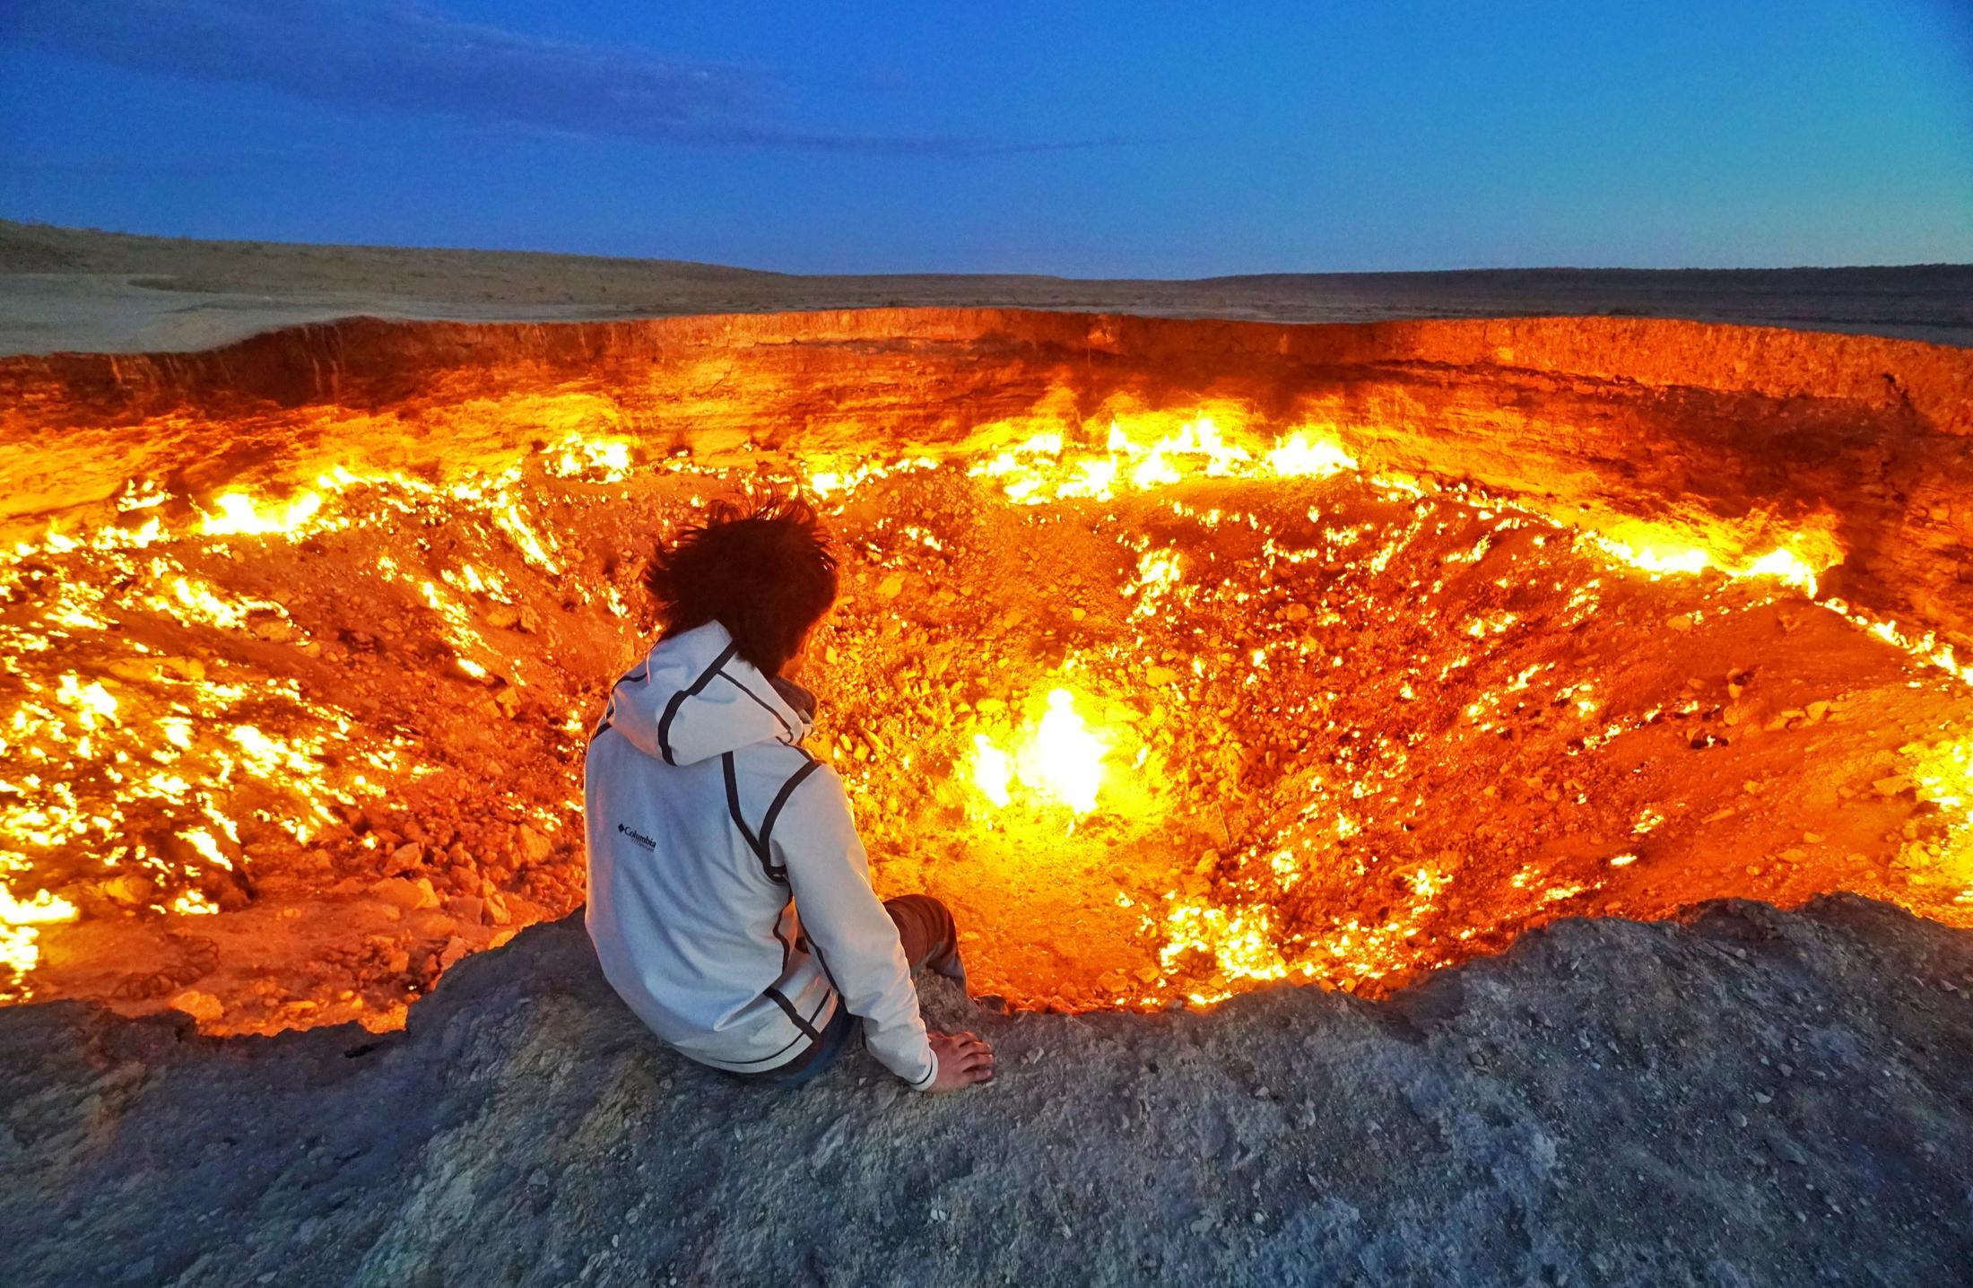
The places and things below are all associated with mysteries. What do you know about them? Ex. A page 18

Slide 3
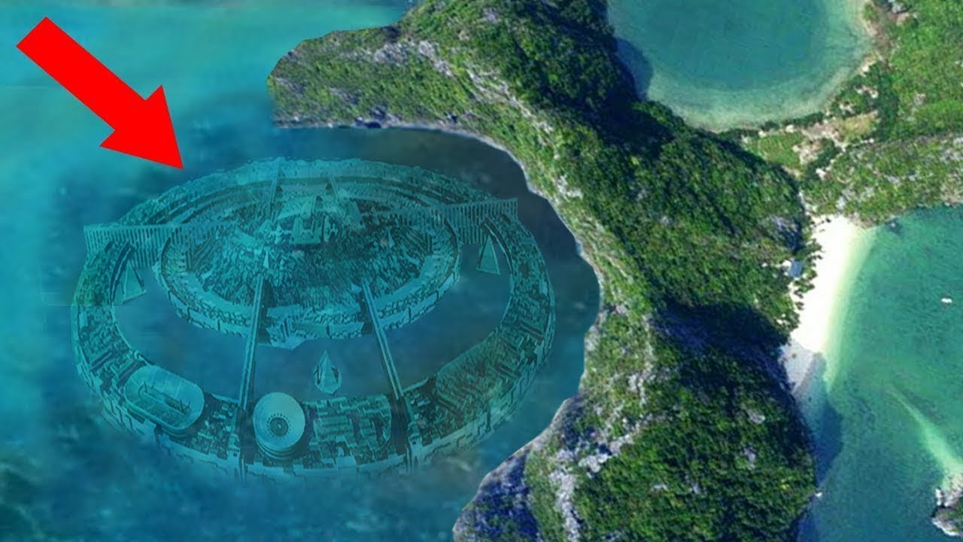
The lost city of Atlantis https://www.youtube.com/watch?v=fVjDBXOjLx0

Slide 4
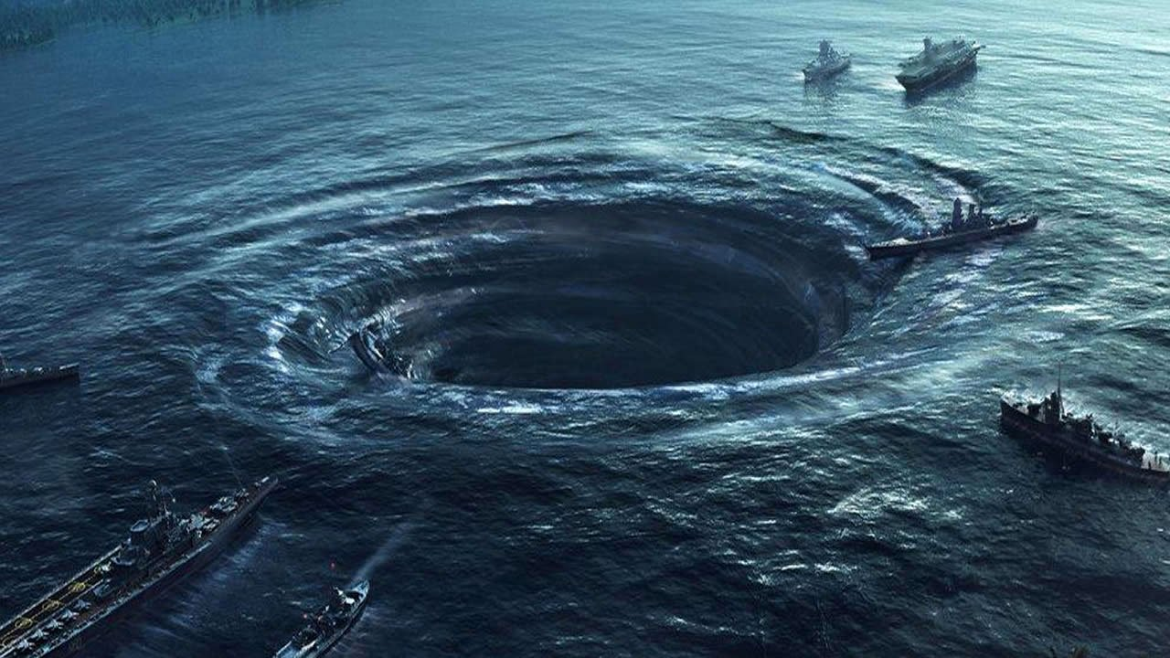
the Bermuda triangle https://www.youtube.com/watch?v=-FuJ5mOV6Vg

Slide 5
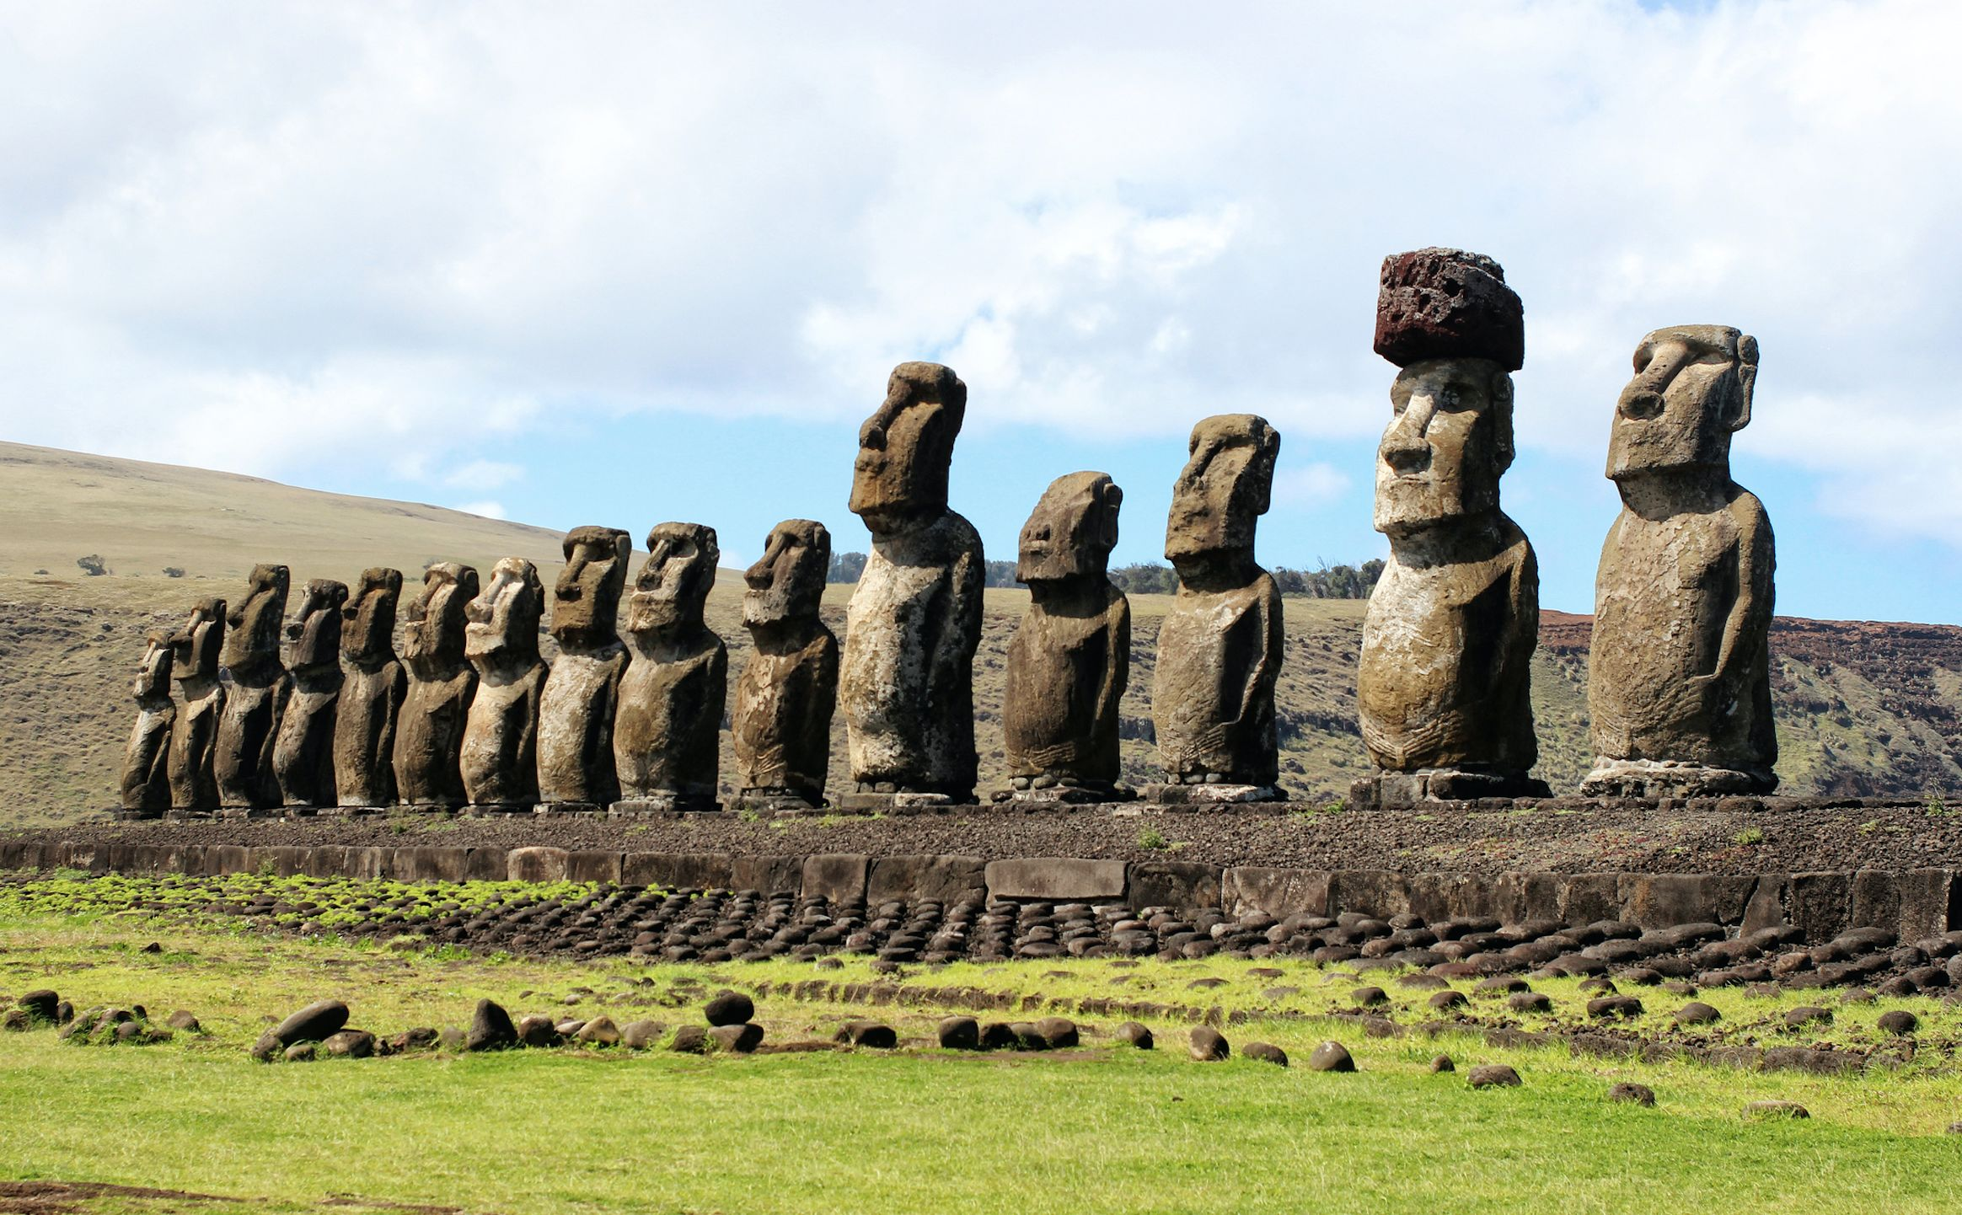
the Easter Island statues https://www.youtube.com/watch?v=QhEeh_BcADg

Slide 6
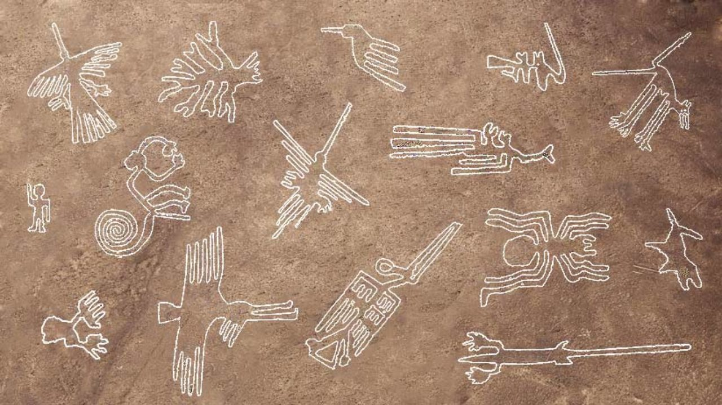
the Nazca lines https://www.youtube.com/watch?v=QhEeh_BcADg

Slide 7
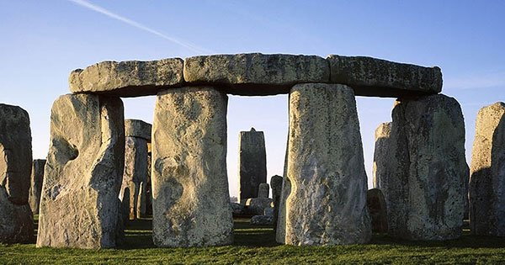
Stonehenge https://www.youtube.com/watch?v=BTwuKCqFwJY

Slide 8
World Mysteries https://www.youtube.com/watch?v=HzqWWiBEfAY 11 Places More Mysterious Than Bermuda Triangle https://www.youtube.com/watch?v=j2wzFzTtkoY the mystery of Maya documentary https://www.youtube.com/watch?v=Q6eBJjdca14 10 Mayan Secret Places That Were Hidden for Centuries https://www.youtube.com/watch?v=zUBeiHgvG5w

Slide 10
Rainforest/ embrace/ wipe out/ overpopulated/ epidemic/ drought

Slide 11
Epidemic The authorities tried to localize the epidemic.

Slide 12
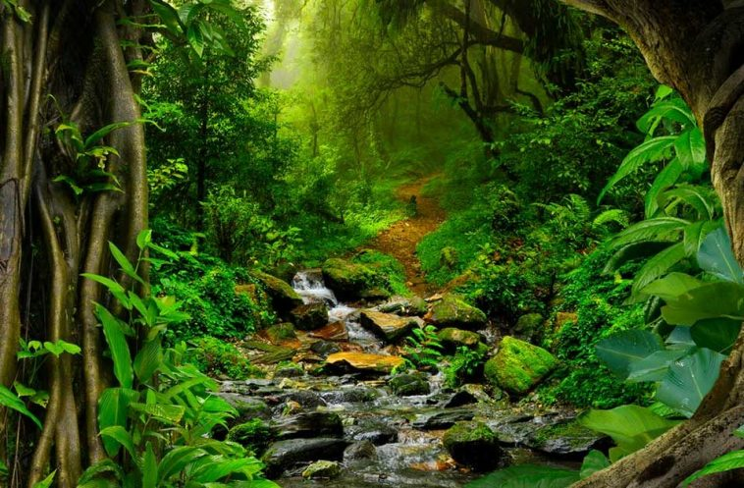
Rainforest/ embrace/ wipe out/ overpopulated/ epidemic/ drought

Slide 13
Rainforest Cutting down the rainforest is an environmental time bomb.

Slide 14
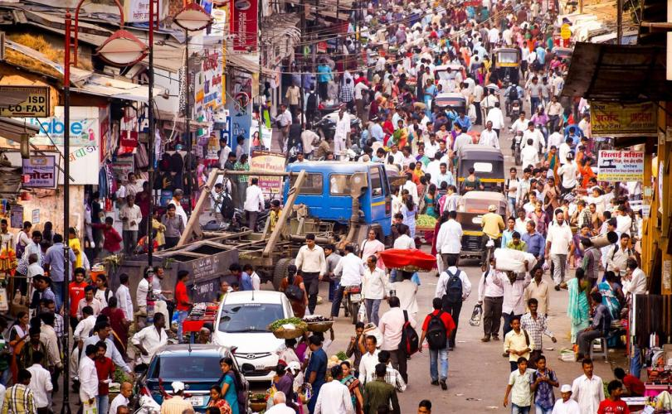
Rainforest/ embrace/ wipe out/ overpopulated/ epidemic/ drought

Slide 15
Overpopulated Did the surface become too polluted or overpopulated?

Slide 16
Rainforest/ embrace/ wipe out/ overpopulated/ epidemic/ drought

Slide 17
Embrace I just want a warm embrace and nothing more.

Slide 18
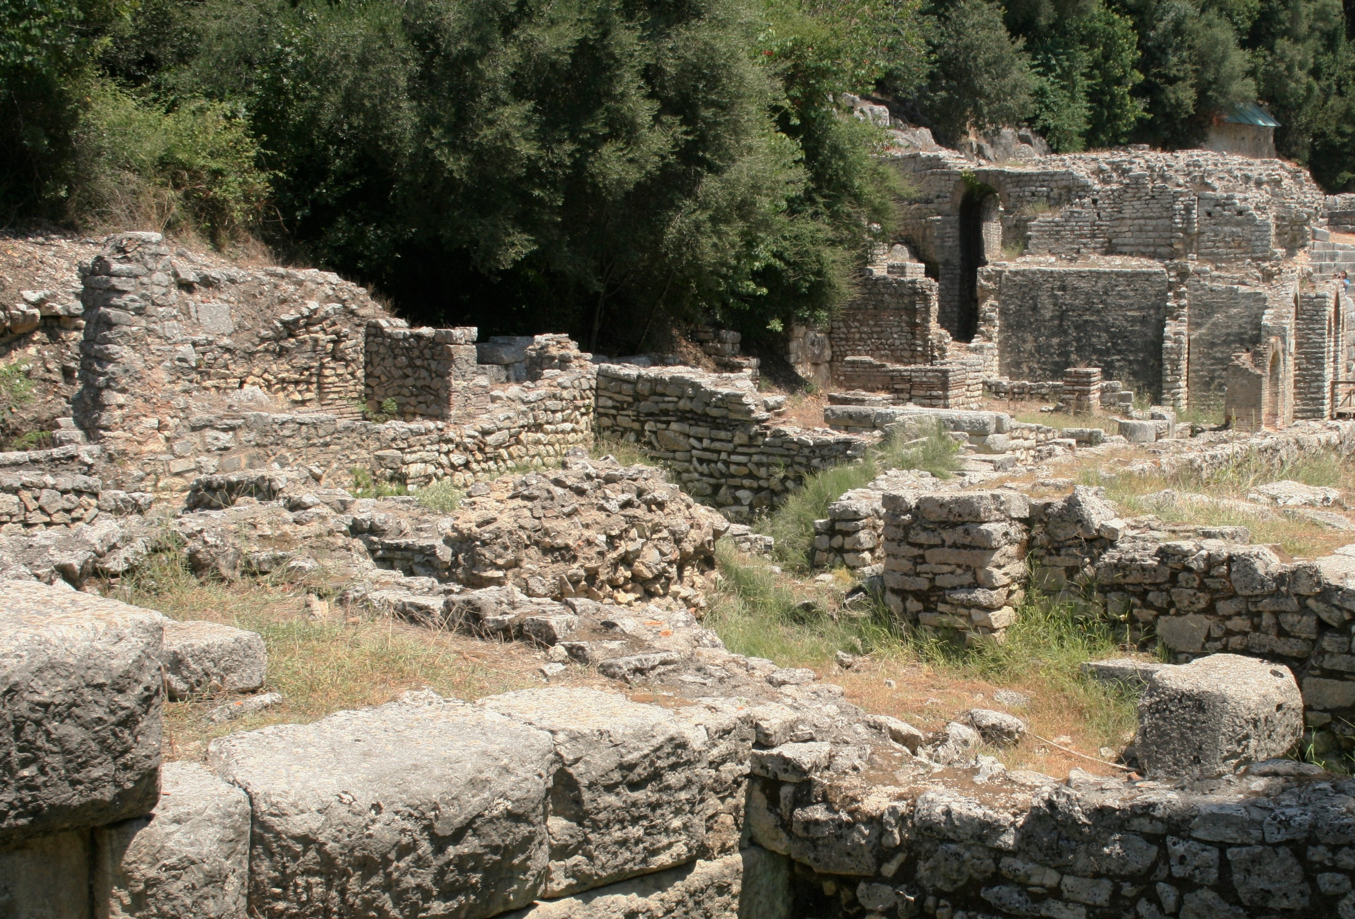
Rainforest/ embrace/ wipe out/ overpopulated/ epidemic/ drought

Slide 19
wipe out You can never wipe out the past.

Slide 20
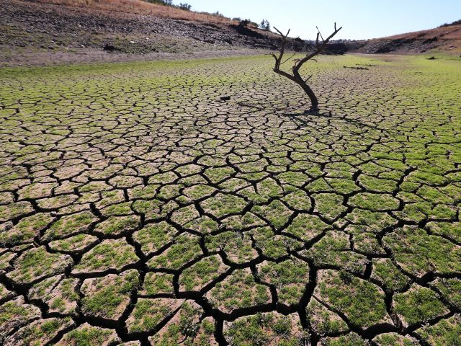
Rainforest/ embrace/ wipe out/ overpopulated/ epidemic/ drought

Slide 21
Drought Whole communities starved to death during the long drought.

