Slide 2
Make out/ look into/ stick to/ take in/ let out/ believe in

Slide 3
Make out/ look into/ stick to/ take in/ let out/ believe in
Manage to do something.
Make a certain sound.
Examine facts and information.
Only talk about one subject.
Trick
Be sure that something exists.

Slide 4
look into Examine facts and information. The college principal promised to look into the matter.

Slide 5
Make out/ look into/ stick to/ take in/ let out/ believe in
Manage to do something.
Make a certain sound.
Examine facts and information.
Only talk about one subject.
Trick
Be sure that something exists.

Slide 6
Make out Manage to see something. I can't make out the number? It's very faint.

Slide 7
Make out/ look into/ stick to/ take in/ Let out / believe in
Manage to do something.
Make a certain sound.
Examine facts and information. Only talk about one subject.
Trick
Be sure that something exists.

Slide 8
let out Make a certain sound. The lion let out a great roar.

Slide 9
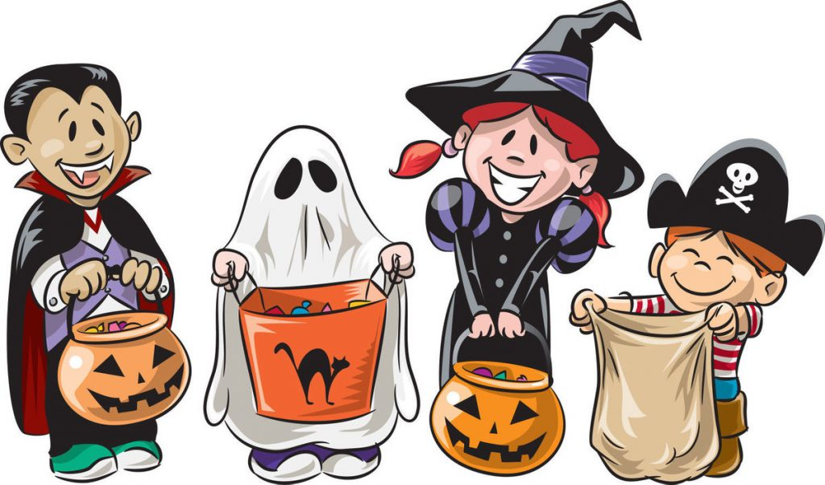
Make out/ look into/ stick to/ take in/ let out/ believe in
Manage to do something.
Make a certain sound.
Examine facts and information. Only talk about one subject.
Trick
Be sure that something exists.

Slide 10
take in Trick The salesman finds it easy to take in old ladies.

Slide 11
Make out/ look into/ stick to/ take in/ let out/ believe in
Manage to do something.
Make a certain sound.
Examine facts and information.
Only talk about one subject.
Trick
Be sure that something exists.

Slide 12
stick to Only talk about one subject. We must stick to our story about the accident.

Slide 13
Make out/ look into/ stick to/ take in/ let out/ believe in
Manage to do something.
Make a certain sound.
Examine facts and information.
Only talk about one subject.
Trick
Be sure that something exists.

Slide 14
believe in Be sure that something exists. Believe in yourself when no one else does.

