Slide 1
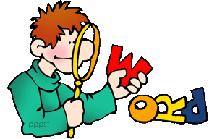
Vocabulary / ex. A page 20

Slide 2
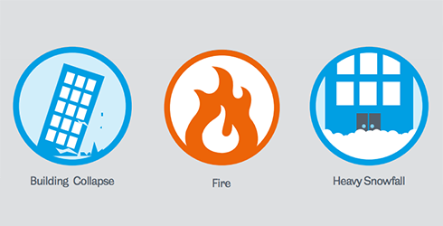
Incident/ phenomenon/ hoax/ illusion/ report/ tomb/ detective

Slide 3
Incident The incident caused discussion among the public

Slide 4
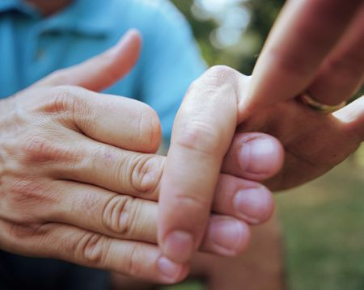
Incident/ phenomenon/ hoax/ illusion/ report/ tomb/ detective

Slide 5
Hoax The emergency call turned out to be a hoax.

Slide 6
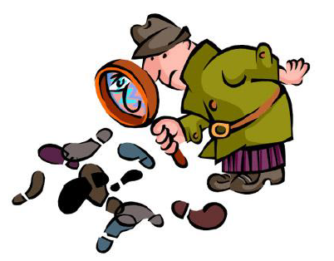
Incident/ phenomenon/ hoax/ illusion/ report/ tomb/ detective

Slide 7
Detective The detective examined the window frame for fingerprints

Slide 8
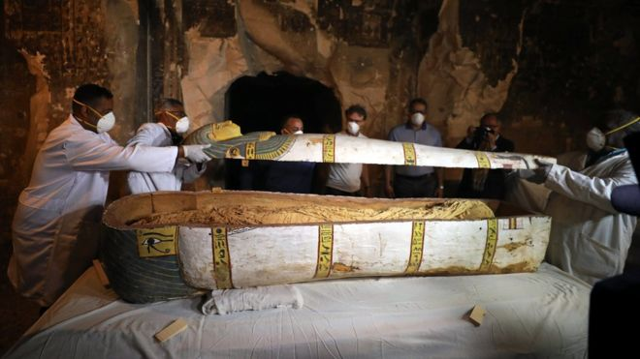
Incident/ phenomenon/ hoax/ illusion/ report/ tomb/ detective

Slide 9
Tomb Tourists queue in thousands to see the tomb

Slide 10
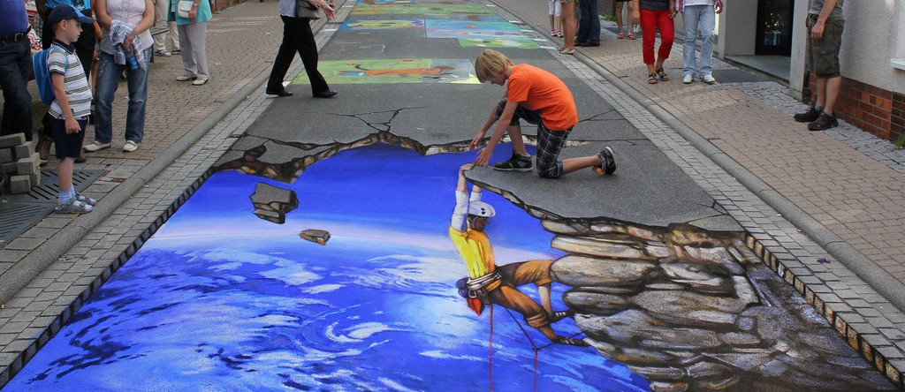
Incident/ phenomenon/ hoax/ illusion/ report/ tomb/ detective

Slide 11
Illusion He could no longer distinguish between illusion and reality

Slide 12
Incident/ phenomenon/ hoax/ illusion/ report/ tomb/ detective

Slide 13
Report The report ended on a positive note.

Slide 14
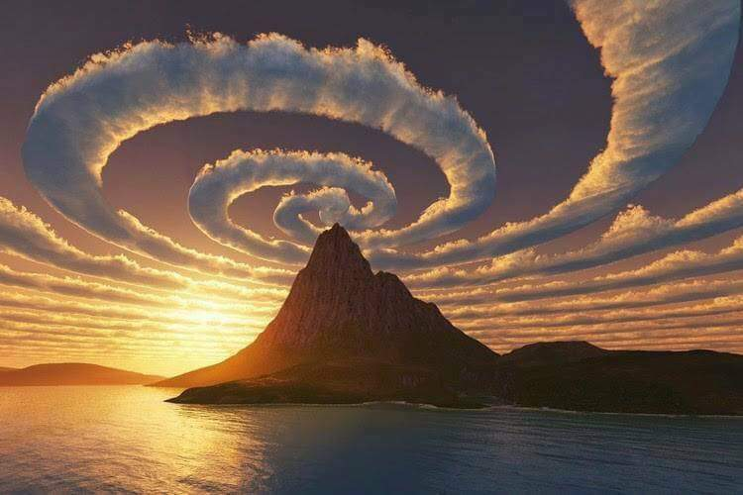
Incident/ phenomenon/ hoax/ illusion/ report/ tomb/ detective

Slide 15
Phenomenon Gravity is a natural phenomenon.

Slide 16
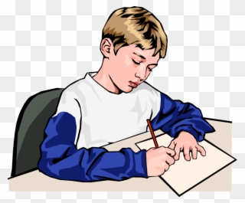
Incident/ phenomenon/ hoax/ illusion/ report/ tomb/ detective Task Write a short story using the above words in it.

