Slide 1
Ward/ meditation/ additives/ vaccination/ injection/ prescription/ crutch/ diagnose

Slide 2
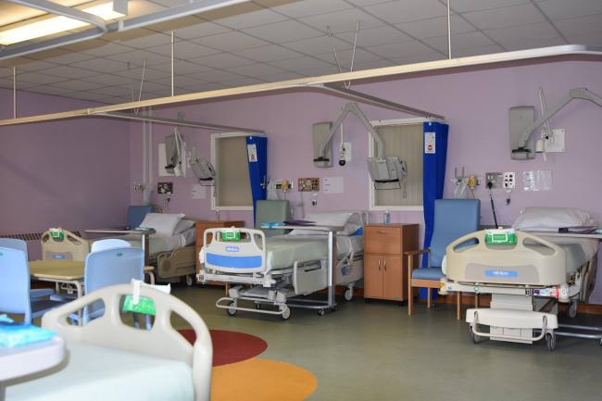
Ward/ meditation/ additives/ vaccination/ injection/ prescription/ crutch/ diagnose

Slide 3
He worked as a nurse on the children's ward.

Slide 4
Ward/ meditation/ additives/ vaccination/ injection/ prescription/ crutch/ diagnose

Slide 5
He was diagnosed (as) a diabetic when he was 64.

Slide 6
Ward/ meditation/ additives/ vaccination/ injection/ prescription/ crutch/ diagnose

Slide 7
Daily insulin injections are necessary for some diabetics.

Slide 8
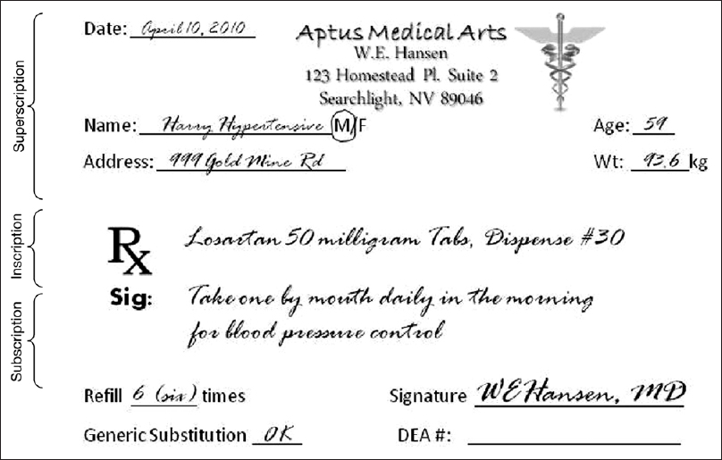
Ward/ meditation/ additives/ vaccination/ injection/ prescription/ crutch/ diagnose

Slide 9
The doctor gave me a prescription for antibiotics.

Slide 10
Ward/ meditation/ additives/ vaccination/ injection/ prescription/ crutch/ diagnose

Slide 11
Make sure your vaccinations are up to date.

Slide 12
Ward/ meditation/ additives/ vaccination/ injection/ prescription/ crutch/ diagnose

Slide 13
He was deep in meditation and didn't see me come in.

Slide 14
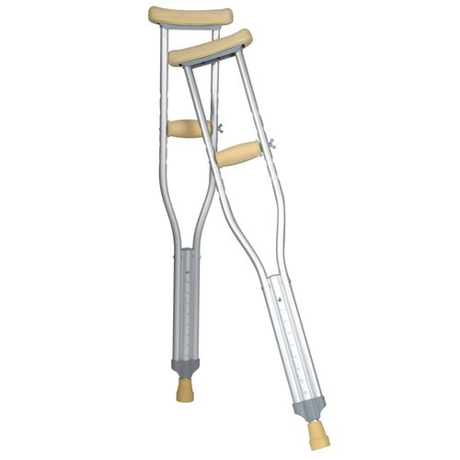
Ward/ meditation/ additives/ vaccination/ injection/ prescription/ crutch/ diagnose

Slide 15
After the accident I spent six months on crutches.

Slide 16
Group work Google and search for the synonyms and antonyms of 10 words then put Ward/ meditation/ additives/ vaccination/ injection/ prescription/ crutch/ diagnose in meaningful sentences.

