Slide 1
Unit 9 “Decimals and percentages”

Slide 2
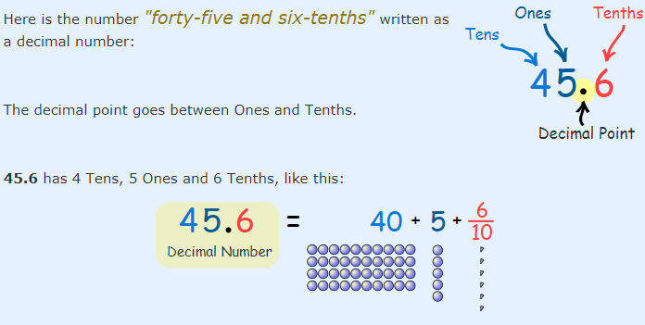
A Decimal Number (based on the number 10) contains a Decimal Point.

Slide 3
Place value.
When we write numbers, the position (or "place") of each digit is important.
For example:
In the number 327:
the "7" is in the Ones position, meaning 7 ones (which is 7),
the "2" is in the Tens position meaning 2 tens (which is 20),
and the "3" is in the Hundreds position, meaning 300.

Slide 4
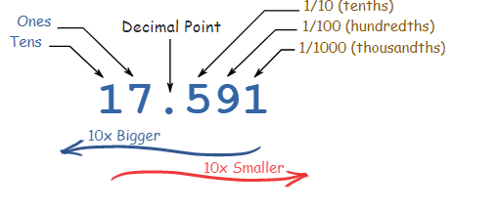
If we have a decimal number:

Slide 5
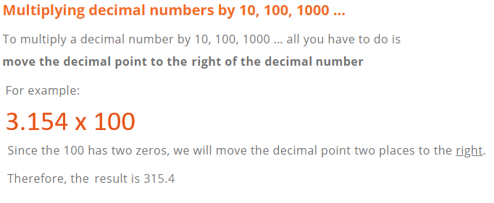
Multiplying and dividing decimals by powers of 10.

Slide 6
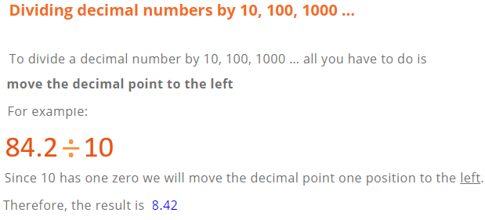
P. 131, Ex 9A
Q1 + 2 + 3

Slide 7
Rounding
Rounding means making a number simpler but keeping its value close to what it was.
The result is less accurate but easier to use.

Slide 8
How to round numbers?
Decide which is the last digit to keep.
Leave it the same if the next digit is less than 5 (this is called rounding down).
But increase it by 1 if the next digit is 5 or more (this is called rounding up).
P. 133, Ex 9B
Q2 + 3 +4 + 9 + 10

Slide 9
Understanding percentages
a percentage is a number or ratio that represents a fraction of 100. It is often denoted by the symbol "%" or simply as "percent" or "pct."
For Example:
35% is equivalent to the decimal 0.35, or the fraction $\frac{35}{100}$
To review watch the video below:
https://www.youtube.com/watch?v=JeVSmq1Nrpw
P. 134, Ex. 9C
Q1 + 3 + 4 + 5

Slide 10
Changing fractions to percentages.
It is easy to write a fraction with a denominator of 100 as a percentage.
For Example:
$\frac{67}{100}$ = 67%
You can change any fraction to a percentage by writing it with a denominator of 100.
P. 135, Ex. 9D
Q1 + 2 + 3 + 4 + 5 + 6 + 7

Slide 11
Expressing decimals as percentages.
To write decimals as percentages you can first write your decimal as a fraction with denominator 100.
For Example:
0.5 as a percentage
$\frac{5}{10}$ = $\frac{50}{100}$ = 50%
A quicker way to change a decimal to a percentage is to multiply by 100.
For Example:
0.471 as a percentage:
0.471 x 100 (move the decimal point to the right 2 decimals places)
So, 0.471 x 100 = 47.1%

Slide 12
To review watch the video below:
https://www.youtube.com/watch?v=-Xt4UDk7Kzw
P. 135, Ex. 9D
Q1 + 3 + 4 + 5 + 7 + 8

Slide 13
Finding percentages of amounts.
Percentages are often used in everyday transactions.
For example:
In each case you have to find the percentage of an amount to find the discount or the tax.
Example:
Find 25% of 100 JD.
$\frac{25}{100}$ x 100 = 25 JD.
Discount
10%
Tax
15 %

Slide 14
To review watch the video below:
https://www.youtube.com/watch?v=rR95Cbcjzus
P. 140, Ex. 9F
Q1 + 2 + 3 + 5 + 6 + 7 + 8 + 10 + 11 + 13

