Slide 1
Unit 6: Fractions

Slide 2
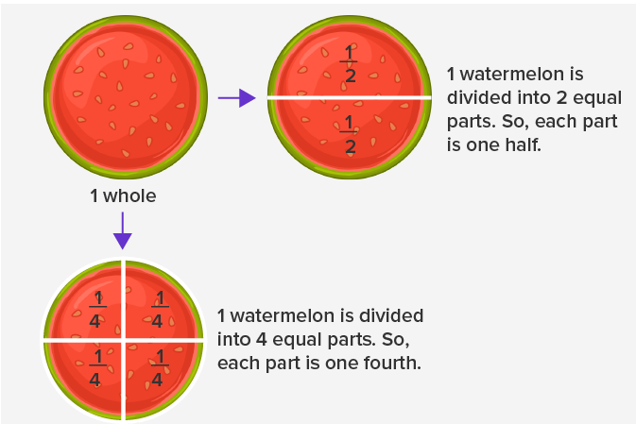
Fractions
Fraction of a whole: When we divide a whole into equal parts, each part is a fraction of the whole.
For example:
The word ‘fraction’ has been derived from the Latin ‘fractus’ which means “broken”

Slide 3
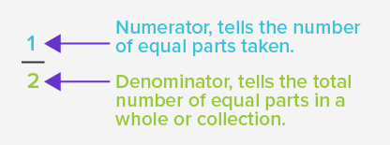
Numerator and denominator.
We call the top number the Numerator, it is the number of parts we have.
We call the bottom number the Denominator, it is the number of parts the whole is divided into.

Slide 4
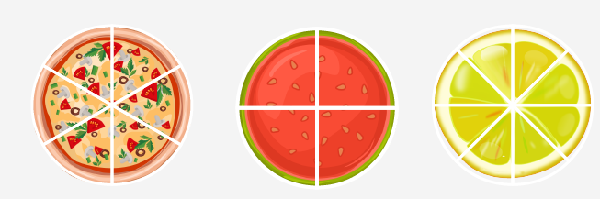
Real life examples
The most common examples of fractions from real life are equal slices of pizza, fruit, cake, a bar of chocolate, etc.

Slide 5
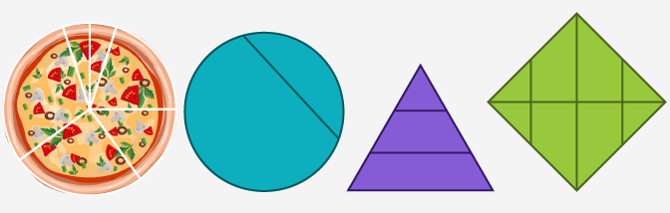
Non-examples!
When the parts of the whole are unevenly divided, they don’t form fractions.

Slide 6
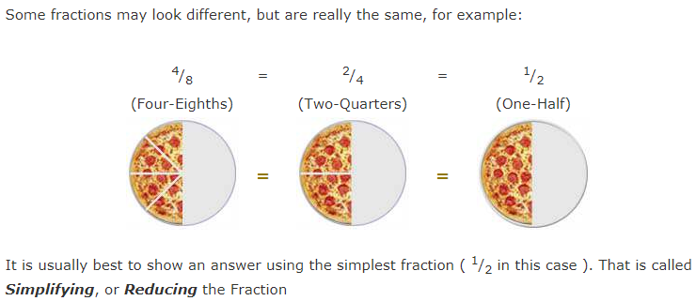
Equivalent fractions

Slide 7
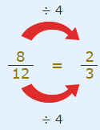
Simplifying fractions.
Simplifying (or reducing) fractions means to make the fraction as simple as possible.
A fraction is in its simplest form when its numerator and denominator have no common factor (other than 1).
To simplify any fraction:
Divide both the top and bottom of the fraction by the Highest Common Factor (you have to work it out first!).
For example, the HCF of 8 and 12 is 4 , so

Slide 8
Fractions greater than 1
A fraction where the numerator is higher than denominator.
We have three types of fractions:
Proper fraction
Improper fraction
Mixed number

Slide 9
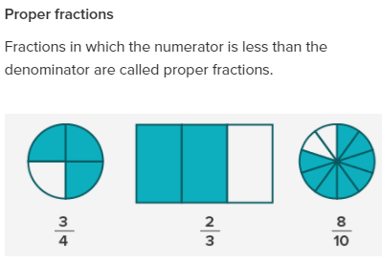

Slide 10
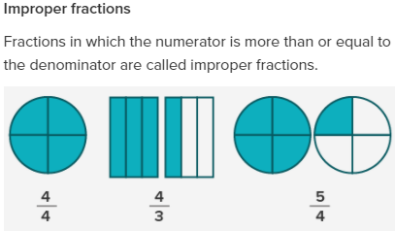

Slide 11
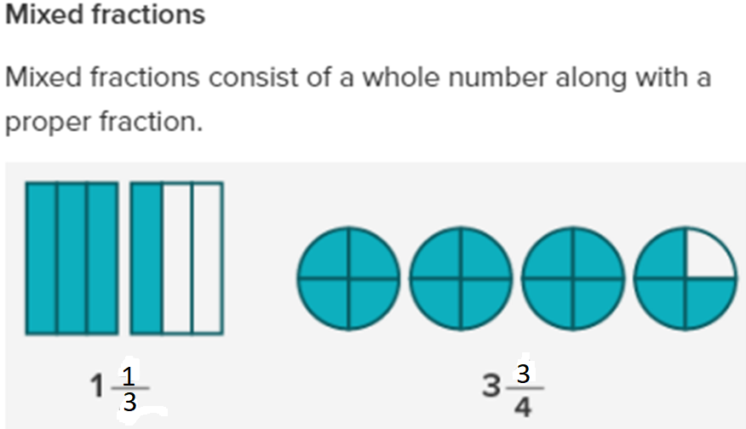

Slide 12
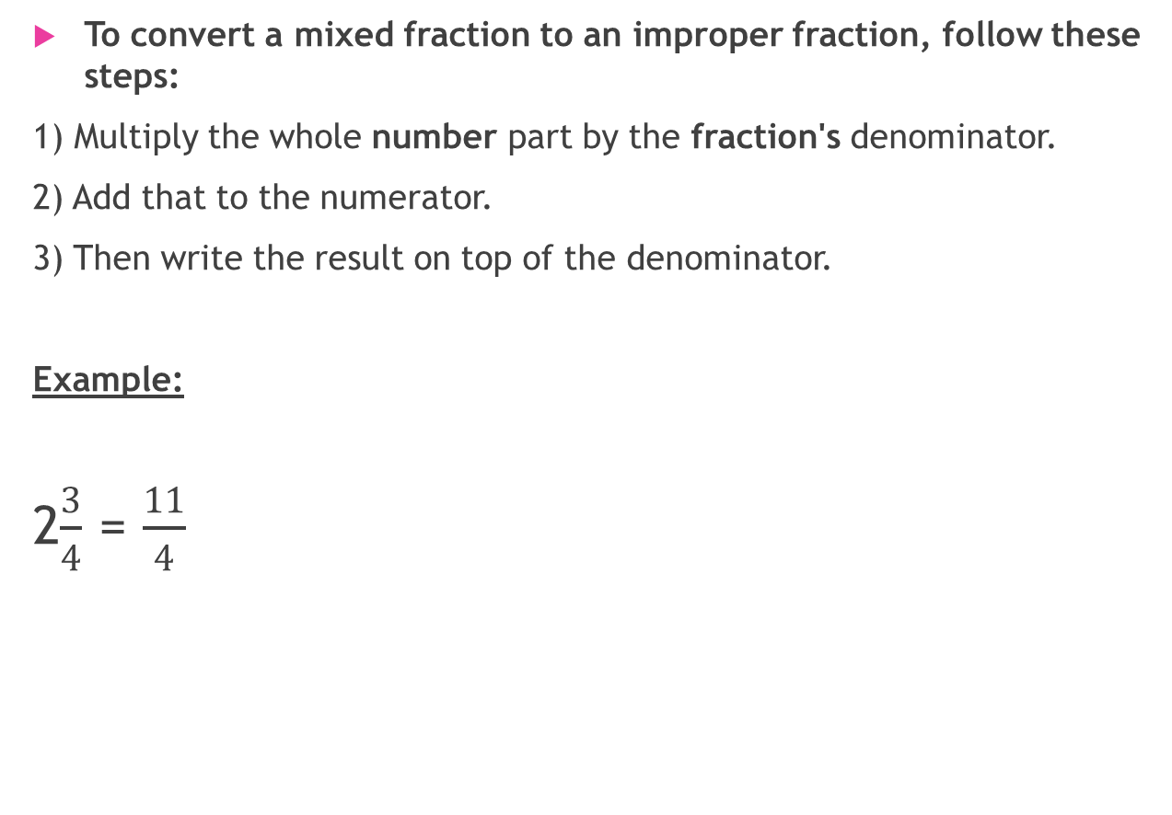
Changing between improper fractions and mixed numbers
To convert a mixed fraction to an improper fraction, follow these steps:
1) Multiply the whole number part by the fraction's denominator.
2) Add that to the numerator.
3) Then write the result on top of the denominator.
Example:
2$\frac{3}{4}$ = $\frac{11}{4}$

Slide 13
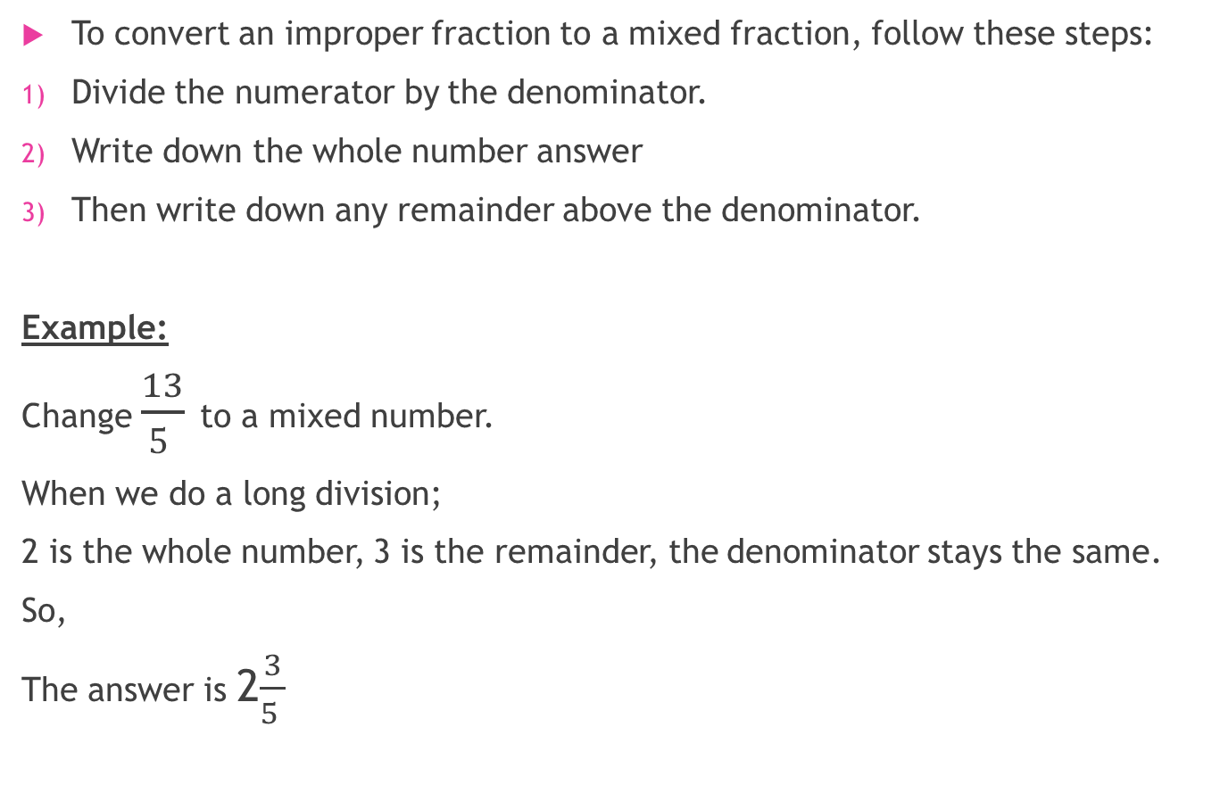
To convert an improper fraction to a mixed fraction, follow these steps:
Divide the numerator by the denominator.
Write down the whole number answer
Then write down any remainder above the denominator.
Example:
Change $\frac{13}{5 }$ to a mixed number.
When we do a long division;
2 is the whole number, 3 is the remainder, the denominator stays the same.
So,
The answer is 2$\frac{3}{5 }$

Slide 14
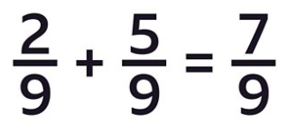
Adding fractions
To add fractions there are Three Simple Steps:
Make sure the bottom numbers (the denominators) are the same
Add the top numbers (the numerators), put that answer over the denominator
Simplify the fraction (if needed)
Example:

Slide 15
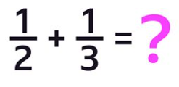
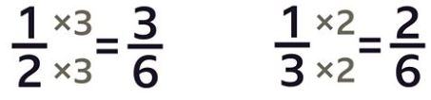
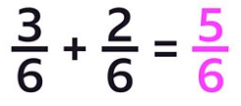
However, sometimes the denominators are different.
Use equivalent fractions to make them the same.
Example:

Slide 16


To review watch the videos below:
Adding fractions with common denominators:
https://www.youtube.com/watch?v=mO53rHEIQr4
Adding fractions with different denominators:
https://www.youtube.com/watch?v=tDQipFjAoT8&t=10s
P. 94, Ex 6A
Q1 + 2 + 3 + 4 + 5 + 6

Slide 17
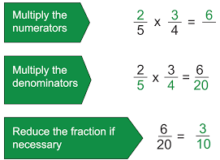
Multiplying fractions

Slide 18
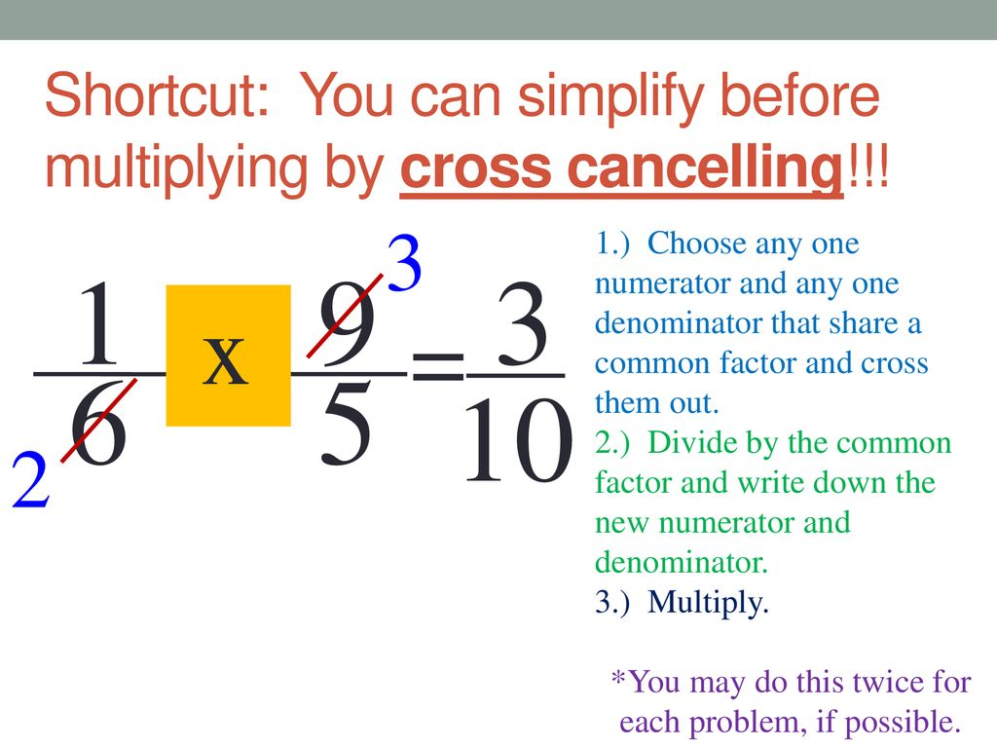
Cancelling method
÷3
÷3

Slide 19
To review watch the videos below:
Multiplying fractions:
https://www.youtube.com/watch?v=qmfXyR7Z6Lk
Multiplying Fractions with Cancellation Method - Basic Fraction Review - YouTube
P. 96, Ex. 6B
Q1 + 2 + 3 + 4 + 5 +8 + 9

Slide 20
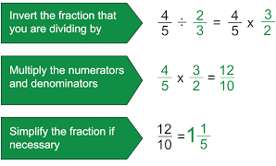
Dividing fractions.

Slide 21
To review watch the video below:
https://www.youtube.com/watch?v=RAKwouL-lTc
P. 98, Ex. 6C
Q2 + 4
P. 100, Ex. 6D
Q1 + 2 + 3 + 4
P.101, Ex. 6
Q1 + 2 + 3 + 4 + 5

