Slide 1
Concentration and Solubility Revision

Slide 2
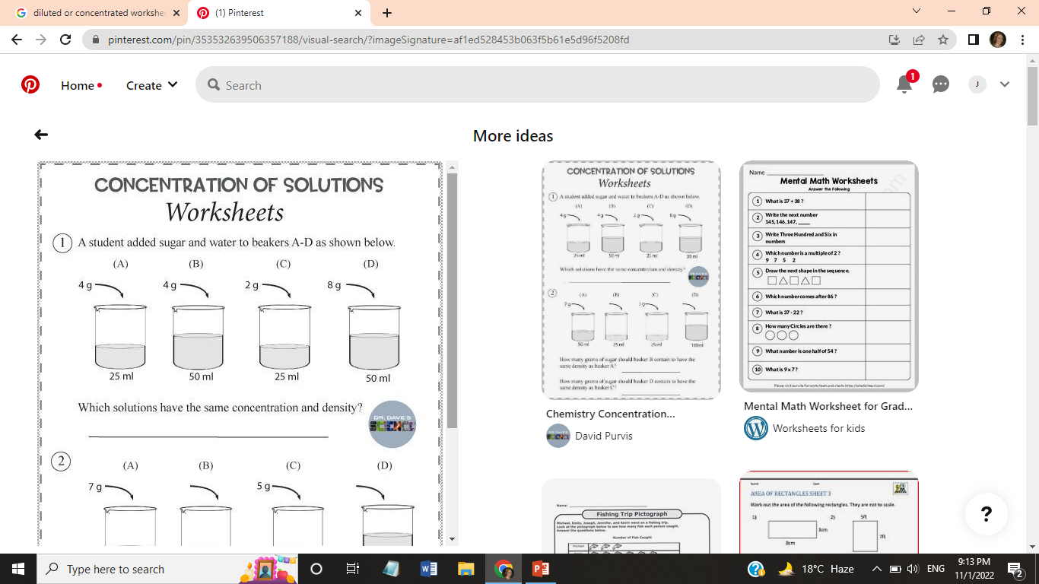
Which two solutions have the same concentration?
Concentration = mass of solute (g)
volume of total solution (L)
Solution A | 4/25= 0.16g/ml
Solution B | 4/50=0.08g/ml
Solution C | 2/25= 0.08g/ml
Solution D | 8/50= 0.16g/ml

Slide 3
15 g of sodium chloride was dissolved in water. The total volume of the sodium chloride solution was 0.75 L. What is the mass concentration of the sodium chloride solution in g/L?
Concentration = mass of solute (g)
volume of total solution (L)
=15 g/0.75 liters
=20 g/L

Slide 4
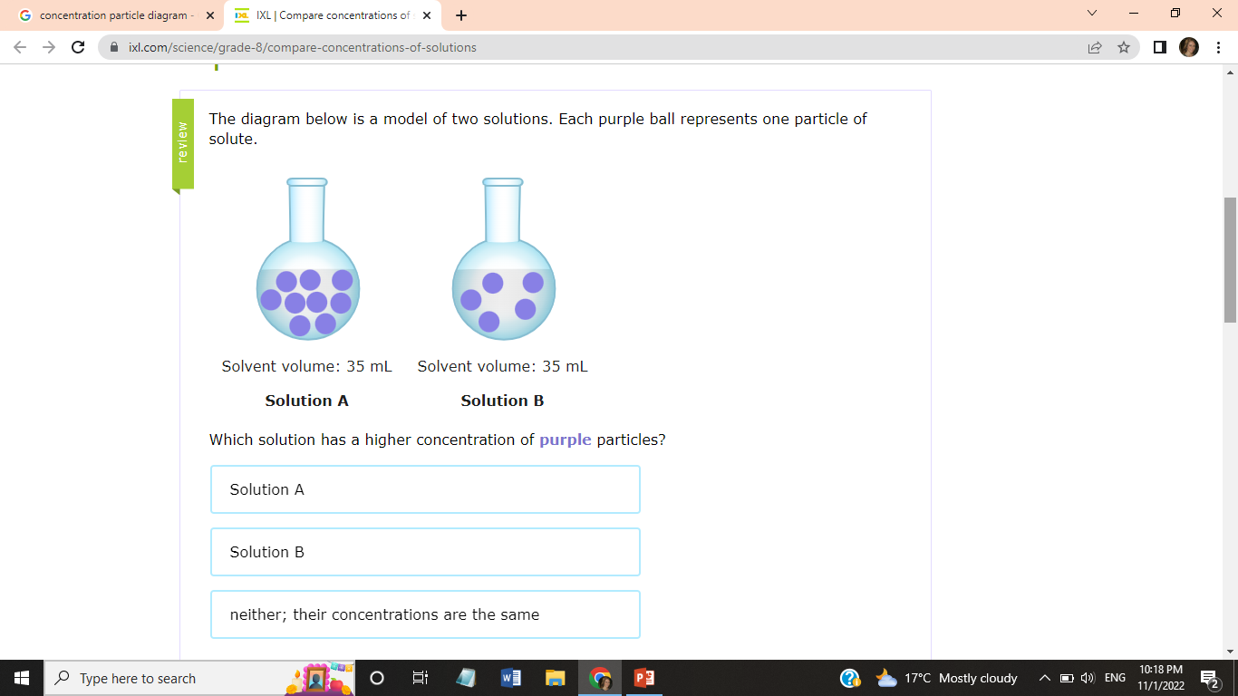
Solution A has more purple particles per milliliter. So, Solution A has a higher concentration of purple particles.

Slide 5
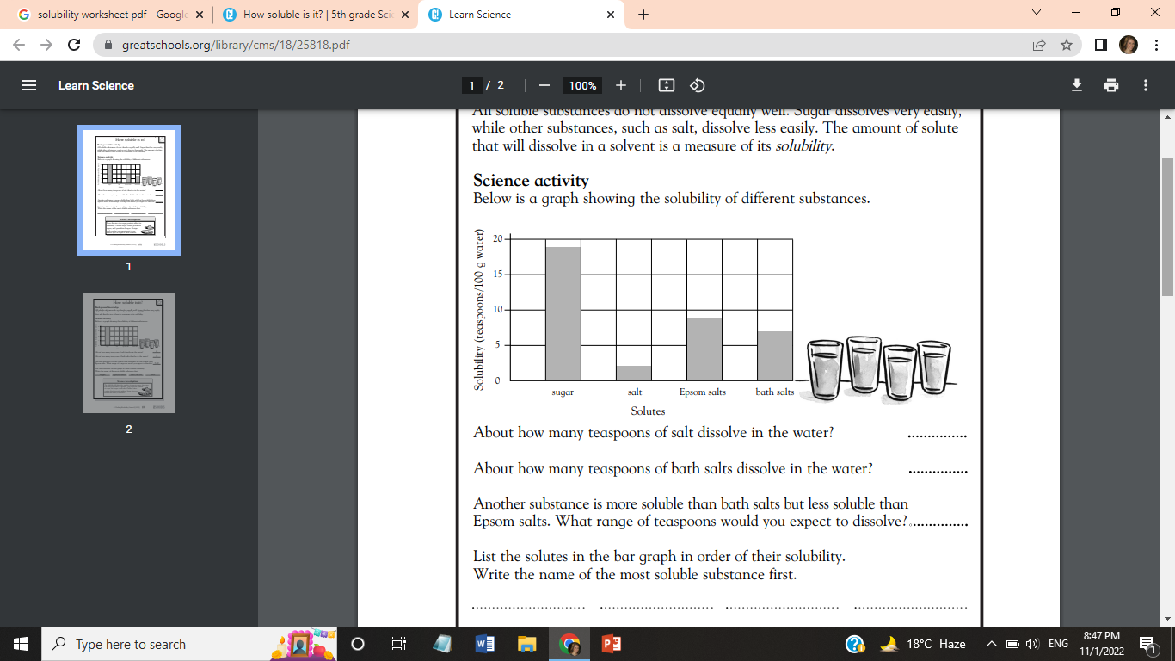
2
7
7-9
Sugar Epsom salt bath salt salt

Slide 6
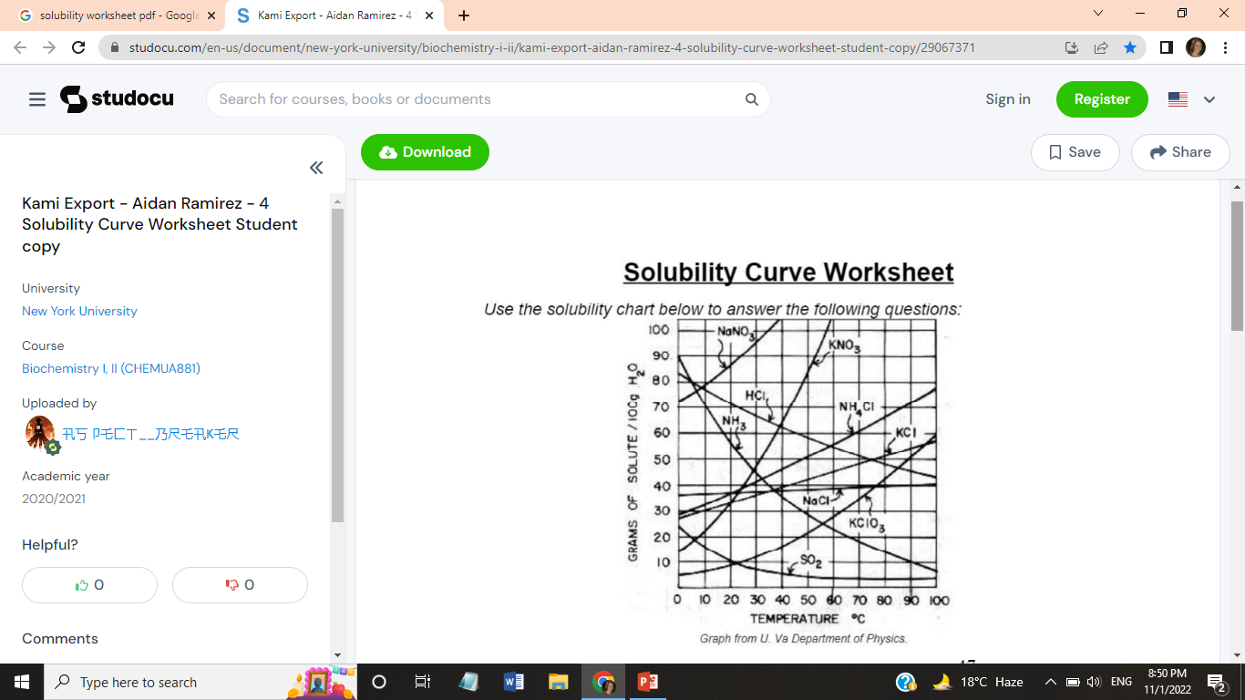
What is the solubility of NaNO3 at 30⁰C? .......
How many grams of NH3 can I dissolve in 200g of water at a temperature of 45⁰C? .............
At what temperature is the solubility of NaCl is the same as KCl? ............
How many grams of NH4Cl would I need to make 300 grams of saturated solution at 70⁰C? ..................
95g
32g*2=64g
38⁰C
60*3=180g

