Slide 1
Will Vs. Be going to
j

Slide 2
*Both ‘will’ and ‘be going to’ refer to the future but there is a slight difference between the two. Remember: base form is used after both of them.

Slide 3
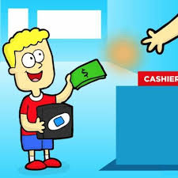
Will
1. Prediction without evidence:
Example:
I think it will rain later so take an umbrella with you.
2. Quick decisions (on spot decisions):
For things that we decide to do now.
Example:
Look at these rings, I will buy one for you.

Slide 4
will
3. Offers:
Example:
I'll give you a discount if you buy it right now.
I will take you to the movies.
4. Promises:
Example:
I promise I will behave next time.

Slide 5
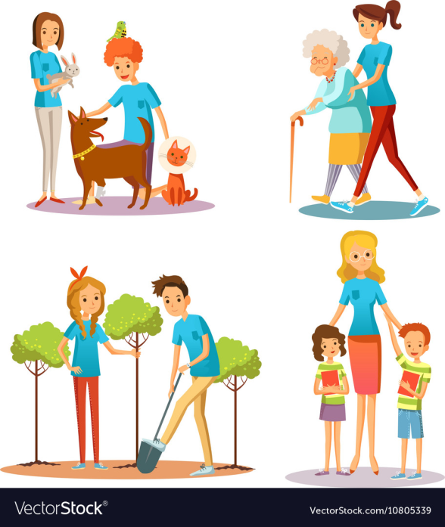
will
5.Requests:
Example:
Will you help me?
6. Threats:
Example:
I will call the police if you don’t stop annoying me.

Slide 6
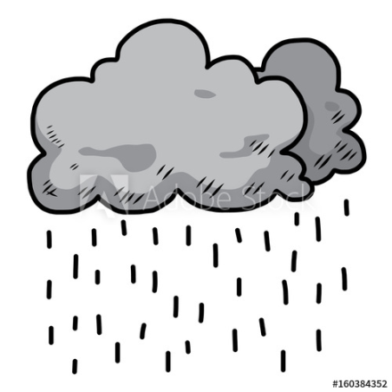
Be going to
1.Prediction with evidence:
Example:
The sky is grey, it’s going to rain.
2. Commands:
Example:
“You are going to clean your room,” mother said.

Slide 7
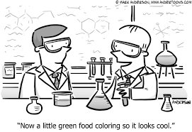
Be going to
3. Intentions or arranged plans ( decisions you made before the time of speaking) Prior plan:
Example:
I’m going to study chemistry.
I’m going to the beach next weekend with my friends.

Slide 8
Affirmative | Negative | Question
She will come on time. | She won’t come on time. | Will she come on time?
The girls will help in the camp. | The girls won’t help in the camp. | Will the girls help in the camp?
They are going to swim. | They aren’t going to swim. | Are they going to swim?
He is going to meet her. | He isn’t going to meet her. | Is he going to meet her?

