Slide 1
Issue Analysis
Objective: Analyzing Issues and considering them from global, national , local and personal perspectives

Slide 2

What is Analysis?
Is the process of breaking a complex topic into smaller parts in order to gain a better understanding of it.

Slide 3
The difference between issue and perspective
Issue : an important topic or problem for discussion , debate or analysis.
Perspective : a particular attitude , viewpoint or way of looking at an issue.
Different perspectives:
Global : relating to the whole world
National :related to a particular country / common to a whole country.
Local: related to a particular community or area.
Personal: related to yourself

Slide 4
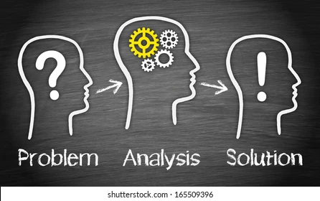

Slide 5
6 Easy key Steps to Analyze Any Problem (issue)
Identify the problem
Find causes
Brainstorm possible solutions
Course of action
Evaluate the outcome
Problem Impact
(the effect)

Slide 6
Issue Analysis
Identify the problem | Find causes | Problem Impact consequence(s) | Possible solutions | Course of action | Evaluate the outcome
make sure that you understand what the problem is. Then consider the issue from different perspectives as a requirement to support your report. | What causing the problem and where its coming from . Always remember to support your findings with evidence. | The consequent results or impact on future events. This step will help you list possible solutions. | A means of solving a problem or dealing with a difficult situation. | Once you’ve agreed on a solution, plan exactly how it will work. Course of action a plan or method used for achieving a specific goal or aim. | Once you have put the plan into action, you need to check how it went. Sometimes you’ll need to try more than one solution

Slide 7
Evidence
While working on the pervious section about finding causes (reasoning), you will have realized the importance of using evidence to support your reasoning for any argument.
This slide will help you explore the types of evidence you will come across during your global perspectives studies.
Types of evidence :
Research suggests…
In the newspaper article from….dated….
Data from
the graph show….
Statistics
In a study conducted by….
Information from the website….
The blogpost by…states…

Slide 8
class Activity
Analysis the report in the attached worksheet
By answering the questions considering and using the pervious 6 steps.

Slide 9
Class Activity # 1
Analyze the previous video by using the previous steps.
Identify the problem?
Find Causes.
List the effects.
Write down possible solutions.
Outcome(action): Elicit and discuss information in the video.

Slide 10
Good Luck

