Slide 2
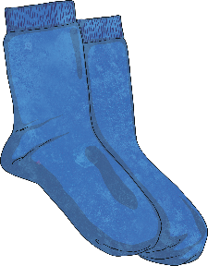

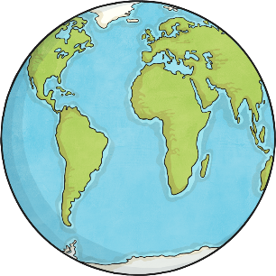
What Is Figurative Language?
Figurative language is a way of using words to compare something to something else – beyond the literal meaning.
Figurative language is used for emphasis and impact.
I’ve told you a million times to clean your room!
She ran as fast as lightning.
His team was on top of the world after winning the
championship game.

Slide 3
Why Use Figurative Language?
Figurative language makes our writing more interesting. It also helps the reader create a mental image of our meaning.
Which sounds more interesting?
We are alike.
OR
We are two peas in a pod.

Slide 4
Types of Figurative Language
Here are a few types we will discuss:
simile
metaphor
personification
hyperbole

Slide 5
Simile
A simile compares two things by using the words “like” or “as.”
Your eyes sparkle like diamonds.
The classroom looked like a tornado had gone through!
I tiptoed as quietly as a mouse.
Similes always include the words “like” or “as.”

Slide 6
Metaphor
A metaphor compares one thing to another without using “like” or “as.”
Laughter is music for the soul.
You are my sunshine.
Those ideas are food for thought.
Metaphors say one thing is another.

Slide 7
Personification
Personification gives human qualities to animals,
non-living objects, or ideas.
The stars danced in the sky.
In the jungle, the lion sings tonight.
That cake is calling my name.
Personification gives something non-human the qualities of a person.

Slide 8
Hyperbole
Hyperbole is obvious exaggeration to make a point.
She knows everything about math!
You are the best teacher in the entire universe.
My hands are ice cold!
Similes and metaphors can also be examples of hyperbole.

Slide 9

Quiz
Can you correctly identify the type of
figurative language?

Slide 10
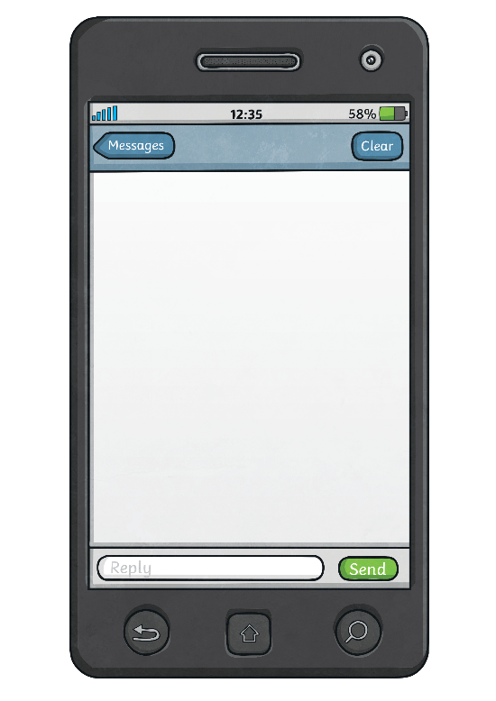
Simile, Metaphor, Personification, or Hyperbole?
My phone shouted at me from the other side of the room.
personification

Slide 11

Simile, Metaphor, Personification, or Hyperbole?
His heart was broken.
metaphor

Slide 12

Simile, Metaphor, Personification, or Hyperbole?
Your name sounds like music to my ears!
simile

Slide 13

Simile, Metaphor, Personification, or Hyperbole?
There’s no river wide enough to keep me from getting to you.
hyperbole

Slide 14
Question:
Why do you think we use figurative language
in writing?

