Slide 3
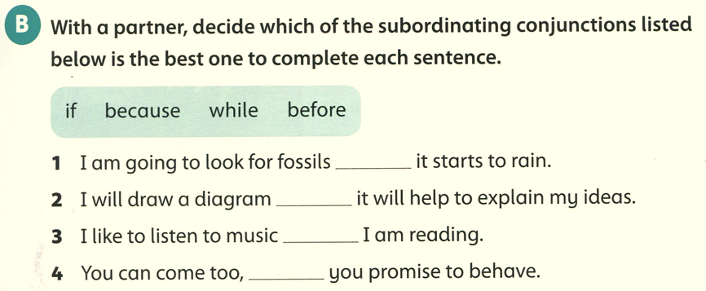
before
because
while
if

Slide 4
1- we will go to the airport when we need to catch our plane.
2- The woman flew in a space shuttle after training to be an astronaut.
3- some animals are carnivores because they eat meat.
4- Some sea creatures died out, so became extinct.

