Slide 1
Lesson: (Melting, freezing and subliming)

Slide 2
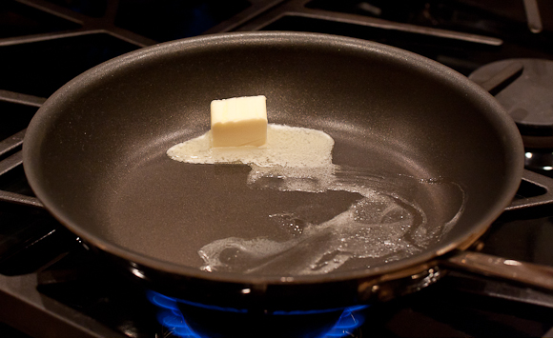
Melting
Melting is a process that results in the phase transition of a substance from a solid to a liquid. This occurs when the internal energy of the solid increases, typically by the application of heat , which increases the substance's temperature to the melting point.
The melting point of a substance is the temperature at which it changes state from solid to liquid.

Slide 3
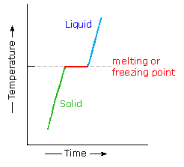
When the solid starts to melt until it has completely turned into a liquid its temperature doesn’t rise. All the heat energy is used to separate the particles so they can flow over one another.
When considered as the temperature of the reverse change from liquid to solid, it is referred to as the freezing point.

Slide 4
The particle theory
When a solid is heated all the particles receive more energy and move more strongly and push each other a little further apart. If the solid is heated further, the energy makes the particles vibrate so strongly that they slide over each other and become a liquid.
Heat

Slide 5
Examples of Solid to Liquid
Rocks to lava - rocks in volcanos can be heated until they become molten lava.
Metal to molten liquid - metals can be molten down and reforms into solid.
Ice to water - ice returns to its water form after being left in temperatures above freezing

Slide 6
Freezing
Freezing is a phase transition where a liquid turns into a solid when its temperature is lowered below its freezing point.

Slide 7
Other substances can freeze into solids at temperature much higher or lower than the freezing point of water.
For example, when molten wax runs down the side of a candle it freezes and becomes a solid before it reaches the bottom.

Slide 8
Examples of Liquid to Solid
Water to ice - when water becomes cold enough it freezes and turns to ice.

Slide 9
Sublimation
Sublimation is the transition of a substance directly from the solid to the gas state, without passing through the liquid state.
The reverse process of sublimation is deposition or desublimation, in which a substance passes directly from a gas to a solid phase.

Slide 10
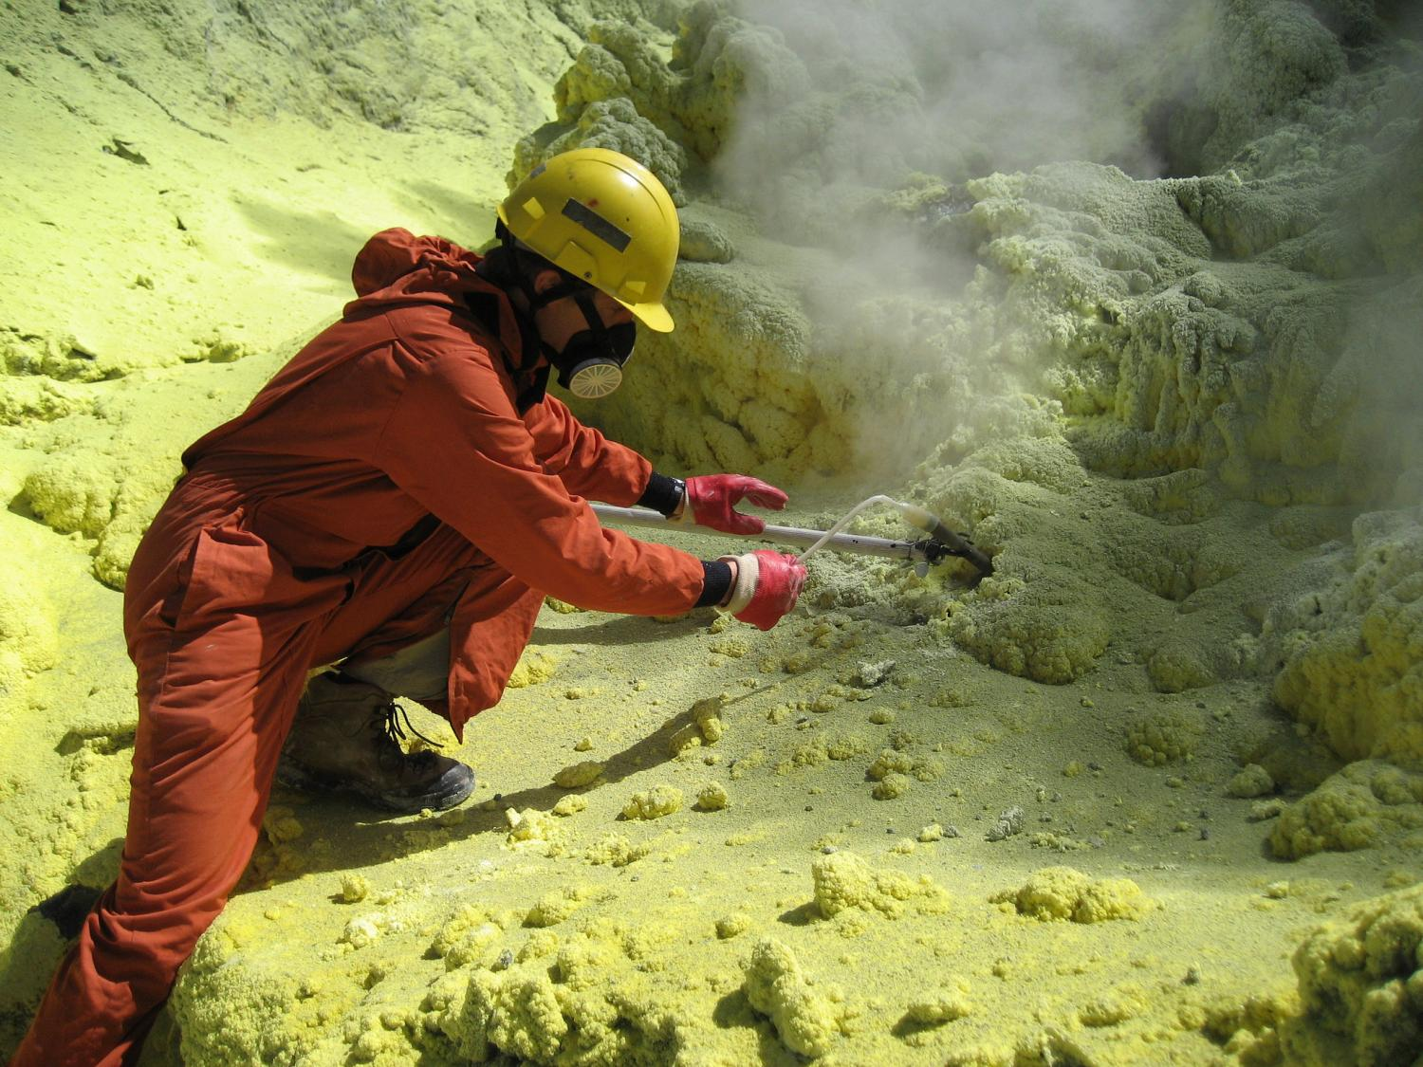
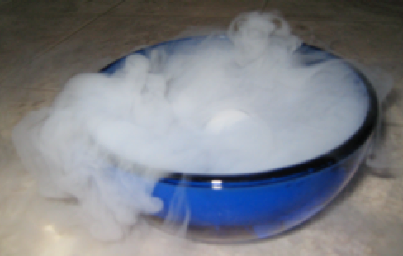
Sublimation- desublimation
Solid Gas
Gas Solid

Slide 11
Examples of Solid to Gas
Dry ice sublimation - carbon dioxide is called 'dry ice' and sublimates when at room temperature.

