Slide 1
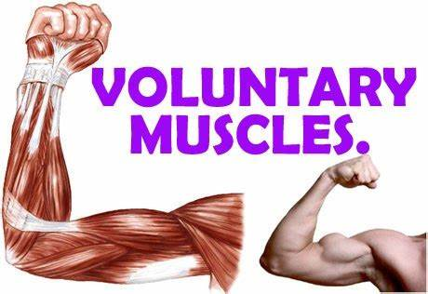
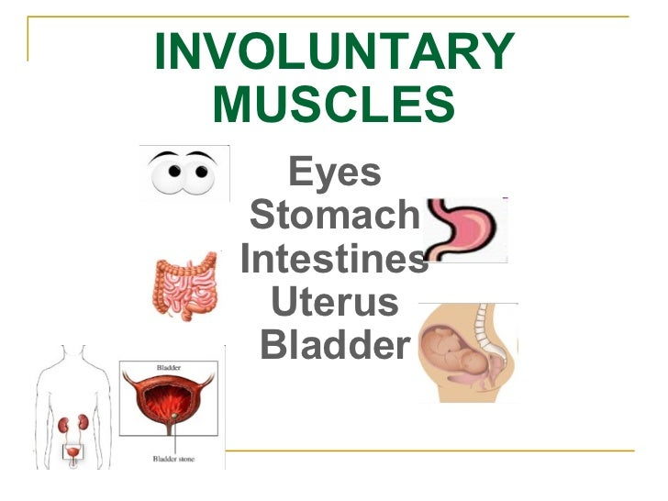
How does the body move?
Movements can be either voluntary or involuntary:
1- Voluntary movements:
Movements that happen in our bodies because we
want them to happen. (ex. Arm and leg muscles)
2- Involuntary movements:
Muscles that work without us having to think
about them.
(ex. digestive system)

Slide 2
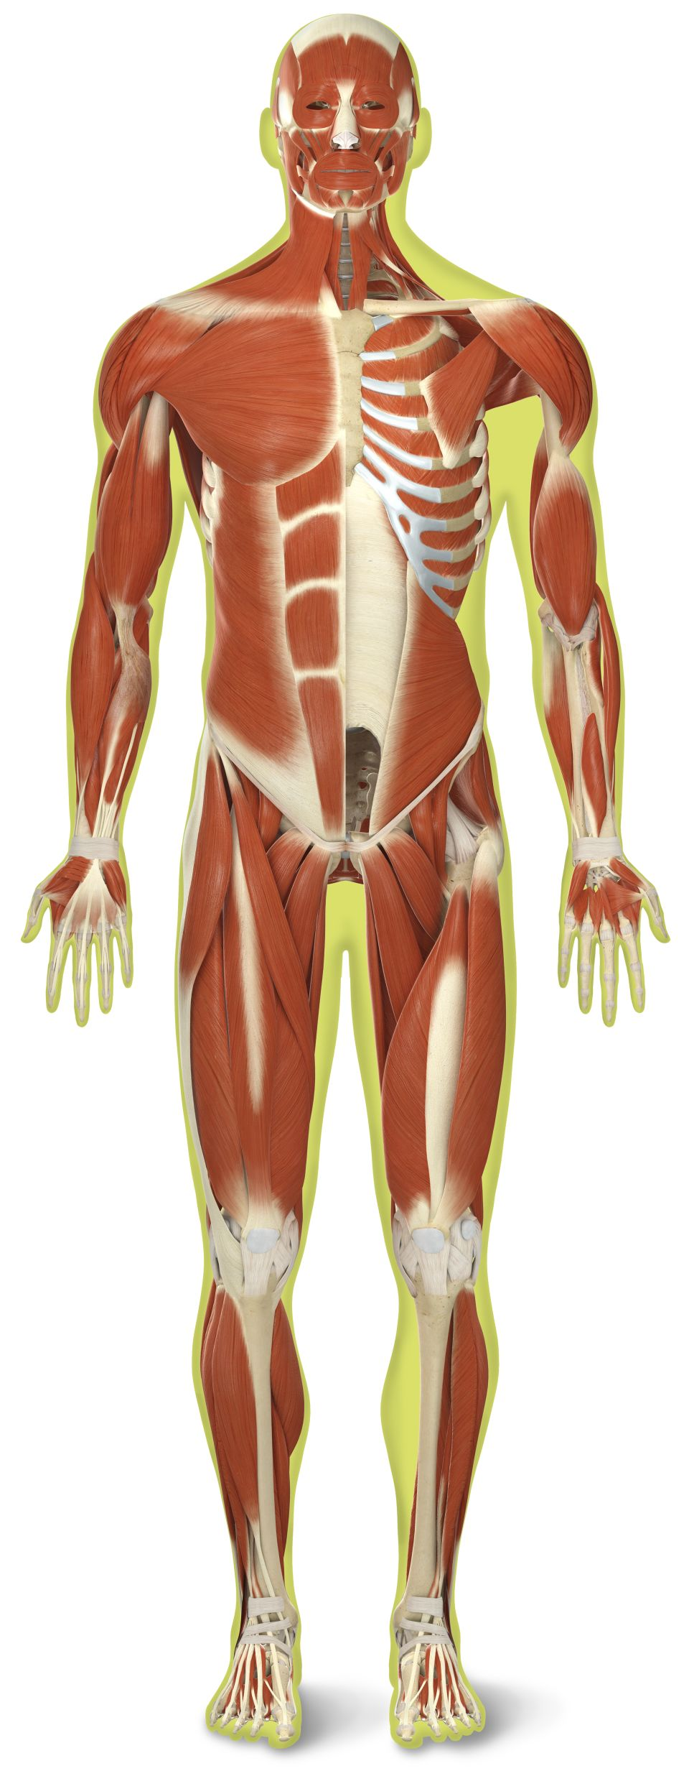
Bones and muscles:
Bones make up the skeleton and support the body.
Bones do not move on their own, they need muscles to allow them to move.
Muscles are made of stretchy, elastic cells and fibers.
Muscles function like rubber bands that stretch and relax in the body.

Slide 3
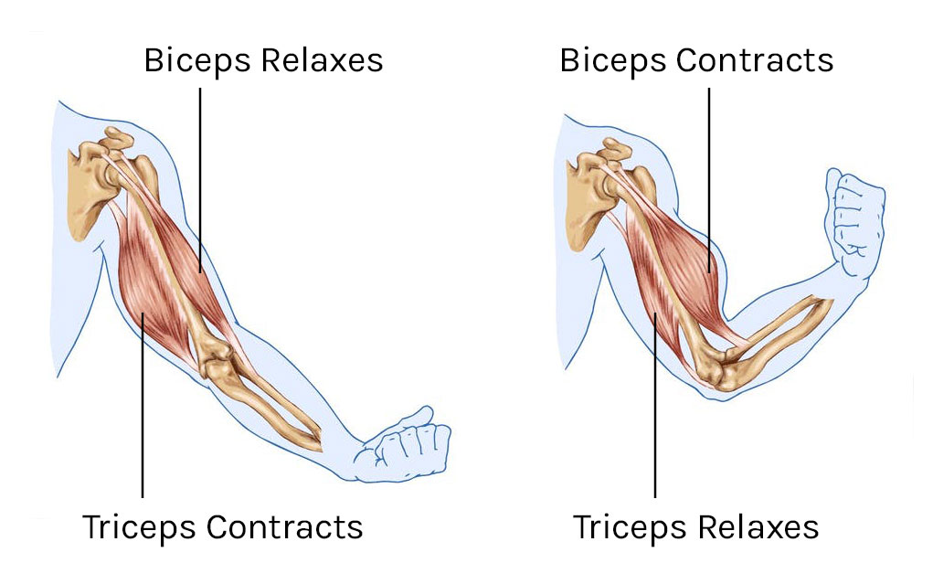
How do muscles work?
Muscles work in pairs, one muscle pulls the bone forward and another muscle pulls the bone backwards.
When one muscle contracts, the other muscle relaxes. Muscles work in pairs.

Slide 4
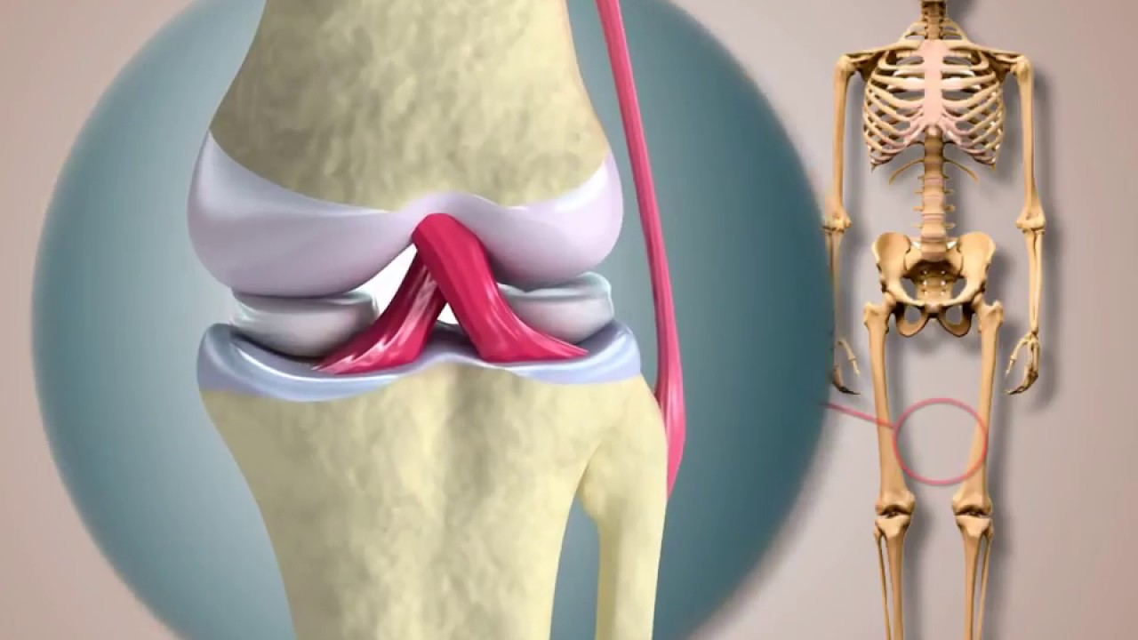
Joints:
The place where one bone joins another is called a joint.
Joints allow movement and give the skeleton its ability to bend, twist and turn.
Tissues called ligaments hold
bones together at joints.

Slide 5
Taking care of bones and muscles:
1- Do regular exercise.
2- Be ware of you posture.
3- Sit and walk with your back straight.
4- Eat food rich with calcium such as dairy products, beans and canned fish.
5- Warm up before exercise to bring blood and oxygen to your muscles.

Slide 6
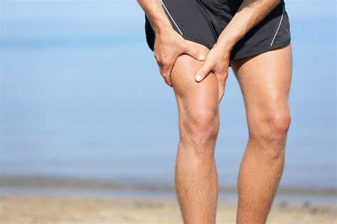
Muscle sprains:
Sprain occur when a muscle is pulled too far. The result can be a break or a tear of a ligament.
Sprains can sometimes happen as a result of an injury. It can also be a result of not warming up before exercises.

Slide 7
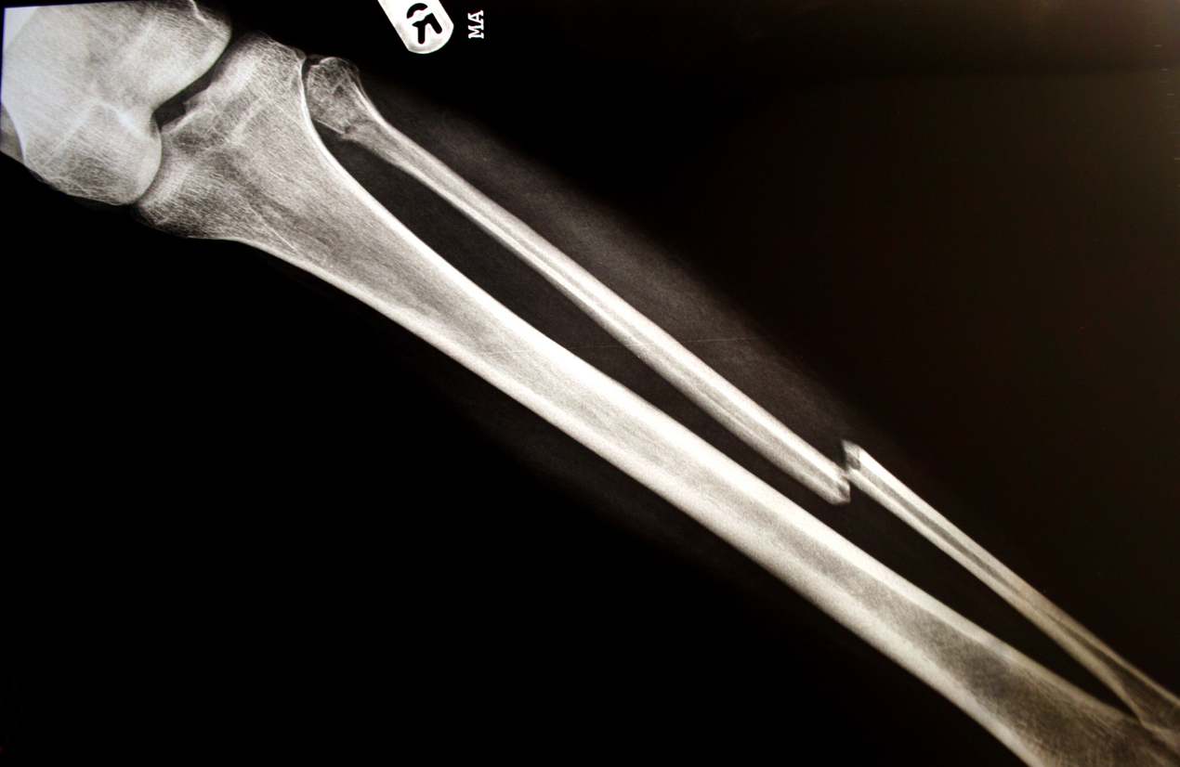
Bone Fractures:
Broken bones often occur as a result of accidents. Its called a fracture.
You can tell that your bone is broken by: the pain is very strong, you cannot move the part that is broken, the tissues around it begin to swell or grow bigger.

Slide 8
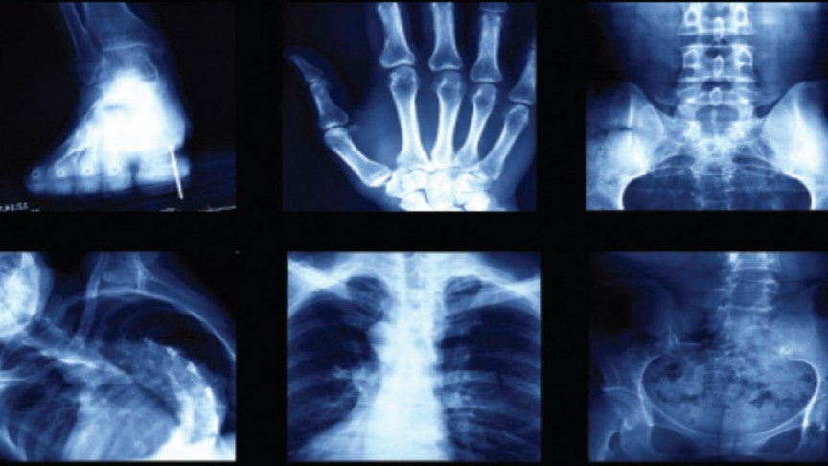
X-ray:
An X-ray is a black and white picture of the bones taken with a special machine. It lets a doctor see if a bone is broken.

