Slide 1
All living things are made of cells
Unit two

Slide 2
Cells:
Are the building blocks of all livings things and the smallest unit of an organism. They can only be seen using microscope.
Group of similar cells makes a tissue, a group of different tissues makes an organ, and a group of different organs working together to perform a specific function makes an organ system:

Slide 3
Some organisms are made up of one cell (unicellular)
While most are made up of many cells (multicellular)

Slide 4
1. Cells of multicellular organism:
An animal cell and a plant cell:

Slide 5
All cells have three parts in common:
1- The cell membrane:
Holds the cell together, gives it its shape, controls what passes in and out of the cell.
2- The cytoplasm:
The jelly like fluid inside of the cell.
3- The nucleus:
One of the largest parts of the cell and is located near its middle. It controls all reactions that take place in the cell.

Slide 6
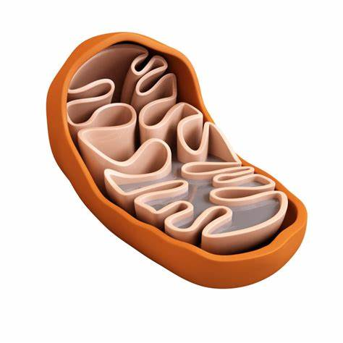
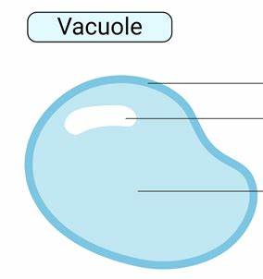
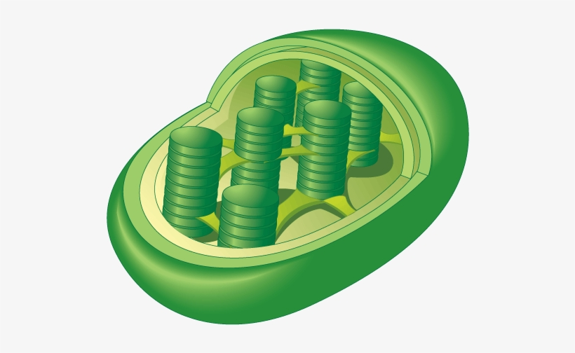
Other organelles in the cell:
Mitochondria: supplies the cell with energy
Vacuoles: open spaces that hold food, water and wastes.
Chloroplast: These are small green containing Chlorophyll which give plants their green color required for photosynthesis.

Slide 7
How plant cells and animal cells are alike:
1- Both are small.
2- Both are filled with watery substance. ( cytoplasm)
3- Both have an outer covering ( cell membrane) and small structures inside (organelles).
4- Both have a nucleus.

Slide 8
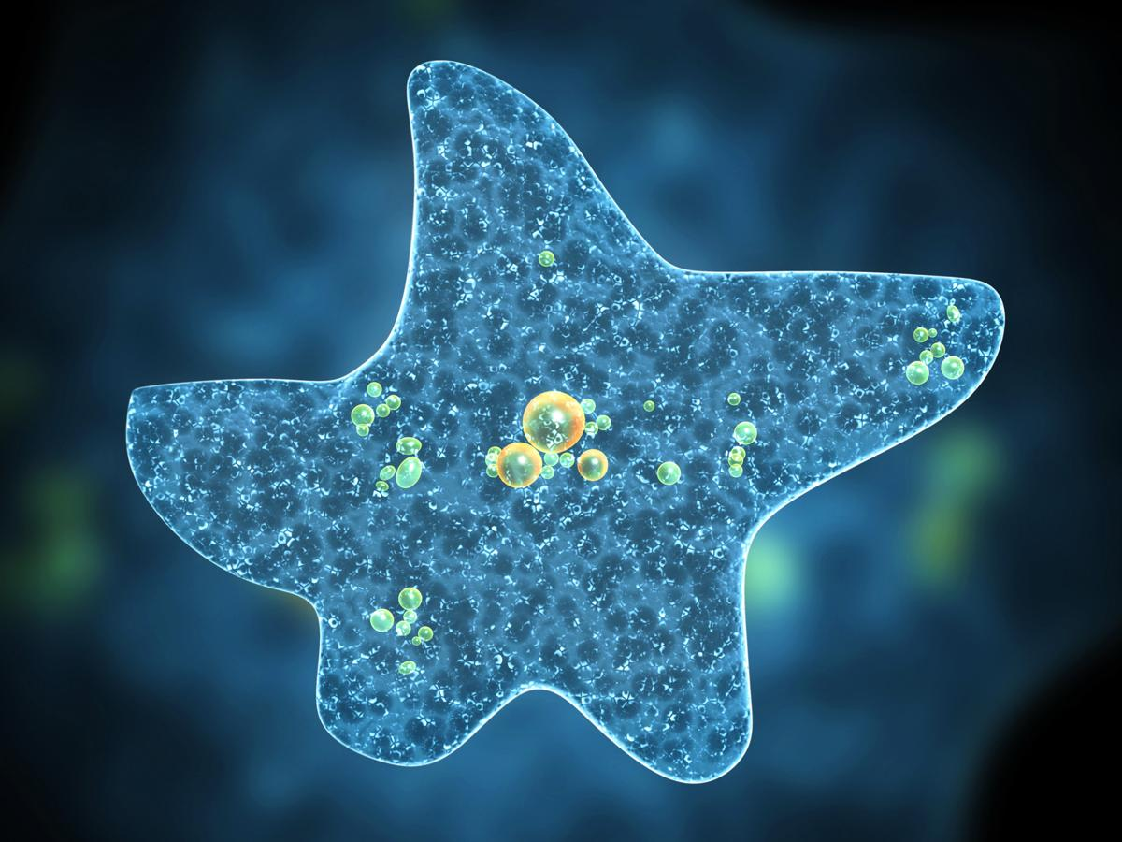
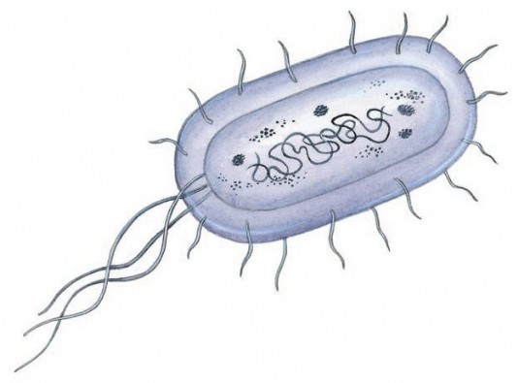
2. Cells of unicellular organisms:
unicellular organisms are made up of only one cell which carries out all functions needed for life ( breathe, feed, reproduce).
Examples: bacteria and amoeba.

Slide 9
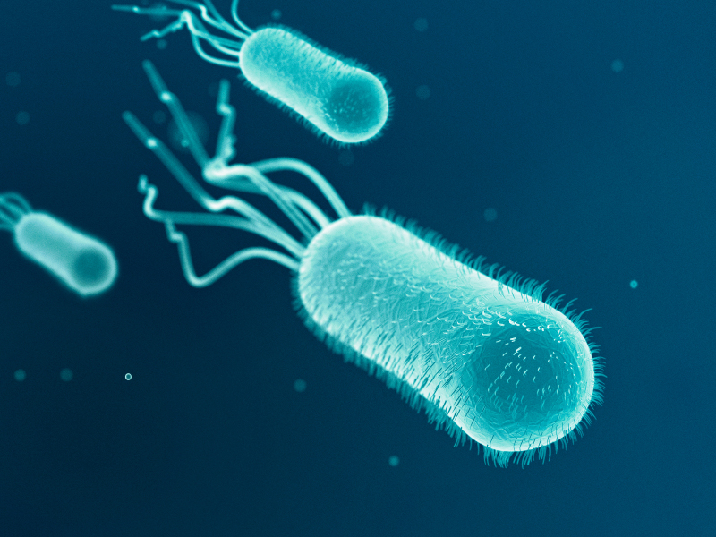
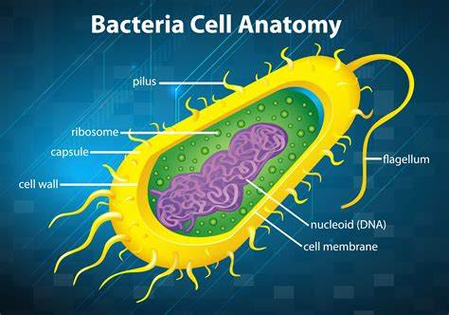
Bacteria
They use air or water to move from one place to another.
Sometimes they have a tail that allows them to move ( flagella)
Some live in the air, others on ground and others are parasites (inside other organisms)

Slide 10
How bacteria is beneficial?
1- some help to decompose (break up) dead organisms to release chemicals and nutrients.
2- some provide medicines (antibiotics) to help fight diseases.
Some bacteria can be pathogenic which means they cause diseases.

Slide 11
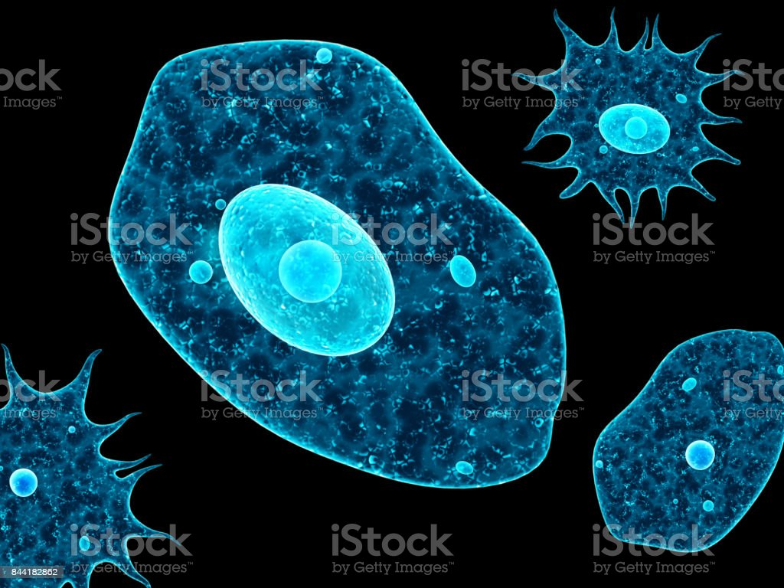
Amoebas
Unicellular organism
Can be found in any ecosystem
Bigger than bacteria
Have no specific form
Some amoebas live freely in damp places, others are parasites in humans or animals.
Amoebas that are parasites in humans cause diseases.
*Parasites means they live off other organisms.

Slide 12
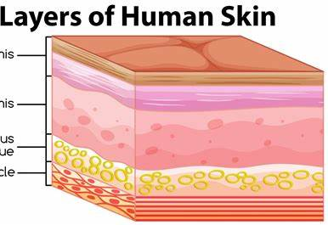
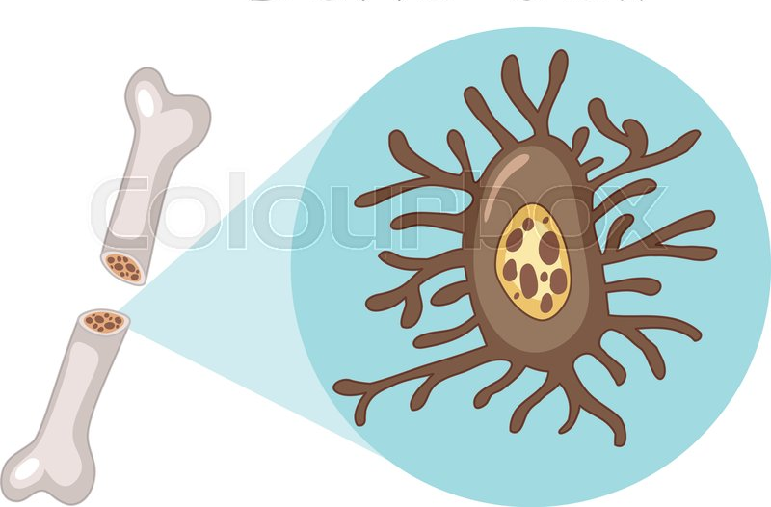
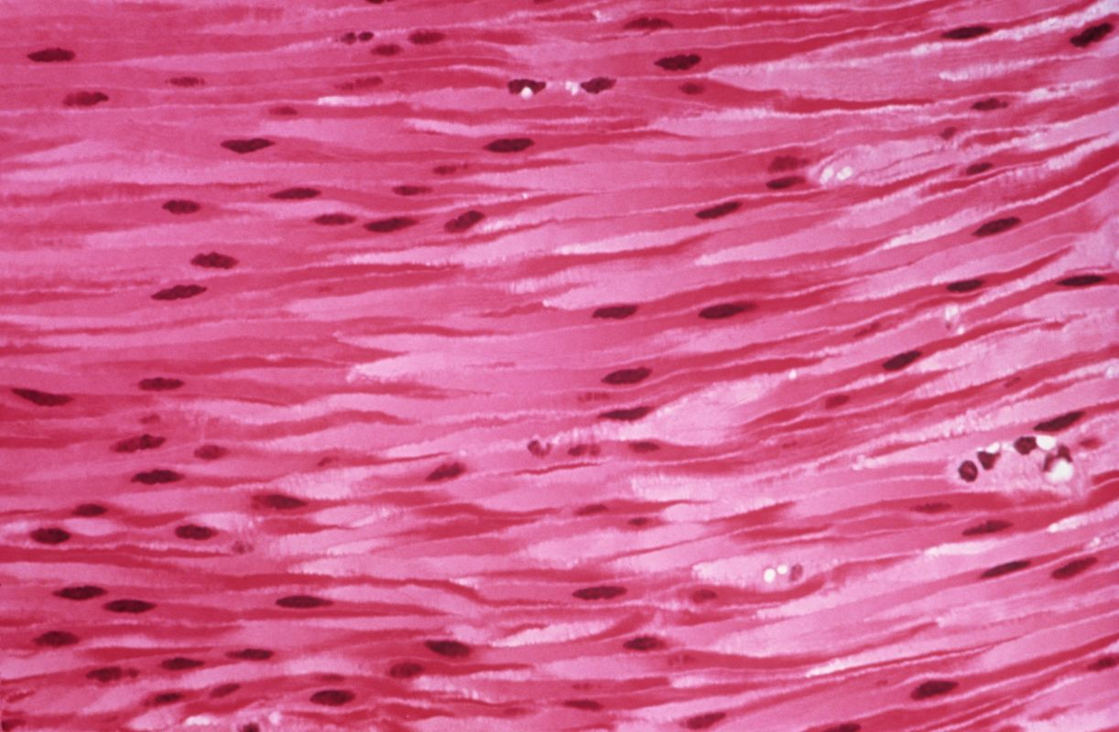
Specialized Cells:
Skin cells: Work together to cover and protect the
body.
Bone cells: work together to support the body.
Muscle cells: work together to move our body.

Slide 13
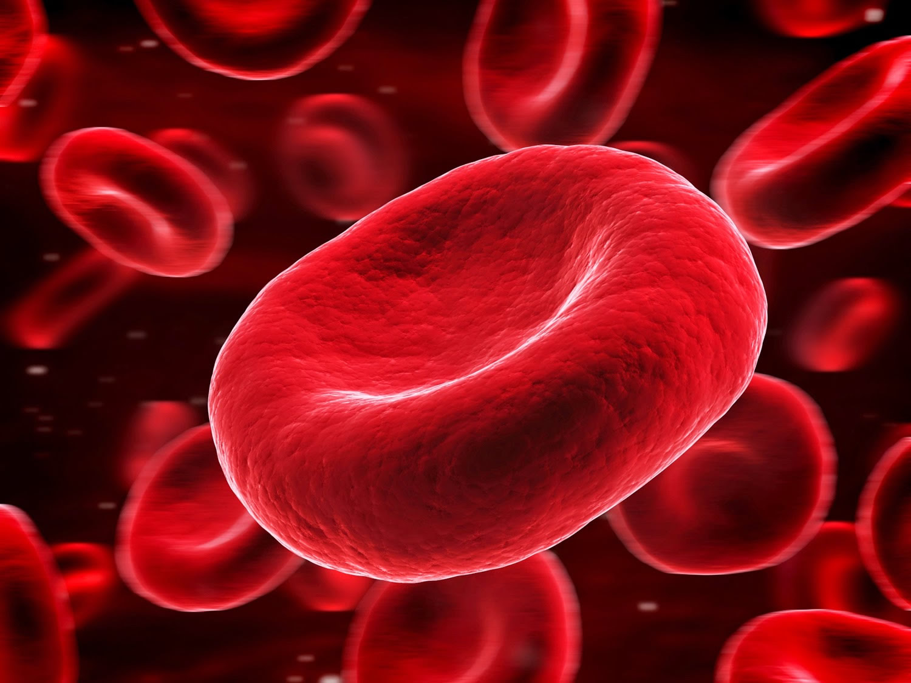
Blood components:
1- Red blood cells (RBCs)
Contains Hemoglobin which carries oxygen to all
Cells in the body.
Unlike most cells RBCs doesn’t have a nucleus
2- White blood cells (WBCs)
Destroys invading bacteria
When invading bacteria enter a body,
the number of WBCs increases

Slide 14
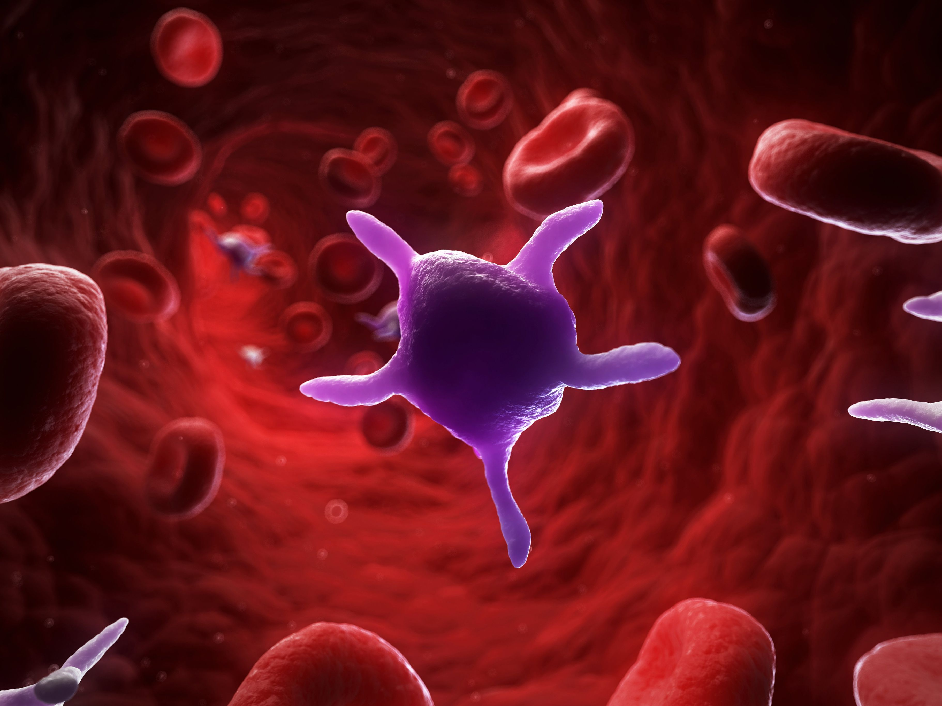
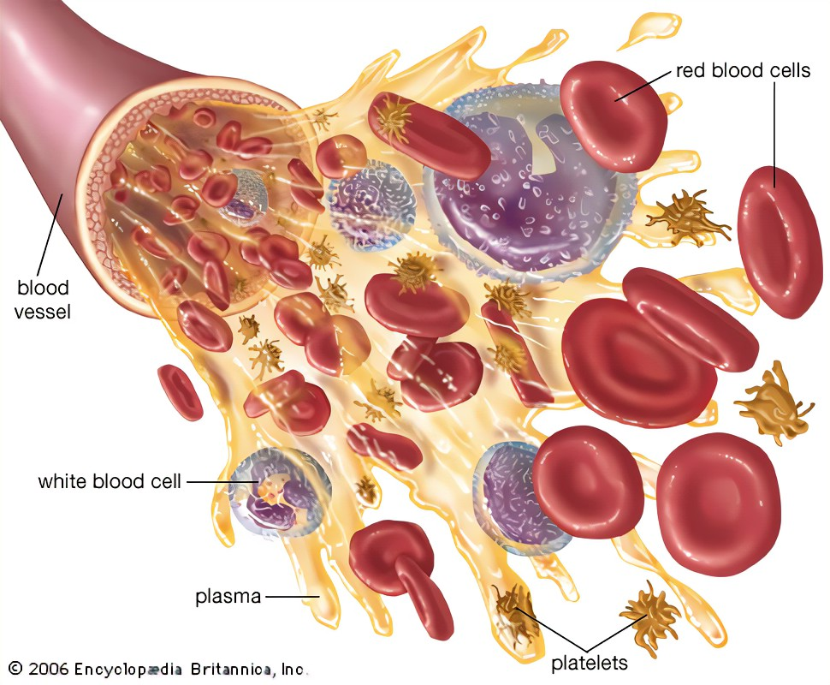
3- Platelets:
They stop bleeding.
4- Plasma:
Is a liquid component of the blood that carry all the other components.

Slide 15
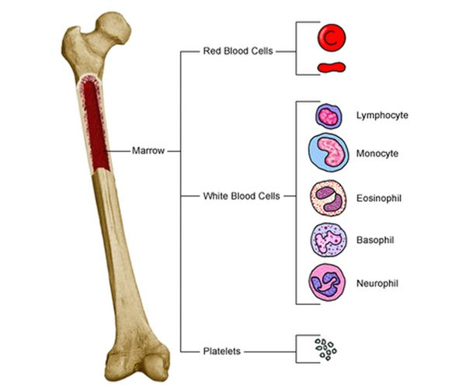
Red blood cells, white blood cells and platelets are made inside bones.(bone marrow)

Slide 16
Organs: are tissues grouped together.
Example: the heart is an organ, it contains muscle tissue, nerve tissue and blood tissue. These tissues work together to carry out its work which for the heart is pumping blood throughout the body.

Slide 17
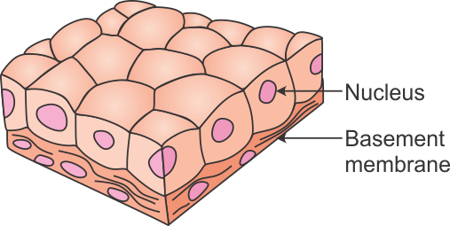
Cells that make up skin tissue have many functions:
1- protect the skin from the sun and cold.
2- they permit us to detect objects.
3- protect us from bacteria and infection.
4- regulate the body’s temperature. ( through sweating)

Slide 18
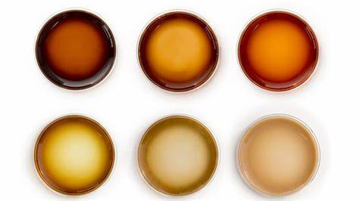
Melanin:
The color of the skin depends on the concentration of Melanin.
The more the melanin a person has in his/her skin cells, the darker the skin color.

