Slide 1
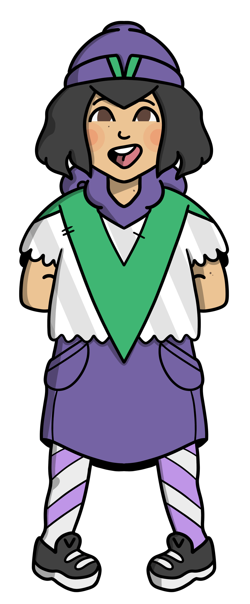

Slide 2
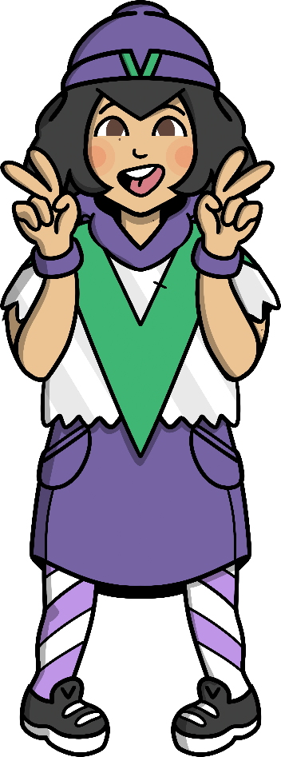
A verb is an action word.
Verbs with Veronica Verb
Do you know what a verb is?
Verbs are action words. They describe what someone or something is doing.
Hey, my name is Veronica Verb!
I love to move and I’m always busy doing different things.
pull
scream
leap
think
sing
spin
smile
bounce

Slide 3
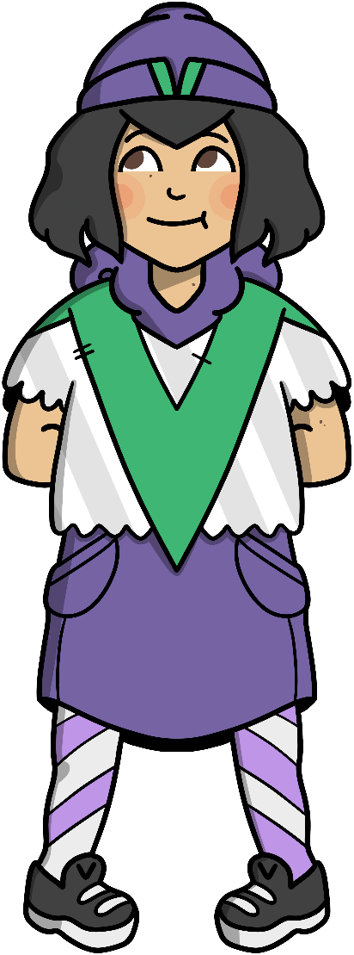
A verb is an action word.
Verbs with Veronica Verb
Find the verb in this sentence.
Spot the Verb
Veronica walks around York with her nan.
Veronica walks around York with her nan.

Slide 4
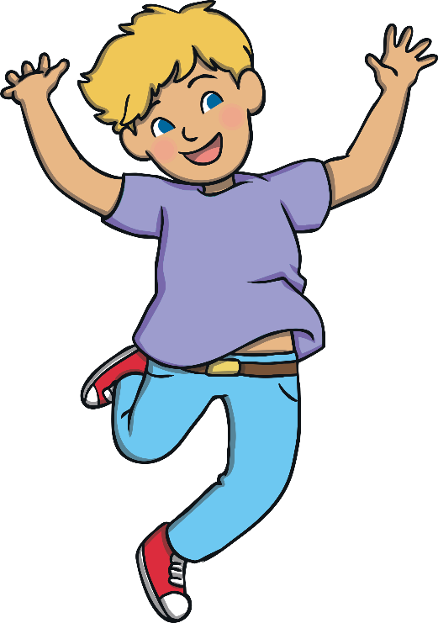
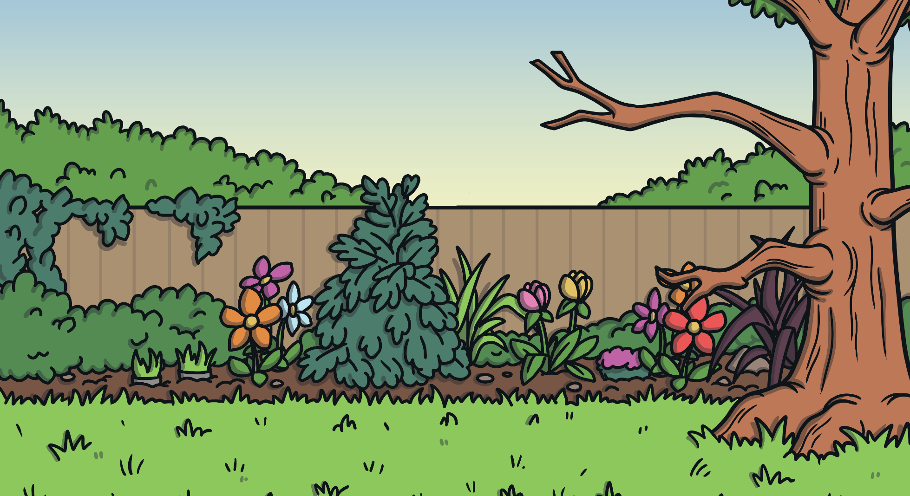
A verb is an action word.
Verbs with Veronica Verb
Find the verb in this sentence.
Spot the Verb
The boy can jump really high on the trampoline.
The boy can jump really high on the trampoline.

Slide 5
A verb is an action word.
Verbs with Veronica Verb
Find the verb in this sentence.
Spot the Verb
George clapped along to his favourite song.
George clapped along to his favourite song.

Slide 6
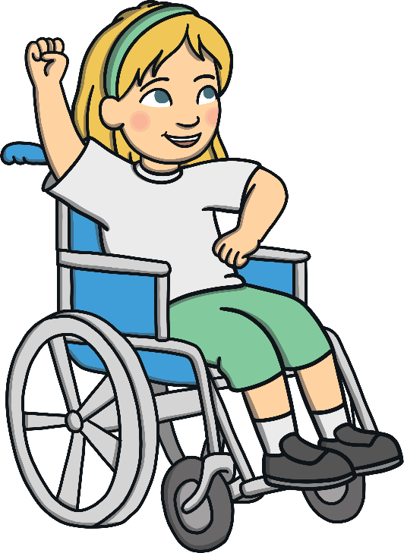
A verb is an action word.
Verbs with Veronica Verb
Try and find two verbs in this sentence.
Spot the Verb
We will sing and dance on the beach.
We will sing and dance on the beach.

Slide 7
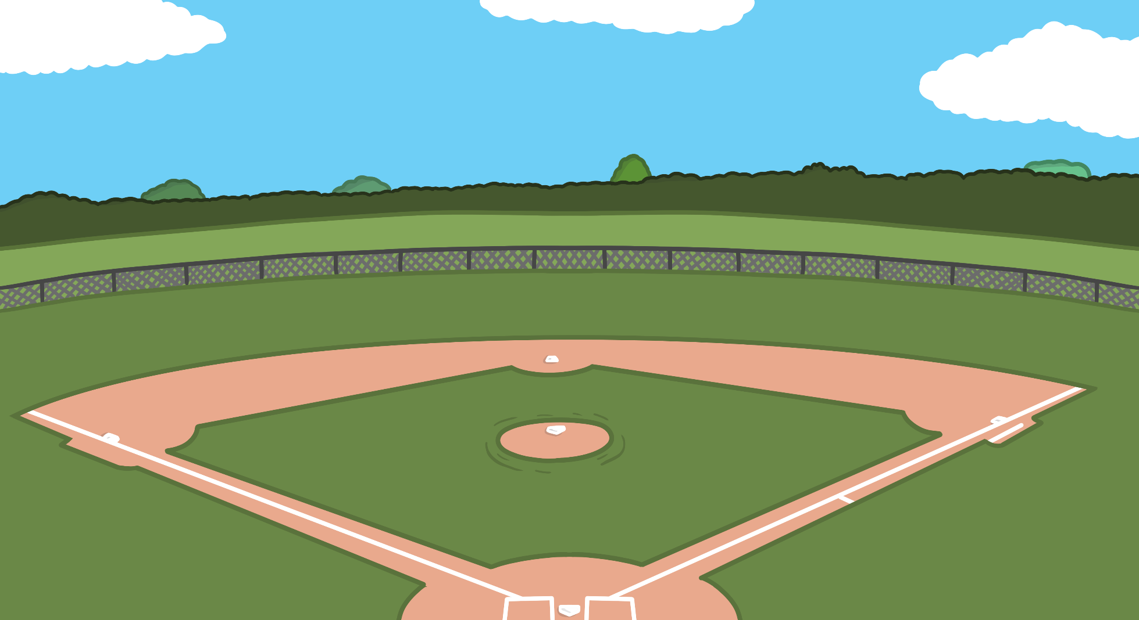
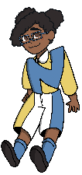
A verb is an action word.
Verbs with Veronica Verb
Try and find two verbs in this sentence.
Spot the Verb
Veronica and Adam asked Naomi if she could play catch.
Veronica and Adam asked Naomi if she could play catch.

Slide 8
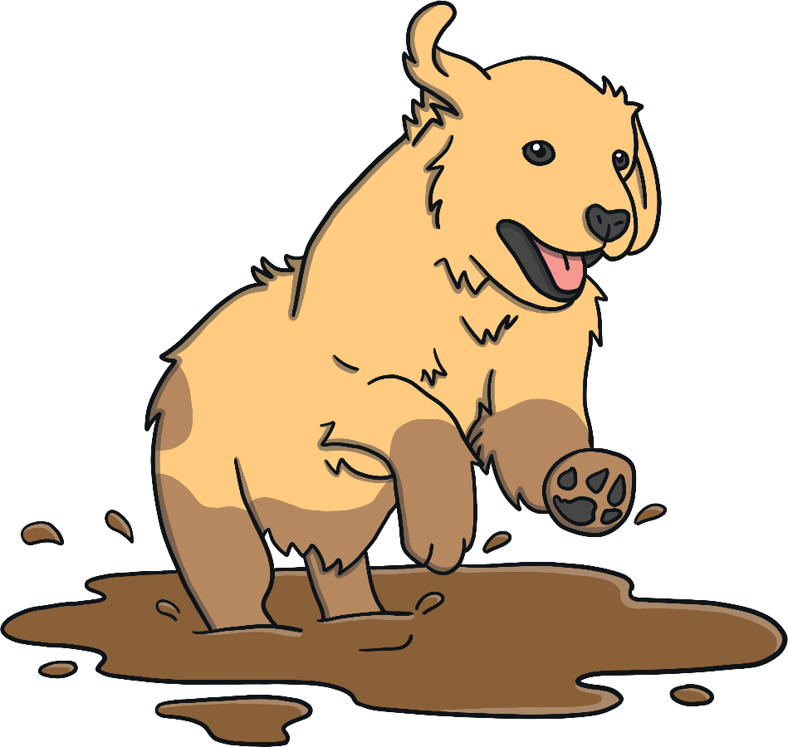
A verb is an action word.
Verbs with Veronica Verb
Try and find two verbs in this sentence.
Spot the Verb
I couldn’t stop laughing when my dog ran through the mud!
I couldn’t stop laughing when my dog ran through the mud!

Slide 9
Try it out!
Verbs with Veronica Verb
Add verbs to Veronica’s sentences to show what the characters are doing.
Tom a picture.
Neena learned to by herself.
She her bike back home.
Amjid his books in the library.
Finish

