Slide 1
Fractions and decimals
Chapter 6

Slide 2
Objectives
You will learn about multiplying and dividing by 0.1 and 0.01.
You will learn about rounding to given significant figures.
You will learn about recurring decimals.
You will learn about subtracting mixed numbers.
You will learn about dividing by a proper fraction.
You will learn about multiplying by a mixed number.
You will learn about simplifying calculations involving fractions.

Slide 3
Multiplying decimals
When dividing by
10, 100, 1000 you move
the decimal to the left
When multiplying by
10, 100, 1000 you move
the decimal to the right
Quick revision:
0.4 × 10 = _____
0.4 ÷ 100 =_____
3.56 × 100 =_____
3.56 ÷ 100=_____
18 $×\frac{1}{10}=$ _______
325 $×\frac{1}{100}=$ _______
Solve:
P.88 Ex. 6A Q1 (a,c,e, j, i), Q2 (b,c,d,e), Q4(c,d,e,f), Q5

Slide 4
Multiplying and dividing integers and decimals by 0.1 and 0.01
You should know that 0.1 as a fraction is ____
And 0.01 as a fraction is _____
So, try to solve the following questions:
2.4 × 0.1 =
2.4 × 1 = 2.4 = 2.4 ÷ 10 = 0.24
10 10
35.6 ÷ 0.01 =
35.6 ÷ 1 = 35.6 × 100 = 3560
100
Watch these videos to review multiplying and dividing fractions
Multiplying fractions: https://www.youtube.com/watch?v=qmfXyR7Z6Lk&t=20s
Dividing fractions: https://www.youtube.com/watch?v=4lkq3DgvmJo&t=2s
Solve:
P.89 Ex. 6B Q1(a,b), Q3, Q4, Q5, Q6, Q8, Q10(b)
P. 90 Ex. 6C Q1(a,b,c,e,L), Q2, Q3, Q5(a,b,e,f), Q6

Slide 5
Conclusion ☺
Multiplying by 0.1 is the same as multiplying by 1/10 or dividing by 10
Dividing by 0.1 is the same as dividing by 1/10 or multiplying by 10
Multiplying by 0.01 is the same as multiplying by 1/100 or dividing by 100
Dividing by 0.01 is the same as dividing by 1/100 or multiplying by 100

Slide 6
Significant Figures

Slide 7
Significant Figures…things to know!
All non zero digits are always significant. Examples:
23 has 2 s.f.
26.38 has 4 s.f.
7.94 has 3 s.f
Zeros between two non-zero digits are significant. Examples:
308 has 3 s.f.
7049 has 4 s.f.
Leading zeros are not significant. They’re nothing more than “place holders”. Examples:
0067 has 2 s.f.
0251 has 3 s.f
0.32 has 2 s.f
0.0071 has 2 s.f
Trailing zeros in a whole number are not significant.
Examples:
300 has 1 s.f.
25000 has 2 s.f.
A final zero or trailing zeros in the decimal portion only are significant.
Examples:
303.0 has 4 s.f.
2.00 has 3 s.f

Slide 8
67300
23.5
0.0329
67000
23
0.033
70000
20
0.03
Solve:
P.91 Ex. 6D Q1(a,b,e,f,h,i), Q2, Q3(a,d,e,g,h), Q4, Q5(a,c), Q6, Q8, Q10, Q12, Q14

Slide 9
Rounding appropriately
Solve:
P.93 Ex. 6E Q1(a,b), Q2(b), Q3, Q5(a,c)

Slide 10
Writing fractions and decimals
There are two kinds of decimals:
Terminating decimal Example: 0.45
Recurring decimal – they go on forever.
Example: 0.33333…..etc or
Fractions can be converted to decimals by using long division.
Example: ½ = 1 ÷ 2 = 0.5
¼ =1 ÷ 4 = 0.25
https://www.youtube.com/watch?v=Tceuvg9vjyc

Slide 11
Some fractions are easy to convert. If fractions are base 10 or can be changed to base 10 then the process is straightforward.
Example: 3 = 0.3
10
Example: 14 = 0.14
100
Example: 3 x125 = 375 = 0.375
8 x125 1000
Example: 4 x 5= 20= 0.20
20 x 5 100
Example: 88 ÷ 2= 44 = 0.44
200 ÷ 2 100
Example: 3 ³ ^{x5} = 3 ¹⁵ = 3.15
^{20 x5} ¹⁰⁰
Solve:
P.93 Ex. 6F: Q1 (a, e, f, i), Q2 (a, c), Q4, Q5 (a,b,f), Q6, Q8(a(i,iii), b(ii,iii)

Slide 12
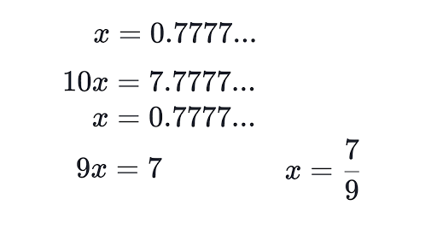
Converting recurring decimals to fractions
To learn how to convert a recurring decimal to a fraction, watch the video below:
https://www.youtube.com/watch?v=xX1sqV1nSAQ&t=10s
Example 1: convert 0. to a fraction
Example 2: convert 0. to a fraction
Subtract
Subtract

Slide 13
Example 3: convert 0. to a fraction
Subtract

Slide 14
Look at the pattern…….
0.0$\dot{6}$ = $\frac{6}{90}$ = $\frac{1}{15}$
0.0$\dot{7}$ = $\frac{7}{90}$
0.00$\dot{6}$ = $\frac{6}{900}$= $\frac{1}{150}$
0.0$\dot{1}\dot{3}$ = $\frac{13}{990}$
What do you notice????
Solve:
P. 95 Ex.6G: Q1, Q2(a,c,g,h), Q5(a,d,e)

Slide 15
Ordering fractions
There are two ways to order or compare fractions:
Convert fractions to decimals then write them in the order required.
Write all fractions with a common denominator, then write them in order by size of the numerator.
Example: Choose < , > or = to complete these:
a) $\frac{5}{40}$ $\frac{1}{8}$
b) $\frac{3}{7}$ $\frac{4}{9}$
c) $\frac{4}{15} 0.3$
Solve P. 96 Ex. 6H:
Q1 (b), Q2(b), Q4, Q5, Q7(b,c), Q9(c,e),Q10(b,c)

Slide 16
Subtracting and adding mixed numbers
To add or subtract mixed numbers, the easiest way is to do the following:
convert mixed numbers to improper fractions.
Make sure denominators are a common number, if not then change them so that they are all the same.
Add or subtract numerators.
If the final answer is an improper fraction, convert it to a mixed number.
Solve P. 97 Ex. 6I:
Q1 (b,f), Q2, Q3(b,f,g), Q4, Q6, Q8(b), Q9(a,d)

Slide 17
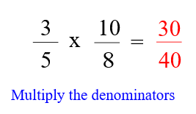
Multiplication of fractions
When you multiply two fractions, you multiply
numerator by numerator and denominator by
denominator.
Always, simplify your answer where possible
When you multiply a whole number by a
fraction, you can write the whole number with a
denominator of 1 before you multiply.
Multiplying fractions:
https://www.youtube.com/watch?v=qmfXyR7Z6Lk

Slide 18
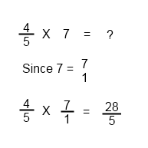
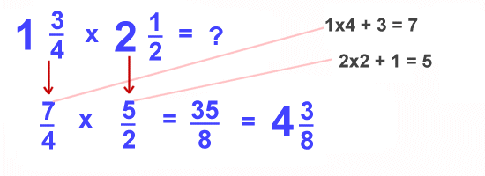
If your final answer is an improper fraction, convert it to a mixed number.
When a multiplication question involves mixed numbers, make sure you convert mixed numbers to fractions first, then proceed.
Solve P. 99 Ex. 6K:
Q1 (c,f,j), Q2(b,d,e,j,L), Q3, Q4, Q6, Q9(a), Q10, Q11
Multiplying mixed numbers:
https://www.youtube.com/watch?v=DSIO0no1c4A

Slide 19
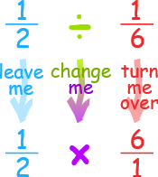
division of fractions:
Just like multiplication, if the question includes mixed number, convert them to improper fractions first then proceed.
Keep
Flip
Solve P. 101 Ex. 6M:
Q1 (b), Q2(e,f,h,j), Q3, Q4, Q6, Q9(c,d,f,g,i), Q10
Division of fractions:
https://www.youtube.com/watch?v=4lkq3DgvmJo&t=146s

