Slide 1
The Flight Of Daedalus And Icarus

Slide 2
Icarus was the young son of Daedalus and Nafsicrate, one of King Minos’ servants. Daedalus was way too smart and inventive, thus, he started thinking how he and Icarus would escape the Labyrinth. Knowing that his architectural creation was too complicated, he figured out that they could not come out on foot. He also knew that the shores of Crete were perfectly guarded, thus, they would not be able to escape by sea either. The only way left was the air.
Daedalus managed to create gigantic wings, using branches of osier and connected them with wax. He taught Icarus how to fly, but told him to keep away from the sun because the heat would make the wax melt, destroying the wings.
Daedalus and Icarus managed to escape the Labyrinth and flew to the sky, free. The flight of Daedalus and Icarus was the first time that man managed to fight the laws of nature and beat gravity.

Slide 3
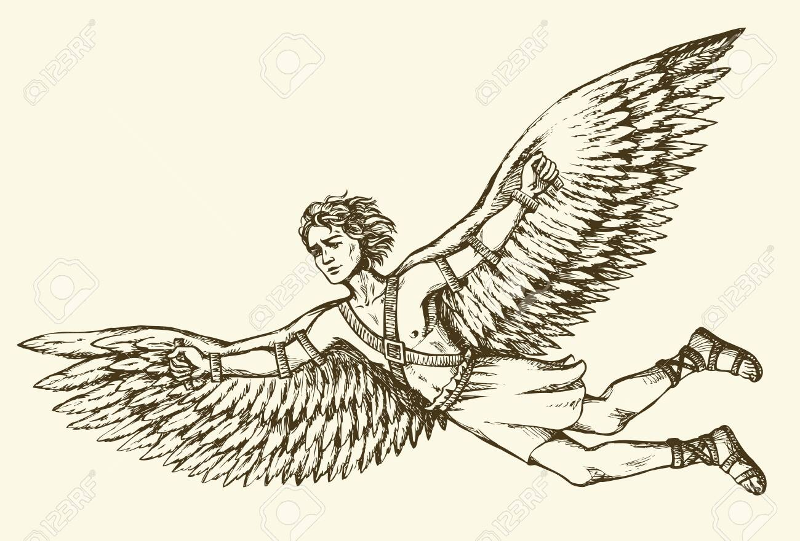
Icarus Death
Although he was warned, Icarus was too young and too enthusiastic about flying. He got excited by the thrill of flying and carried away by the amazing feeling of freedom and started flying high to salute the sun, diving low to the sea, and then up high again.
His father Daedalus was trying in vain to make young Icarus to understand that his behavior was dangerous, and Icarus soon saw his wings melting.

Slide 4
Theme One of the themes is that younger people should heed the warnings of their elders. In the story, Icarus ignores the warnings of his father as soon as he begins to take flight which ultimately leads to Icarus' death as he flies too high and the wax melts from the heat of the sun.

Slide 5
What is the setting of the story of Icarus and Daedalus? Crete is the biggest island in Greece.

Slide 6
What is the conflict of the story Daedalus and Icarus? The conflict of the story is that Icarus didn't listen to his father that is why it is man vs. man. Icarus wanted to escape he thought that birds were not careful when they fly so he thought that he didn't need to be careful.

