Slide 1
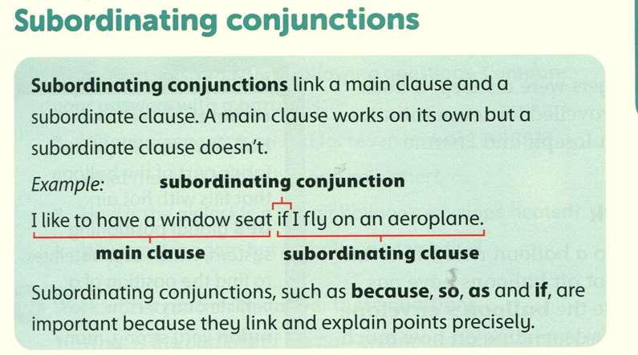
Page 31

Slide 2
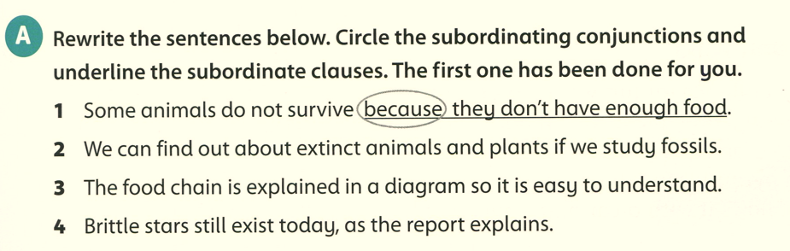

Slide 3
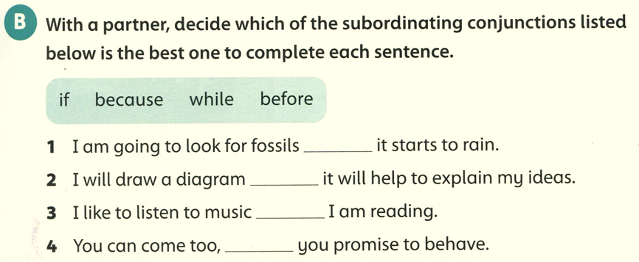
before
because
while
if

Slide 4
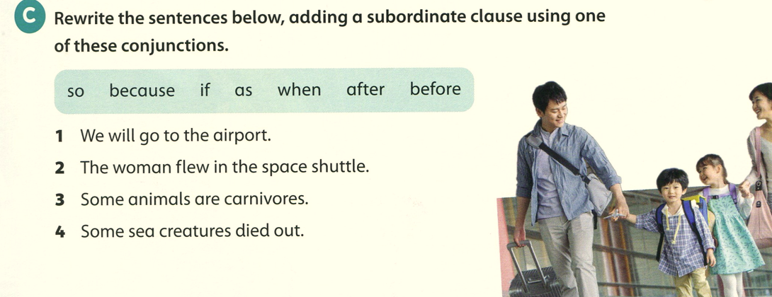
1- we will go to the airport when we need to catch our plane.
2- The woman flew in the space shuttle after training to be an astronaut.
3- some animals are carnivores because they eat meat.
4- Some sea creatures died out so became extinct.

