Slide 1
Using but correctly
Page 14

Slide 2
What is a simple sentence?

Slide 3
A simple sentence consists of just one clause. (Express a complete thought)
Example:
The wind blew strongly.
Subject predicate (include the verb “blew”)

Slide 4
What is a compound sentence?

Slide 5
A compound sentence is made up of two clauses of equal weight (two complete thoughts.) connected to one another with a conjunction – and, or, but, so - These are both known as main clause or independent clause.
Example:
The wind blew strongly, so the boat moved quickly
Mom likes to hike, but dad likes to fish.

Slide 6
Use a comma before “but” when you join two sentences to form a compound sentence.

Slide 7
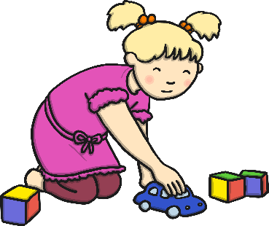




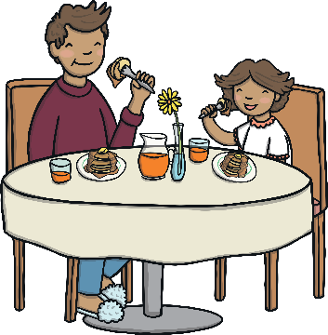
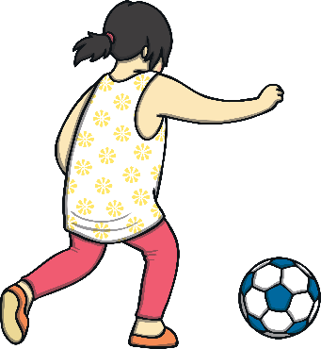
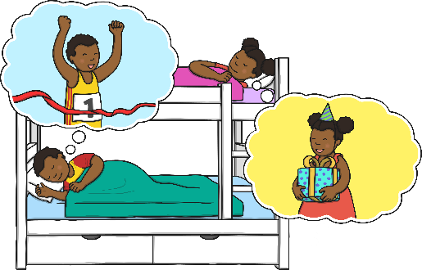

Can you look at these pictures of people doing two things at once and write a sentence using the conjunction ‘and’?
Kaia is playing with the car and she is playing with the blocks.
Leon is reading and he is listening to music.
Stella is playing tennis and she is eating a burger.
Leon is...
Stella is...
Jayden is sleeping and he is dreaming about winning the race.
Chloe is eating pancakes and she is talking.
Magda is playing football and she is eating an apple.
Jayden is...
Chloe is...
Magda is...
Can you write a sentence about two things you can do at once using ‘and’?

Slide 8

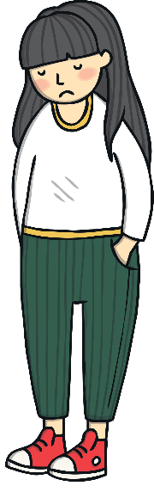


These children have all come up with excuses about why they haven’t done things. Can you help them to complete their excuses using the conjunction ‘but’? Try to make your excuses as silly as you can!
I was being careful with my new toy...
e.g. I was going to do my homework, but then my dog ate my activity sheet!
I was being careful with my new toy, but then a superhero had to borrow it to help fight crime.
I was going to tidy my room, but I was kidnapped by space aliens before I could do it!
I was going to tidy my room...
I would have eaten all my vegetables...
I would have eaten all my vegetables, but a fairy cast a magic spell on me that meant I couldn't!
I tried to keep my new clothes clean...
I tried to keep my new clothes clean, but a mud monster pulled me into a bog!
Can you write your own silly excuse sentence using the conjunction ‘but’?

Slide 9





Can you choose the correct conjunction to complete the sentence as the conjunction shooting stars fly through space?
but
Correct!
He went to the post office ___ sent his parcel.
and
and

Slide 10
Can you choose the correct conjunction to complete the sentence as the conjunction shooting stars fly through space?
but
Correct!
I was going to come to your party ___ I had the flu.
and
but

Slide 11
Can you choose the correct conjunction to complete the sentence as the conjunction shooting stars fly through space?
but
Correct!
She likes rock climbing ___ she likes cooking.
and
and

Slide 12
Can you choose the correct conjunction to complete the sentence as the conjunction shooting stars fly through space?
but
Correct!
We could join the queue ___ we will have to wait a long time.
and
but

Slide 13
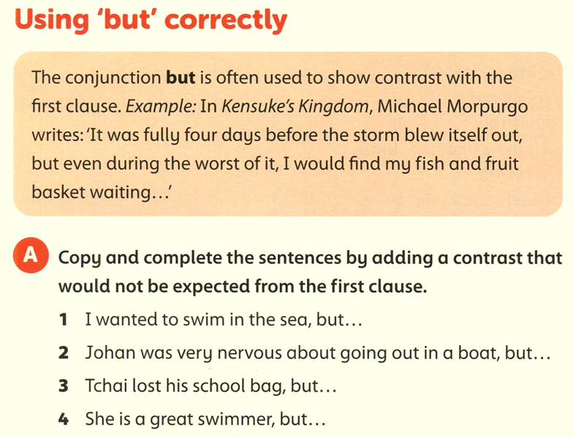
I was afraid of sharks.
he enjoyed it.
he didn’t lose his pencil case.
she didn’t win the champions.

Slide 14
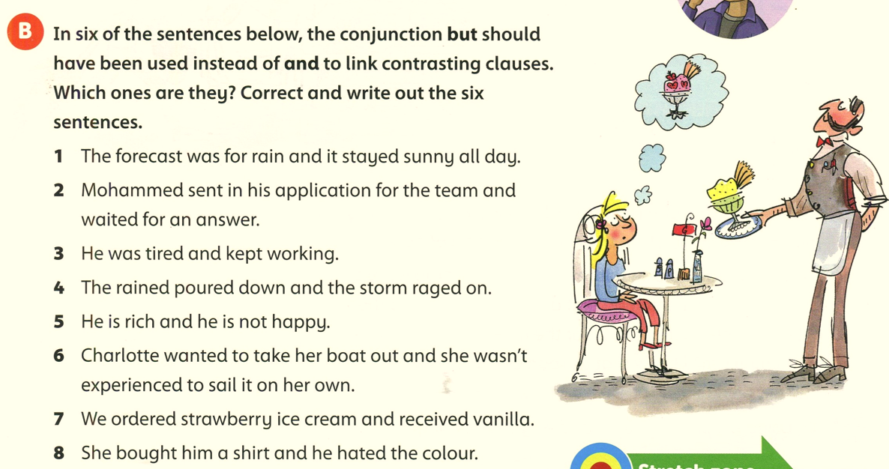
,but
,but
,but
,but
,but
,but

Slide 15
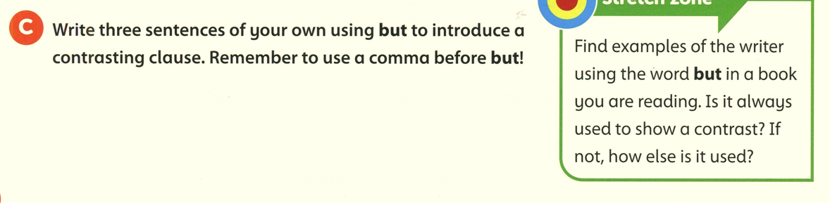
He is not very fast, but he always finishes.
He was injured, but he didn’t give up.
I am old, but you are young.

Slide 16
Open your workbook page 6

Slide 17
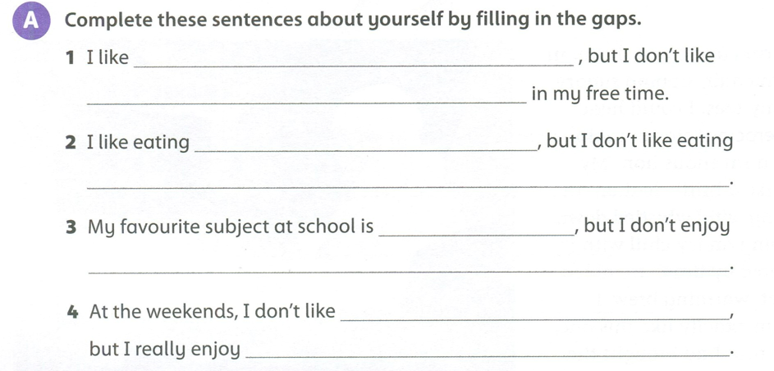

Slide 18
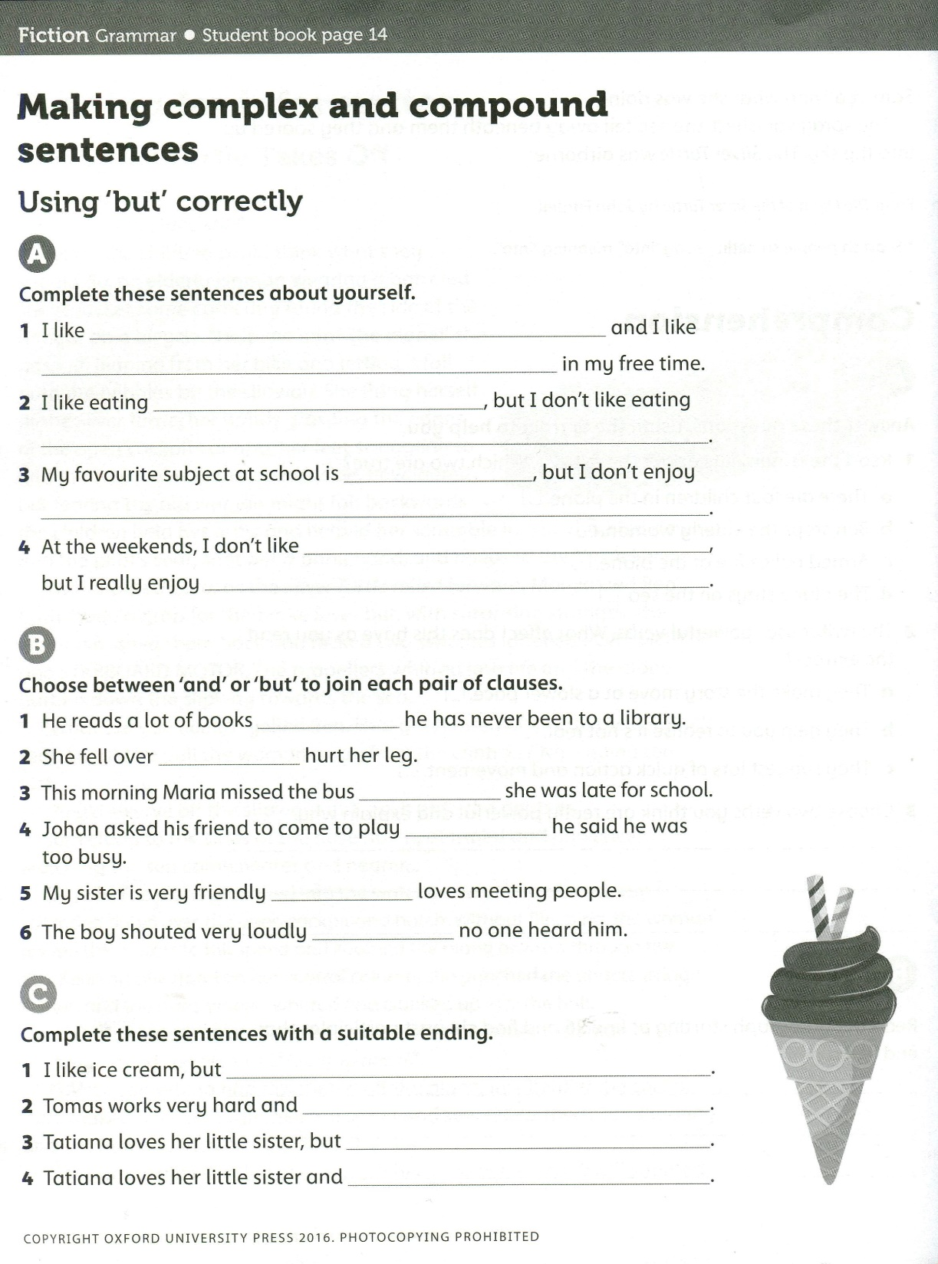
,but
and
and
,but
and
,but

Slide 19
I don’t like chocolate.
he always succeeds.
she gets cross with her sometimes
never gets cross.

