Slide 1
Nouns
First grade

Slide 2
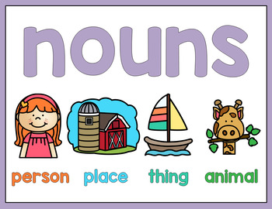

Slide 3
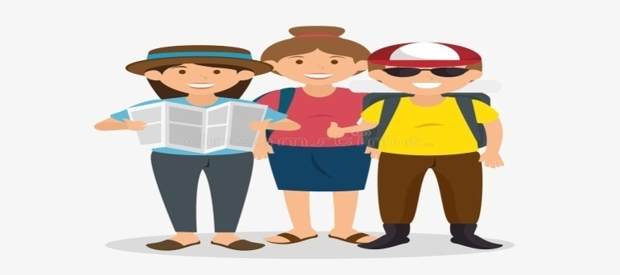
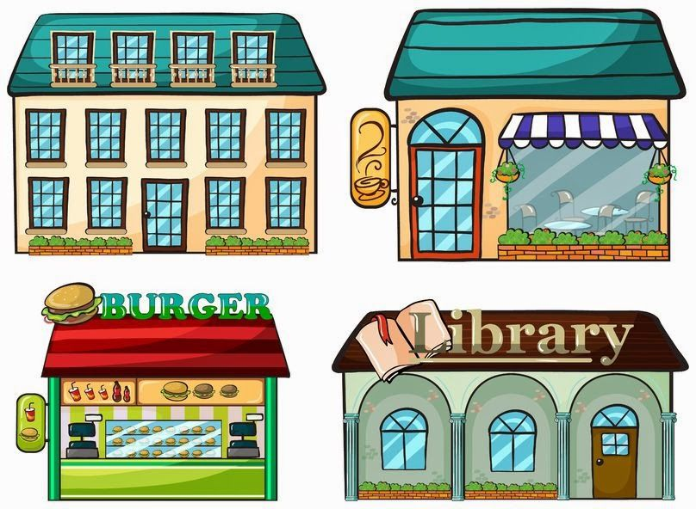

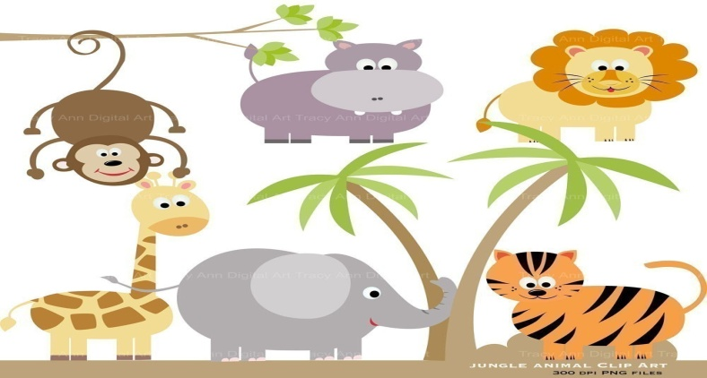
Nouns are
Names of people Names of places
Names of things Names of animals

Slide 4
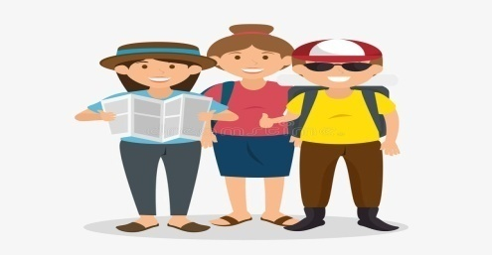
Nouns for people
sister
mother
doctor
Sami
teacher

Slide 5
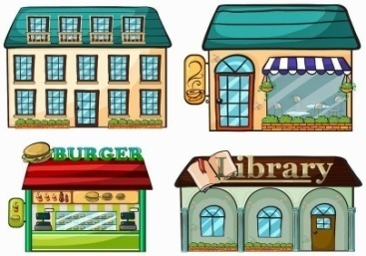
Nouns for places
school
house
zoo
garden

Slide 6
Nouns for things
ball
pen
book
chair

Slide 7
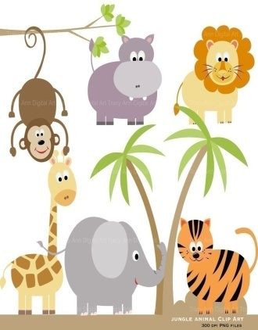
Nouns for animals
cat
frog
tortoise
dog

Slide 8

House is a name of
Place?
People?

Slide 9
Which noun is a name of an animal?
mat
hat
cat

Slide 10
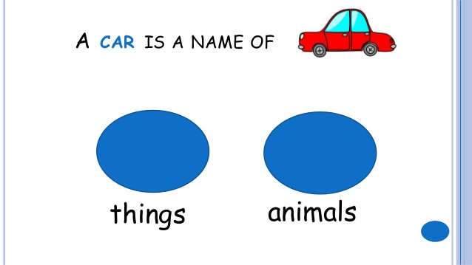

Slide 11
